Slide 1
Principles of Robot Autonomy I
Course overview, intro to robotic systems and ROS

Slide 2
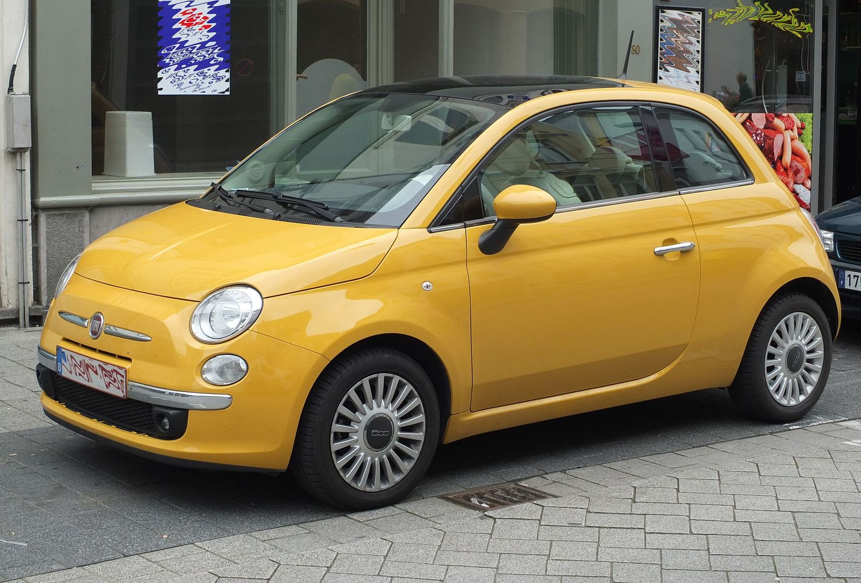
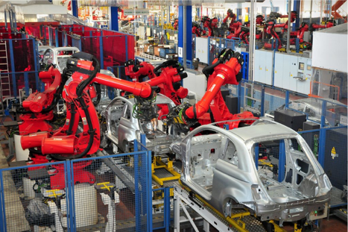
From automation…

Slide 3
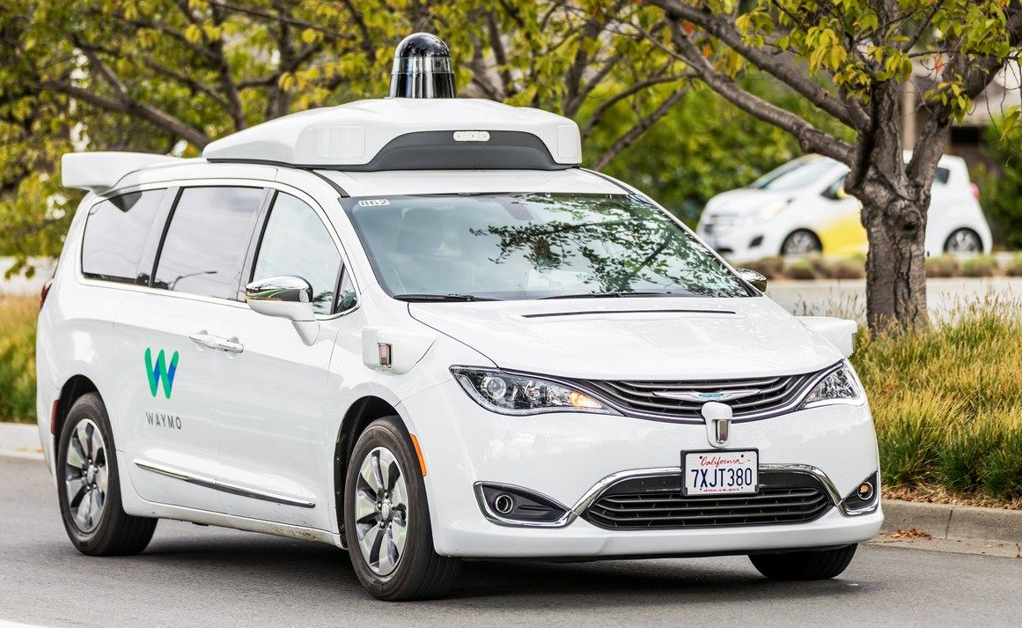
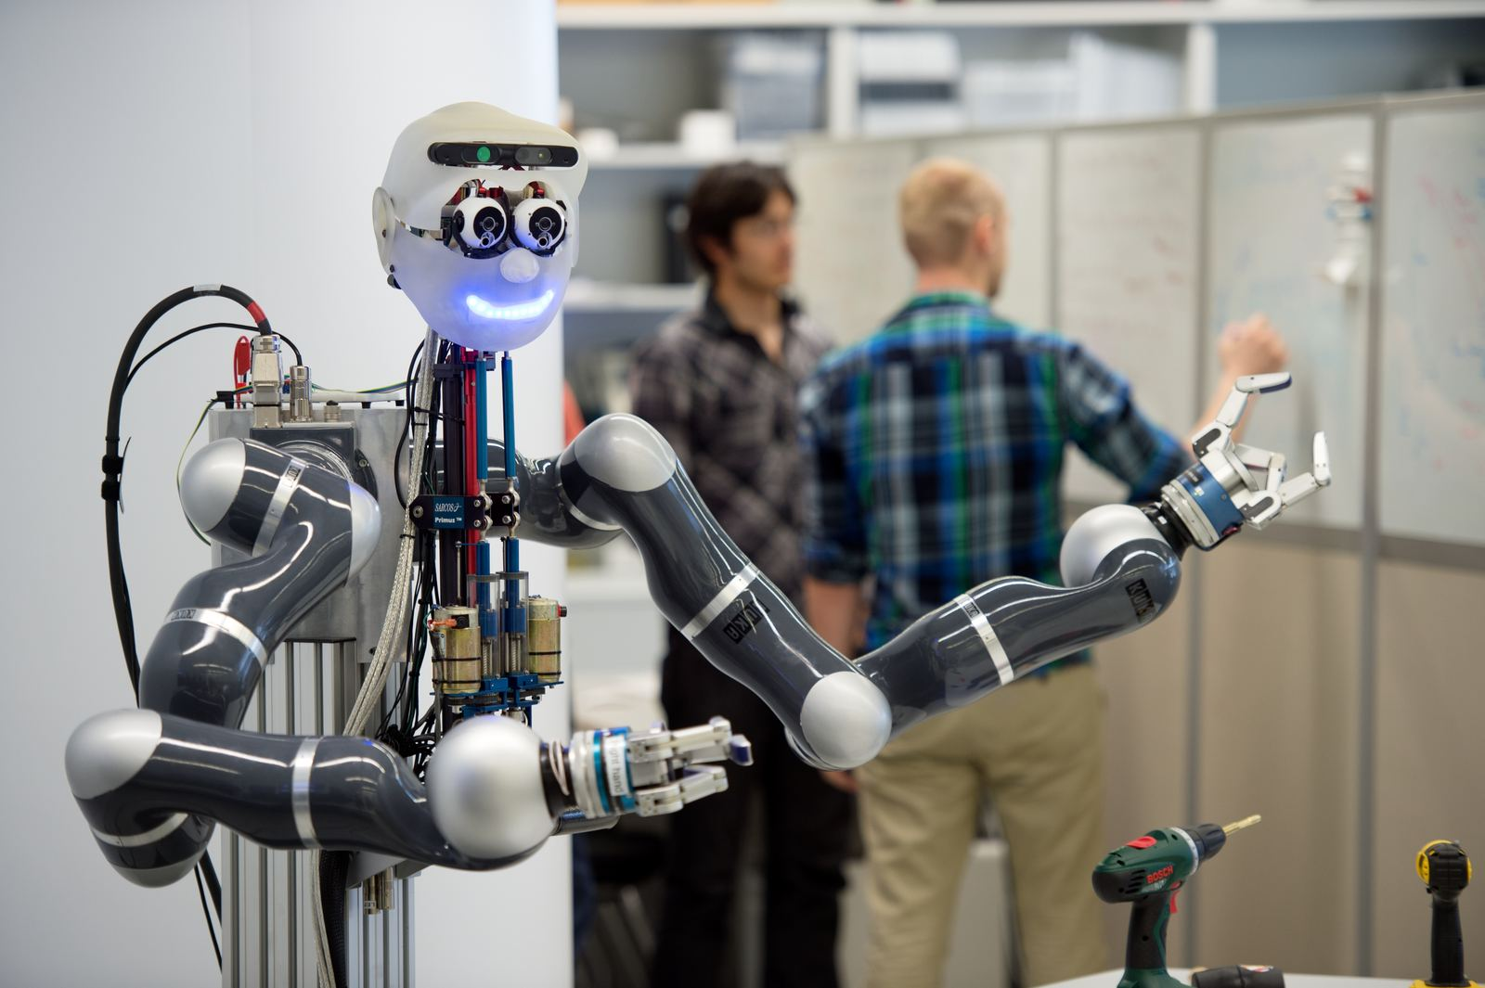
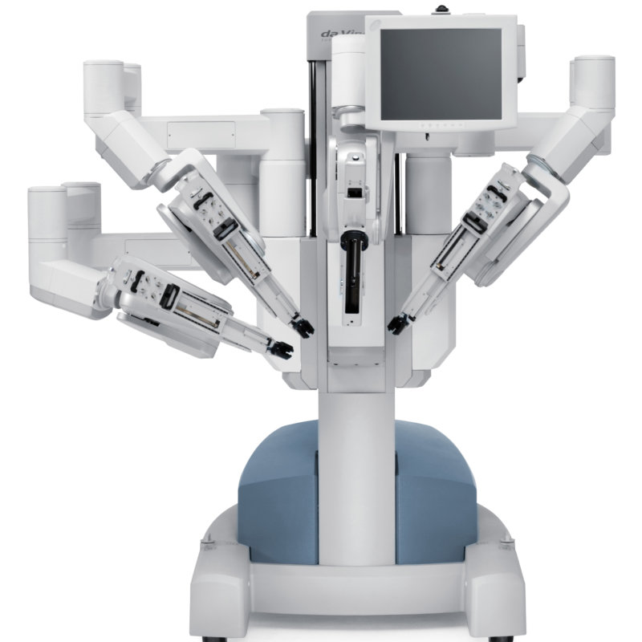
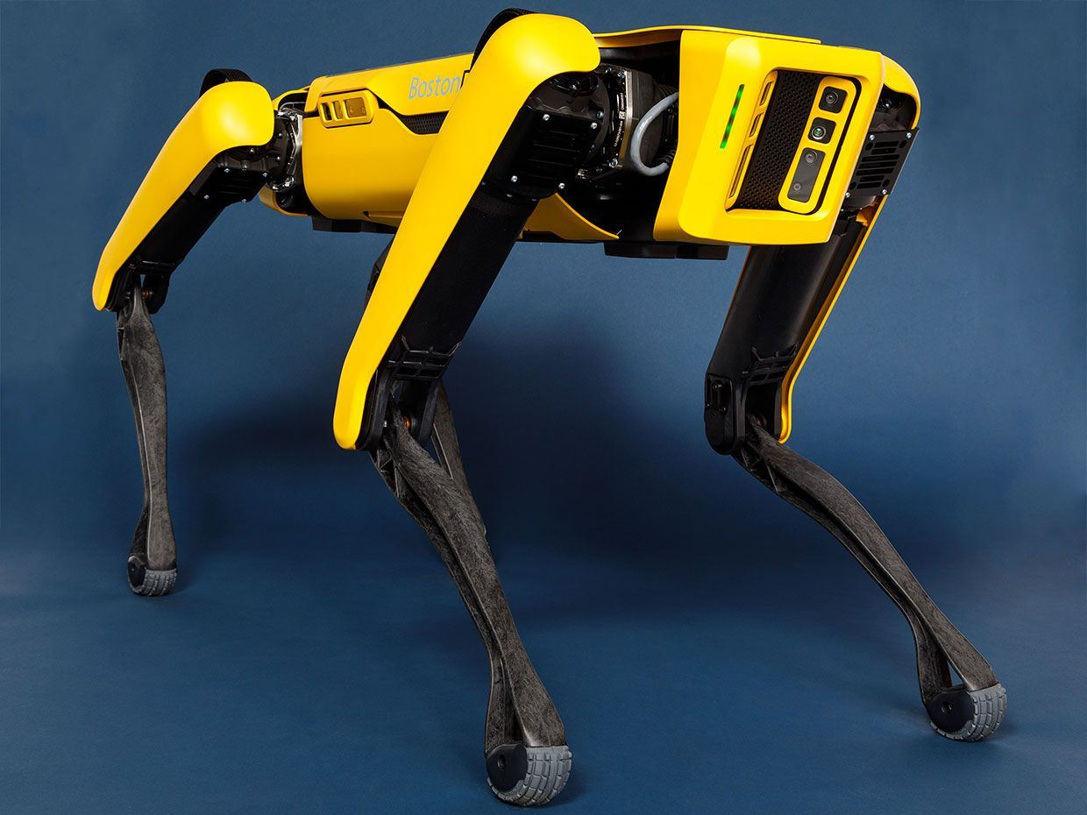
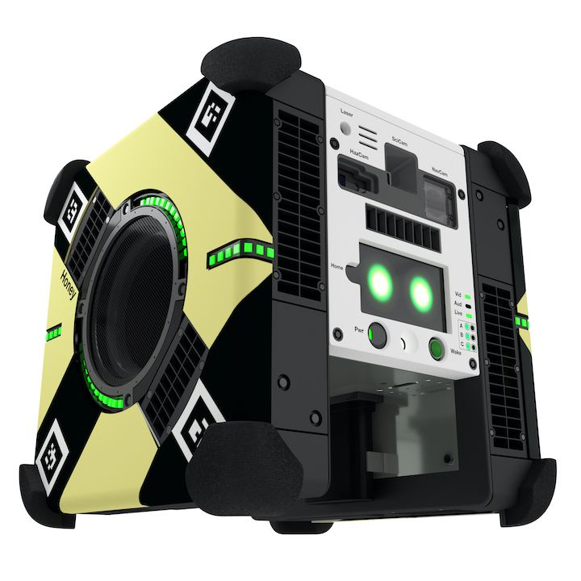
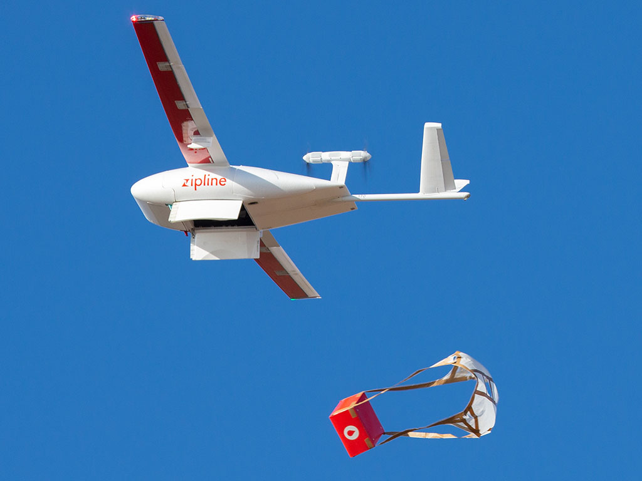
…to autonomy
Waymo Self-Driving Car
Intuitive DaVinci Surgical Robot
Apollo Robot at MPI
Astrobee - NASA
Boston Dynamics – Spot Mini
Zipline

Slide 4
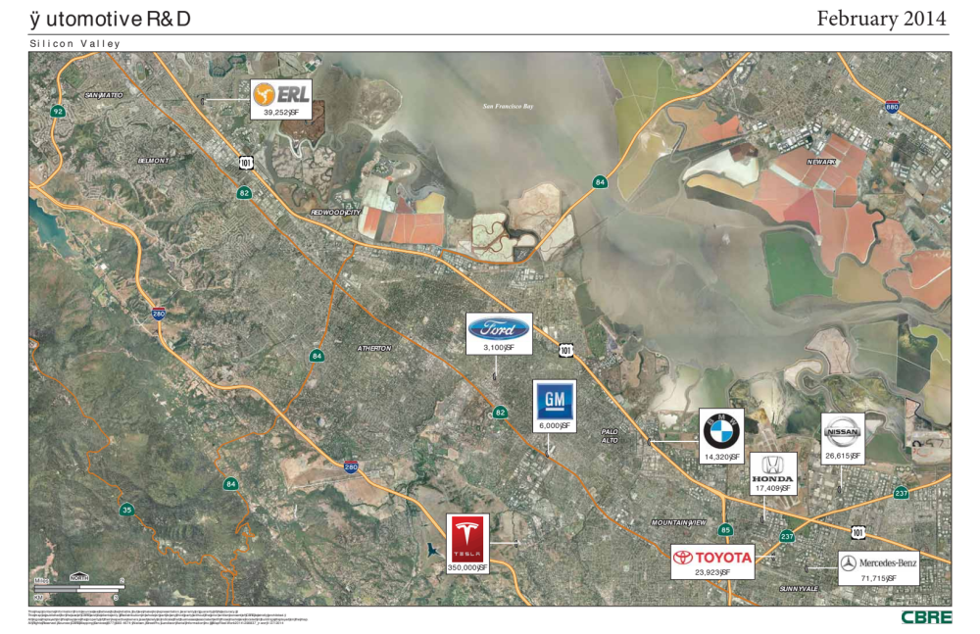

Slide 5
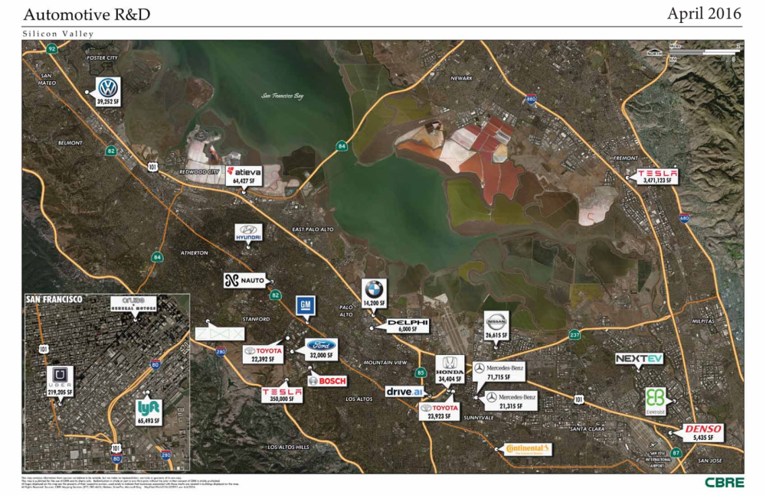

Slide 6
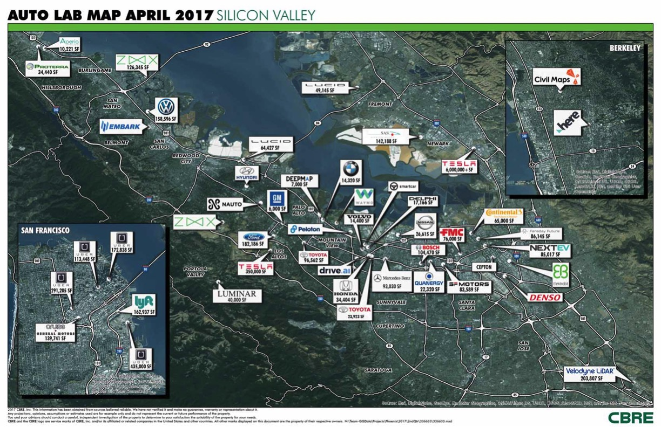

Slide 7
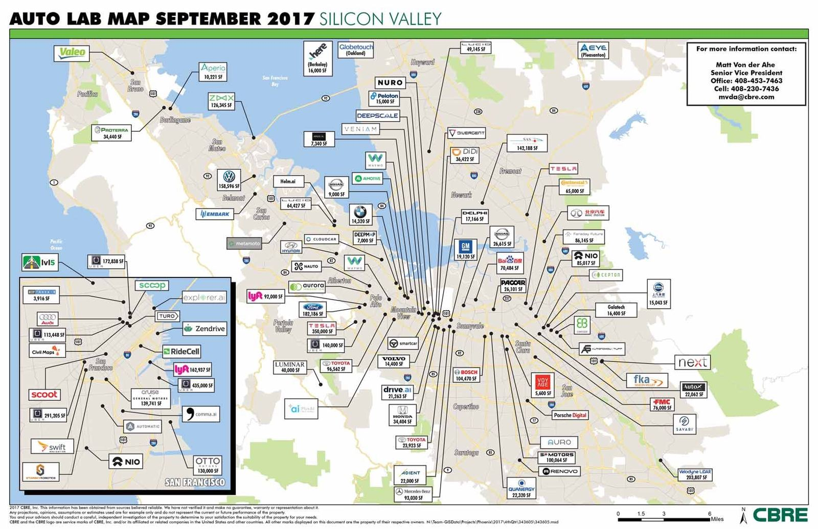

Slide 8
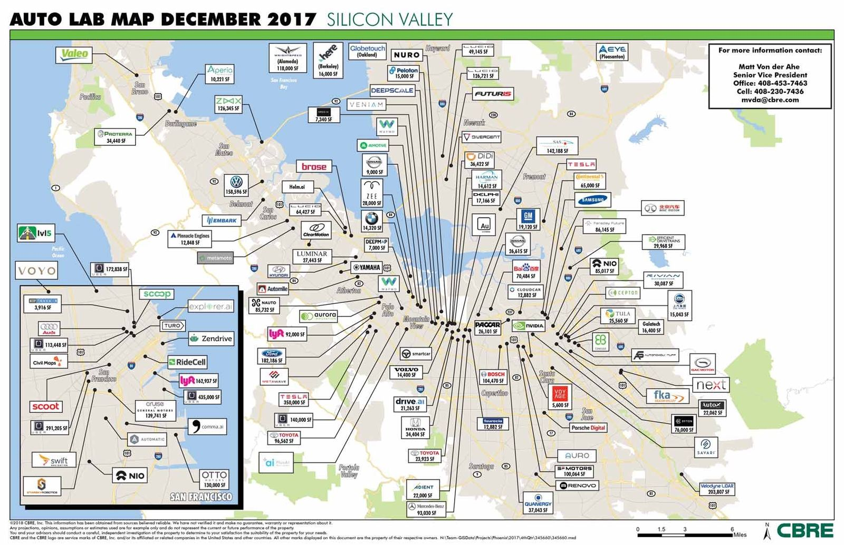

Slide 9
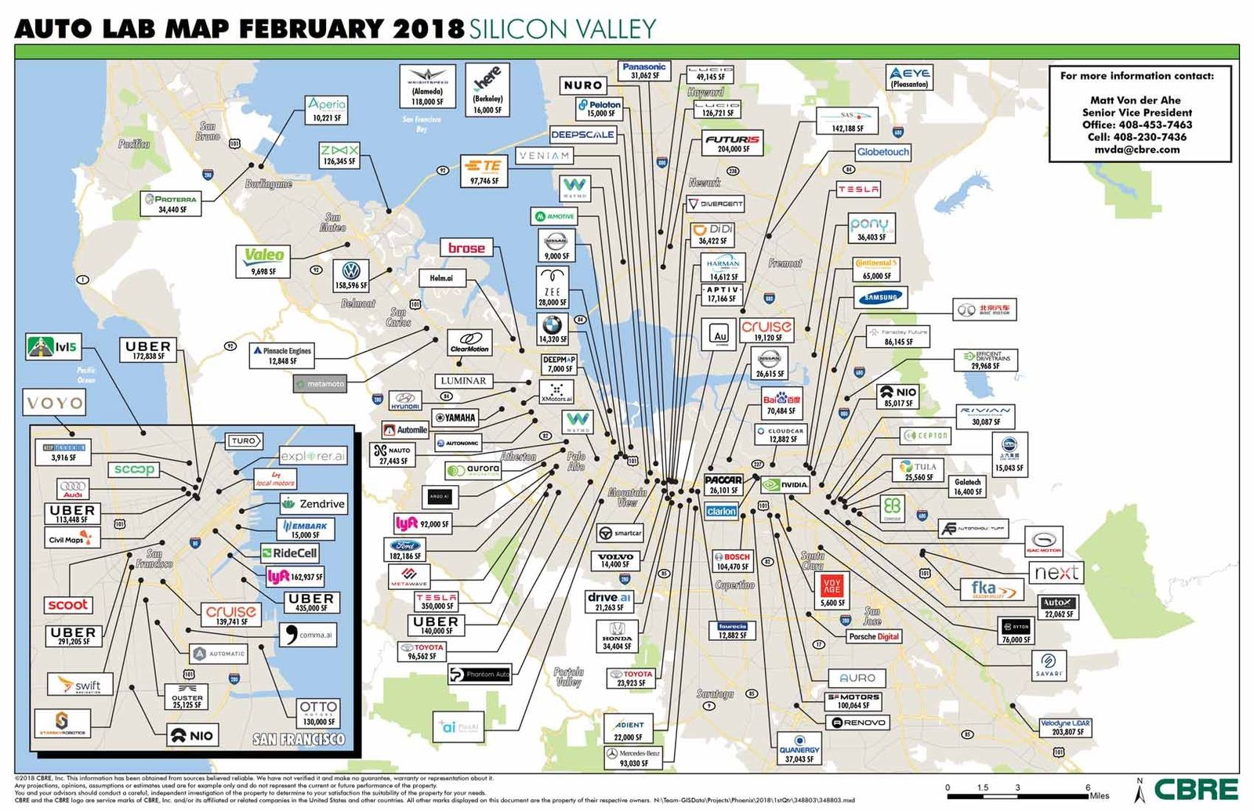

Slide 10
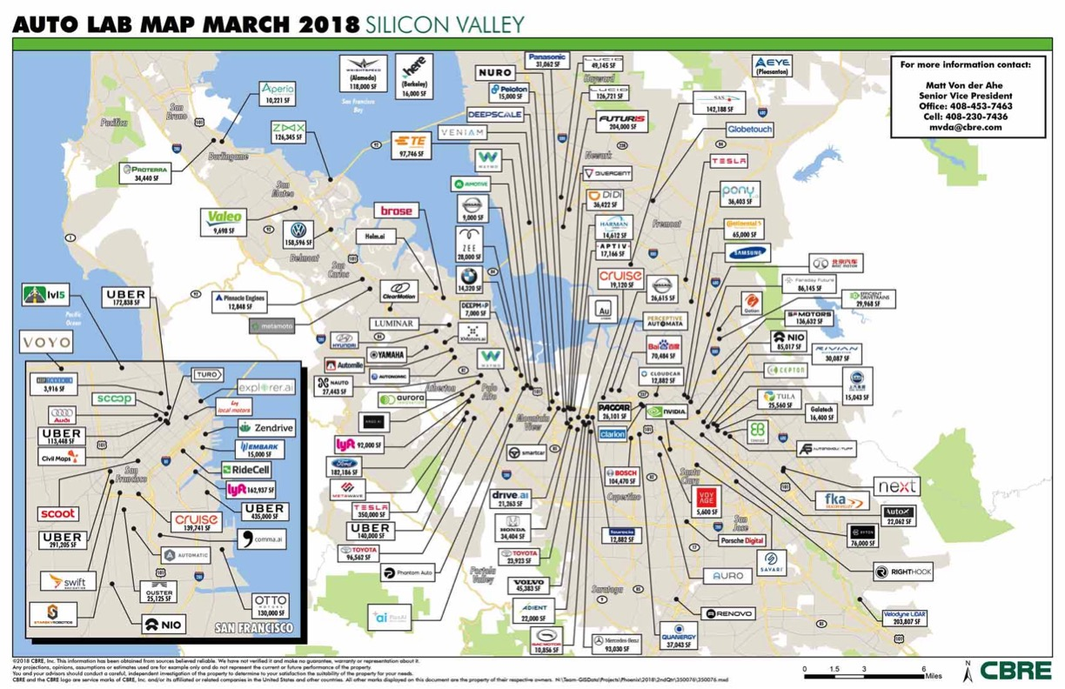

Slide 11
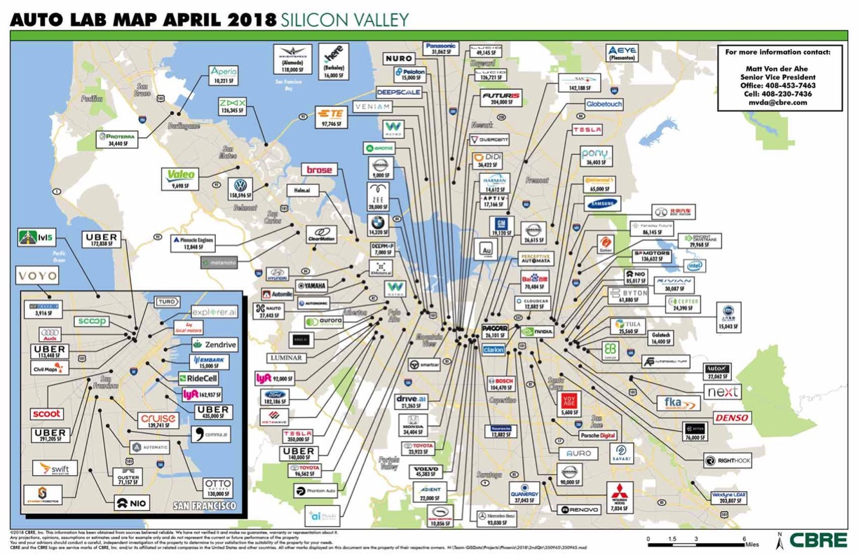

Slide 12
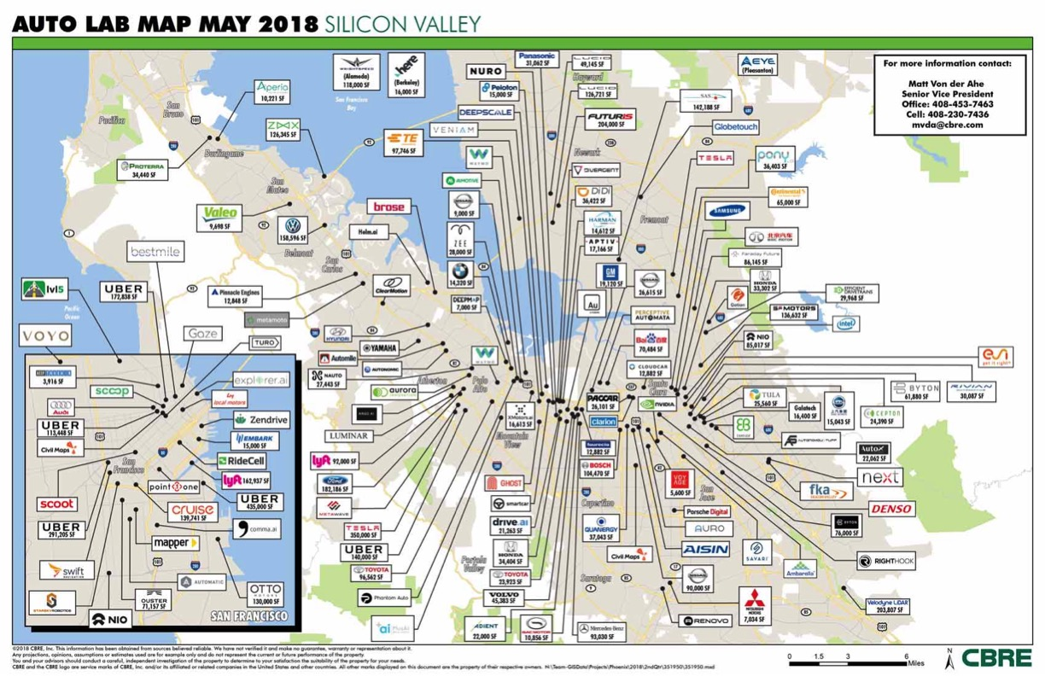

Slide 13
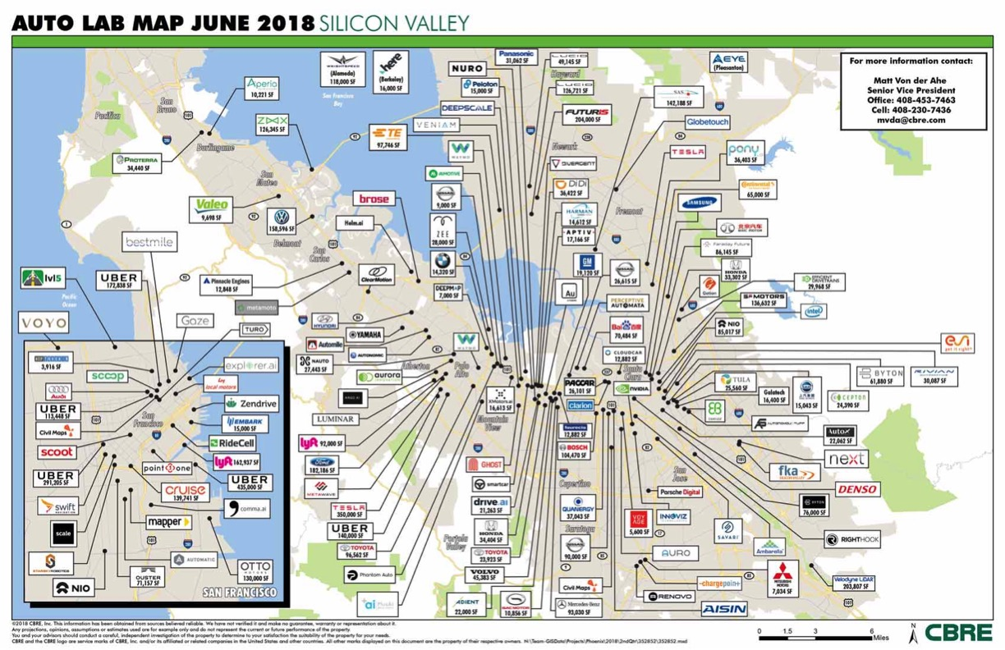

Slide 14
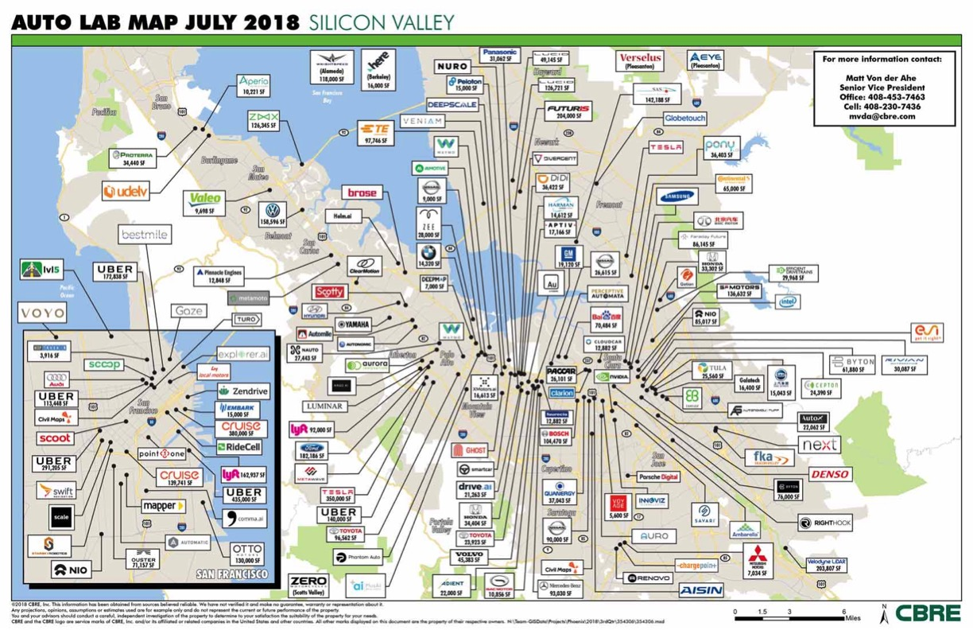

Slide 15
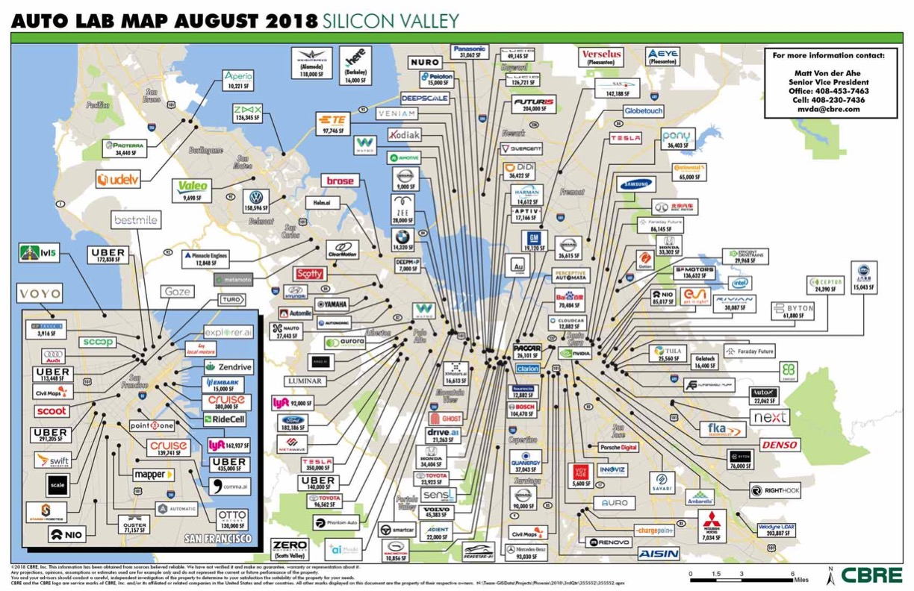

Slide 16
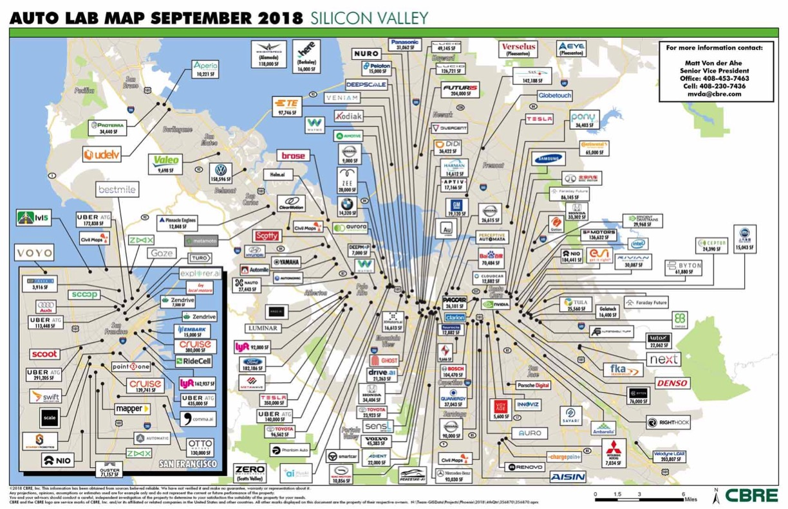

Slide 17
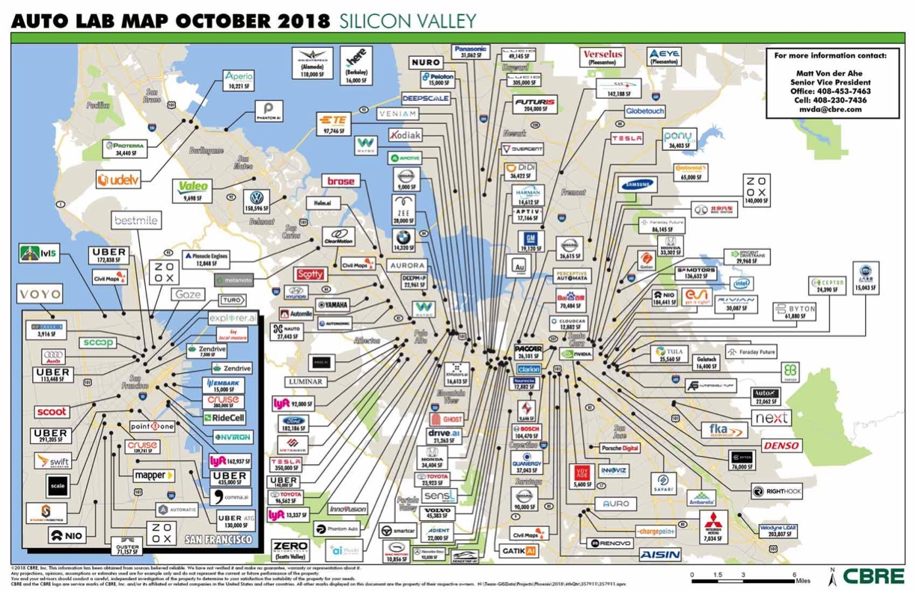

Slide 18
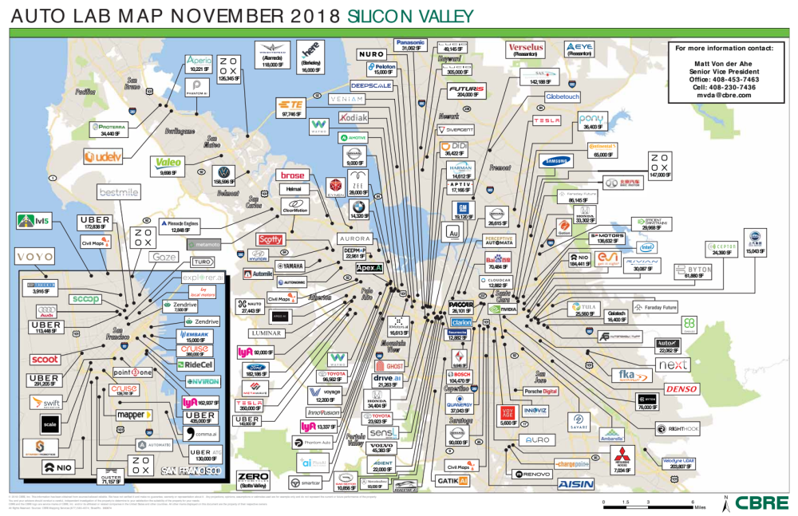

Slide 19
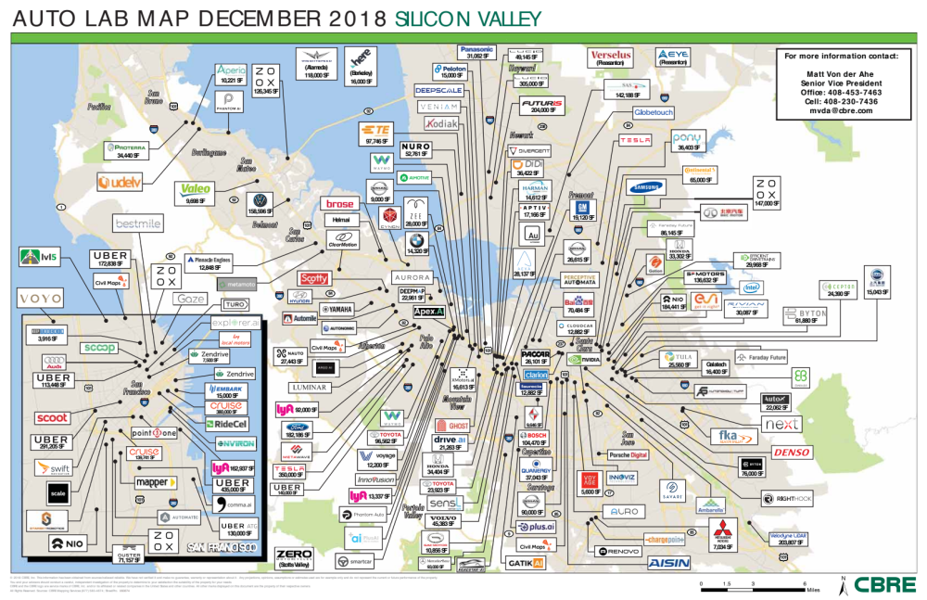

Slide 20
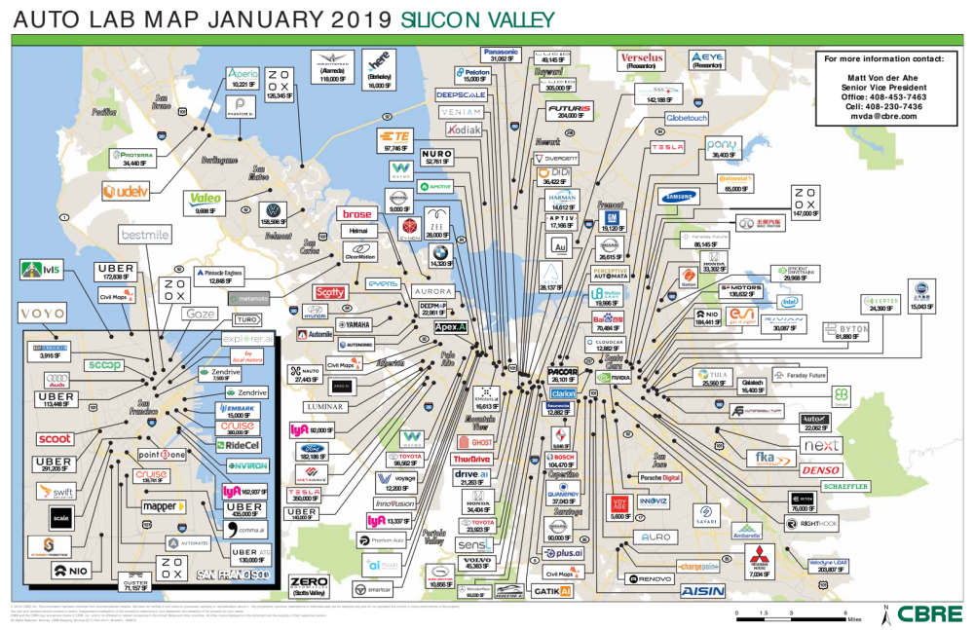

Slide 21
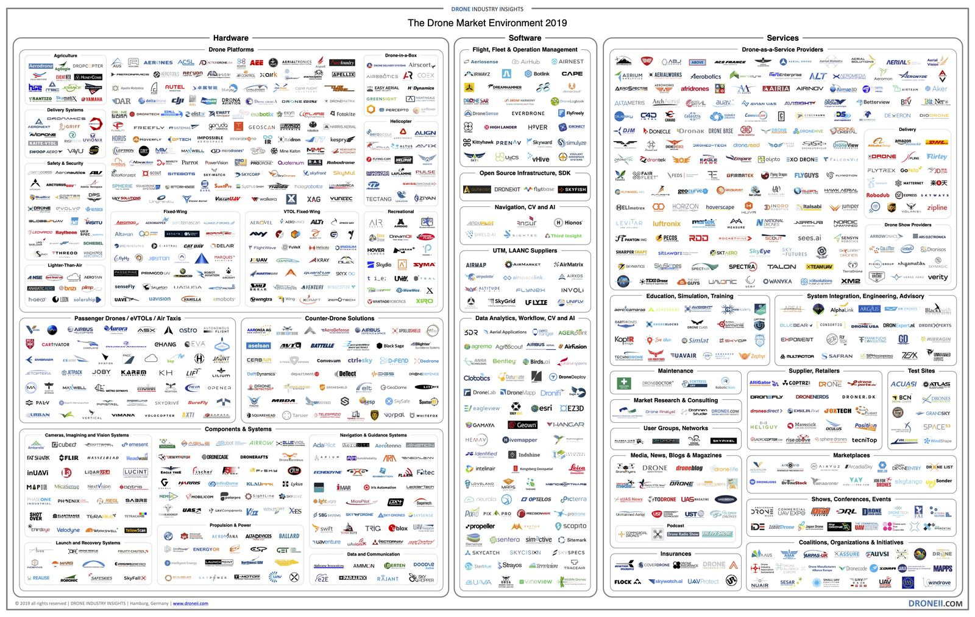

Slide 22
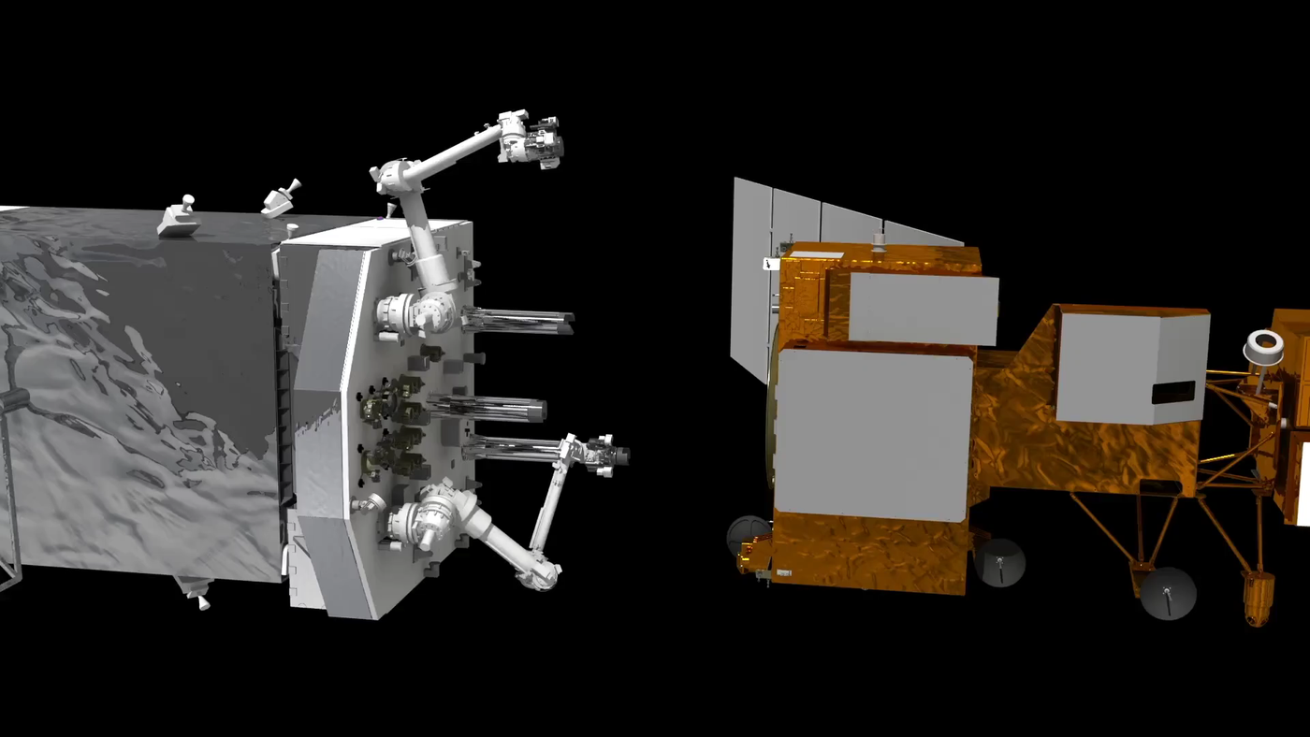

Slide 23
Course goals
To learn the theoretical, algorithmic, and implementation aspects of main techniques for robot autonomy. Specifically, the student will
  Gain a fundamental knowledge of the “autonomy stack”
  Be able to apply such knowledge in applications using ROS

Slide 24
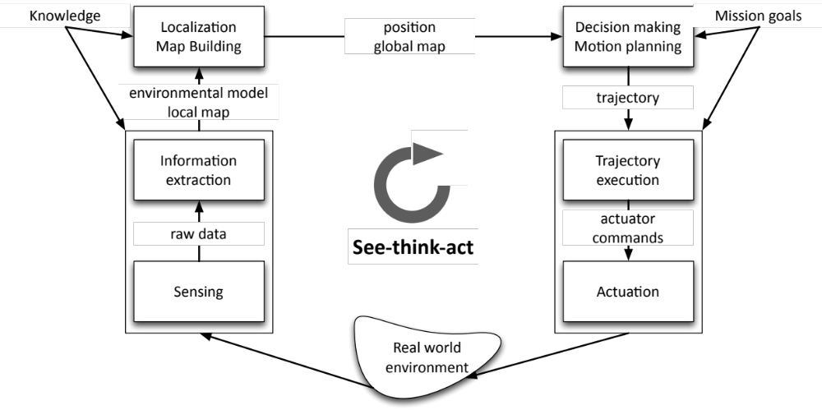
The see-think-act cycle

Slide 25
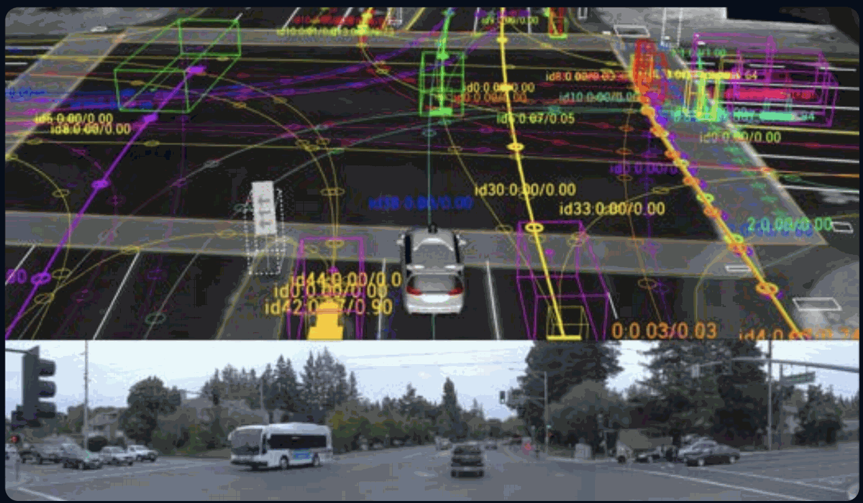
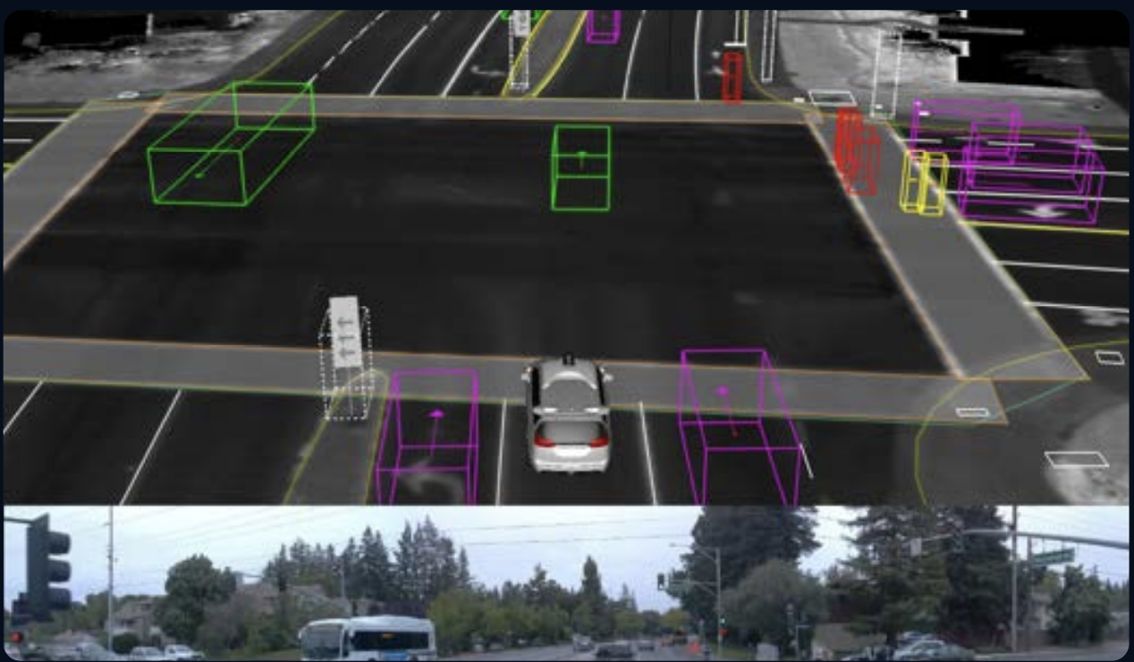
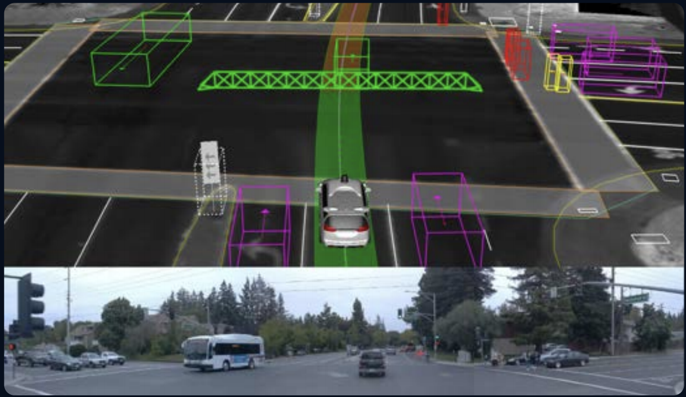
See-think-act cycle for AVs
Note: other architectures are possible and subject of active R&D!
Think
See
Act
Waymo report, 2020

Slide 26
Course structure
Four main topics:
  Robot Operating System (week 1)
  Controls & Motion Planning (weeks 2-4) -- act
  Perception (weeks 5-8) -- see
  State Estimation, Localization & SLAM (weeks 8-11) -- think
Extensive use of the Robot Operating System (ROS)
Requirements
  CS 106A or equivalent
  CME 100 or equivalent (for calculus, linear algebra)
  CME 102 or equivalent (for differential equations)
  CME 106 or equivalent (for probability theory)
  See also the pre-knowledge quiz on the course website

Slide 27
Logistics
Lectures:
  Tuesdays and Thursdays, 10:30am – 11:50am (CODAB60)
Sections
  2-hour, once-a-week on Fridays
  Hands-on exercises that complement the lecture material, build familiarity with ROS, and develop skills necessary for working with hardware
  Link to the section sign-up sheet

Slide 28
Logistics
Office hours:
  Prof. Pavone: Tuesdays, 1:00 – 2:00pm (Durand 261), after class, and by appointment. Office hours will start during the week of Sep 29.
  Course assistants: Wednesdays, 4:30 – 6:30pm (Durand 270), and Thursdays, 4:30 – 6:30pm (Durand 270)
Course websites:
  For course content: https://stanfordasl.github.io/PoRA-I/aa174a_aut2526/
  For course announcements: https://canvas.stanford.edu/courses/214652/
  For course-related questions: https://edstem.org/us/courses/87236/discussion/
  For homework submissions: https://www.gradescope.com/courses/1137718
  To contact the AA174A staff: aa174a-aut2526-staff@lists.stanford.edu

Slide 29
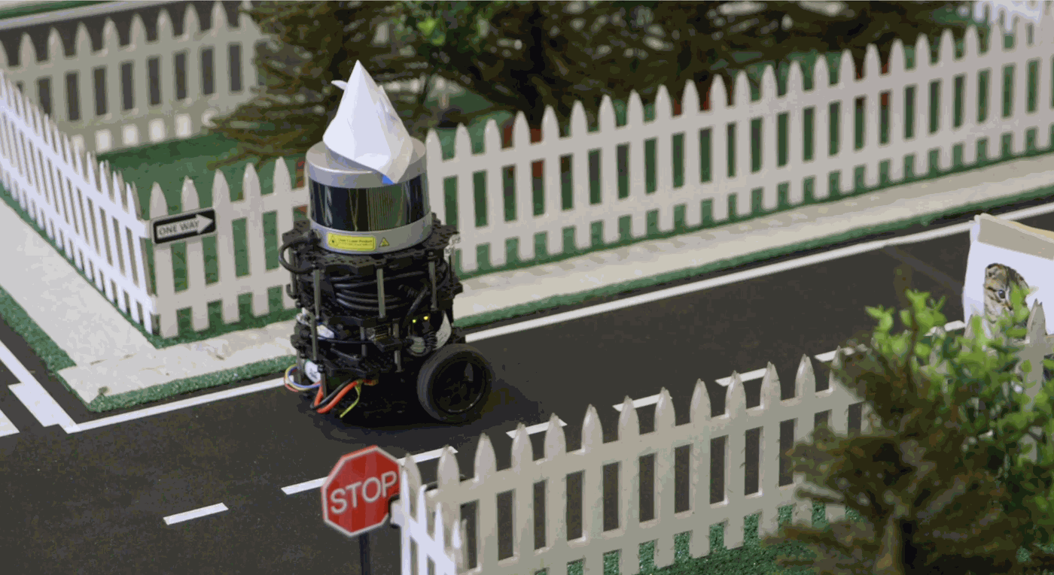
Grading
Course grade calculation
  (20%) final project
  (60%) homework
  (20%) sections
  (extra 5%) participation on Piazza

Slide 30

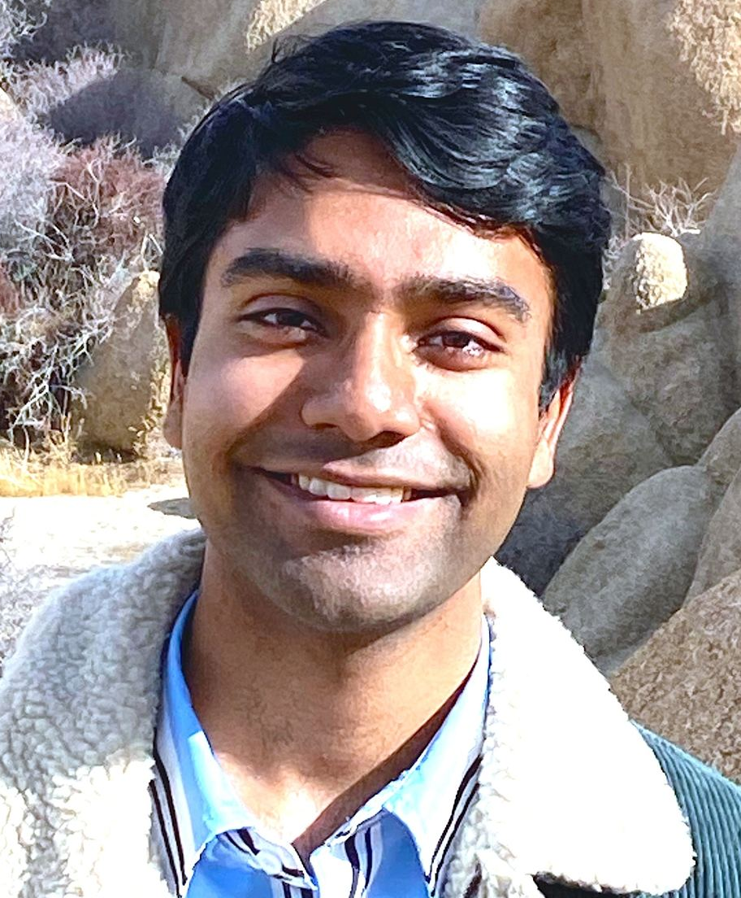

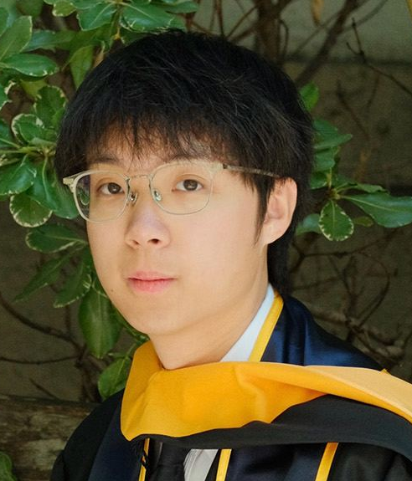
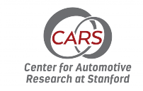
Team
Labs:
Instructor
CAs
Milan Ganai
Yujung Jenny Kim
Marco Pavone
Associate Professor AA, and CS/EE (by courtesy)
Collaborators
Daniel Watzenig
Labs
Jacky Kwok

Slide 31
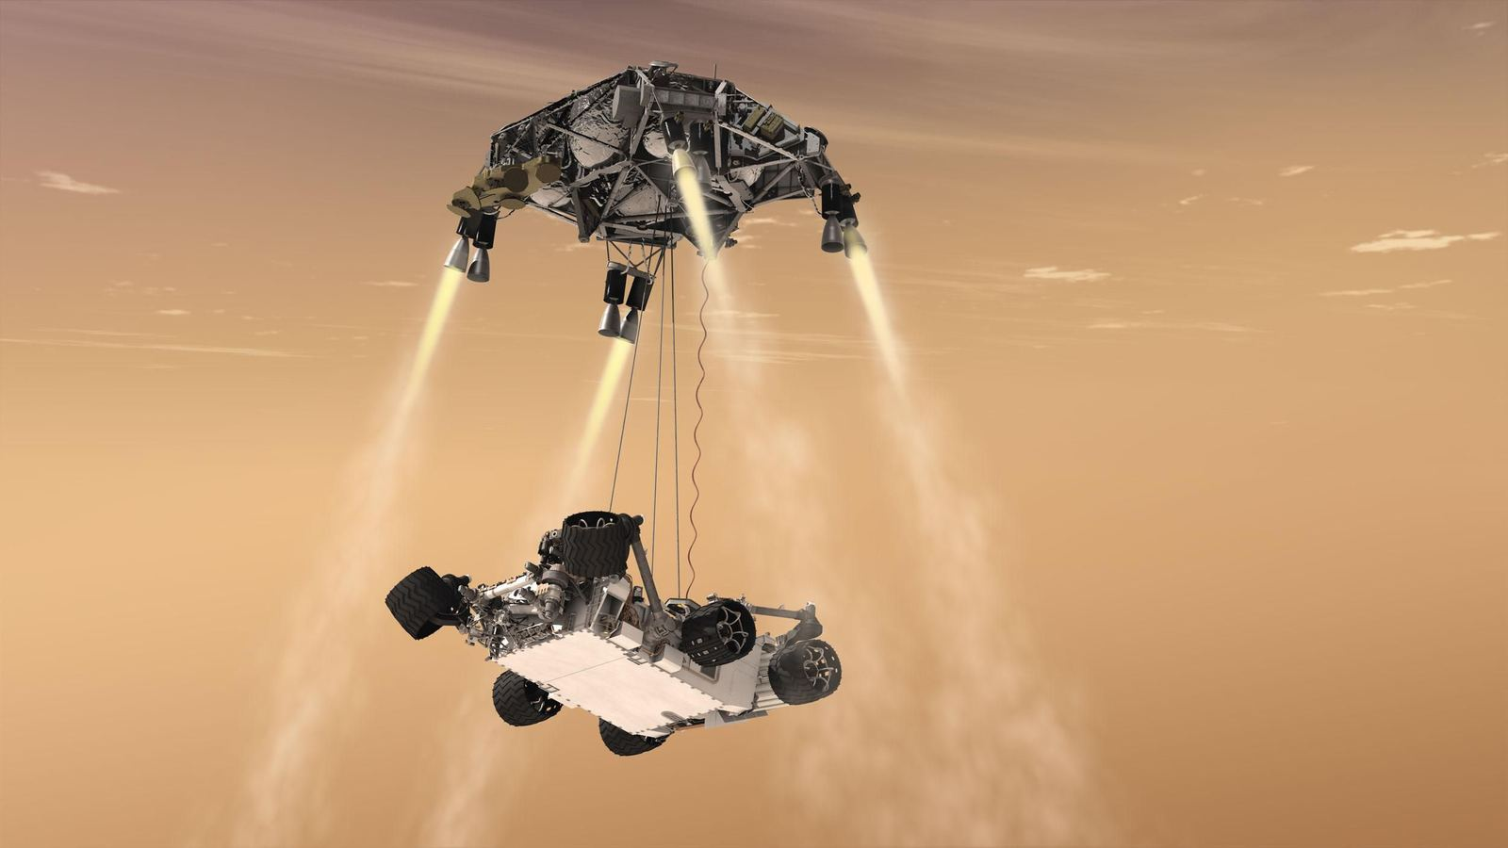
Courtesy of NASA JPL

Slide 32
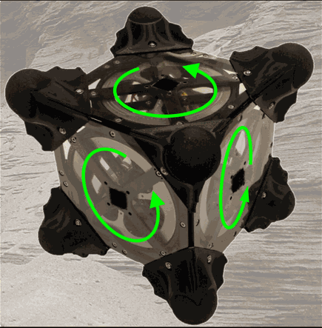
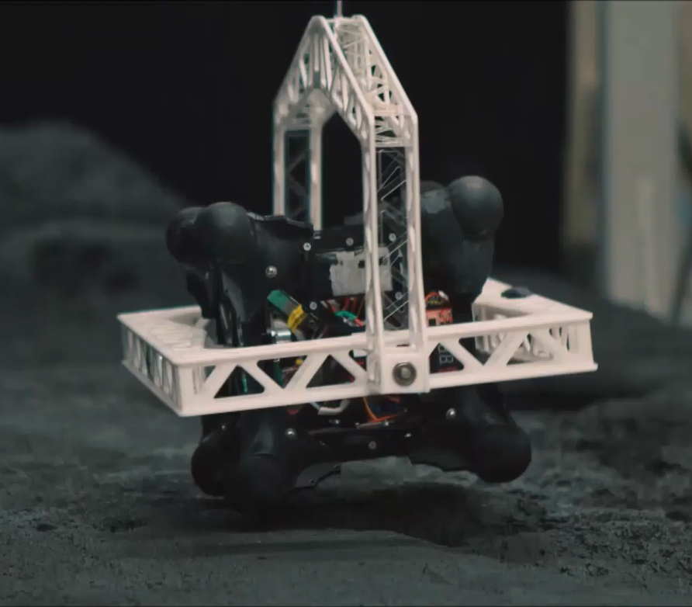
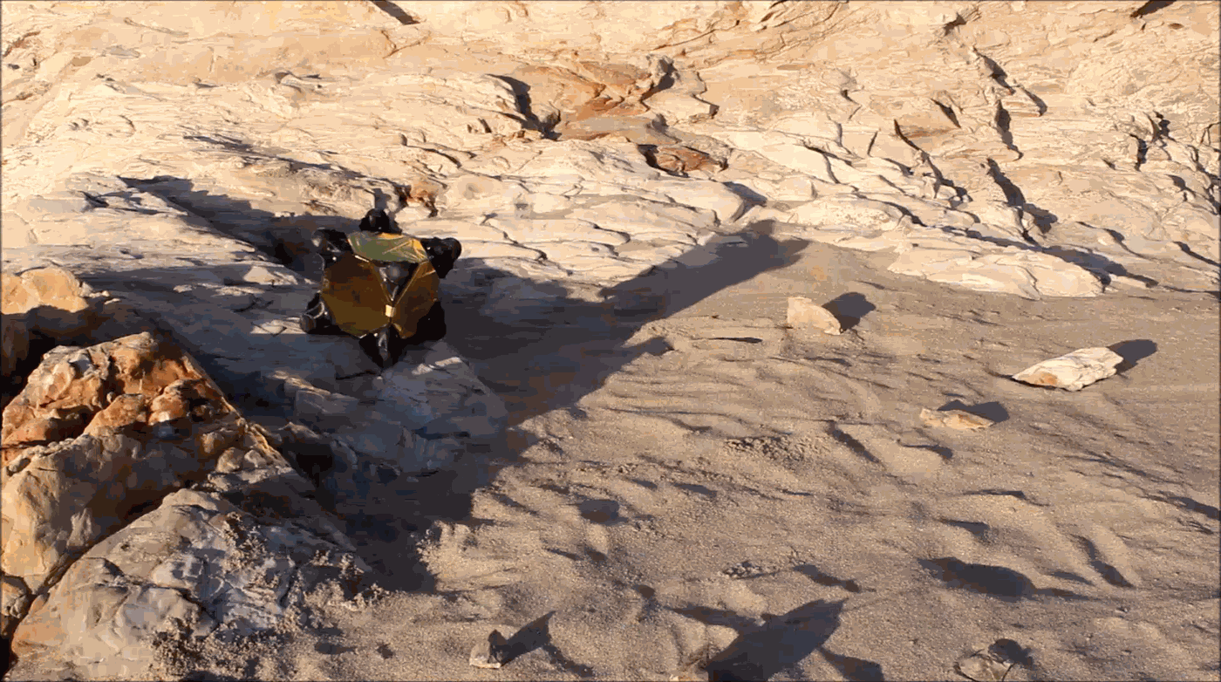

Slide 33
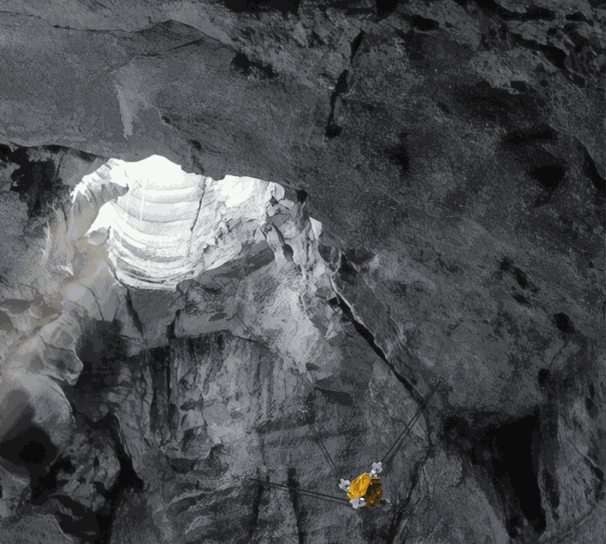
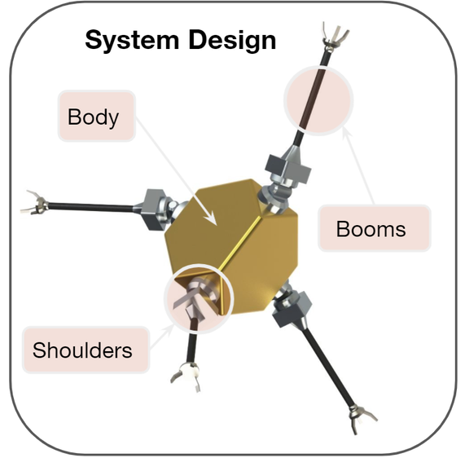
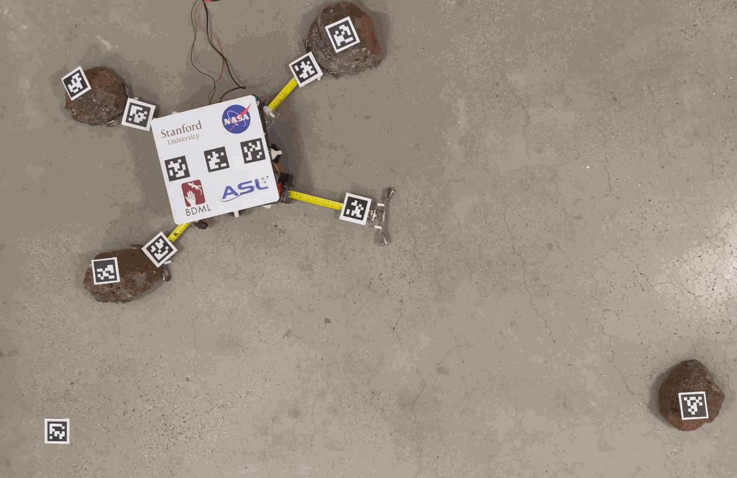

Slide 34
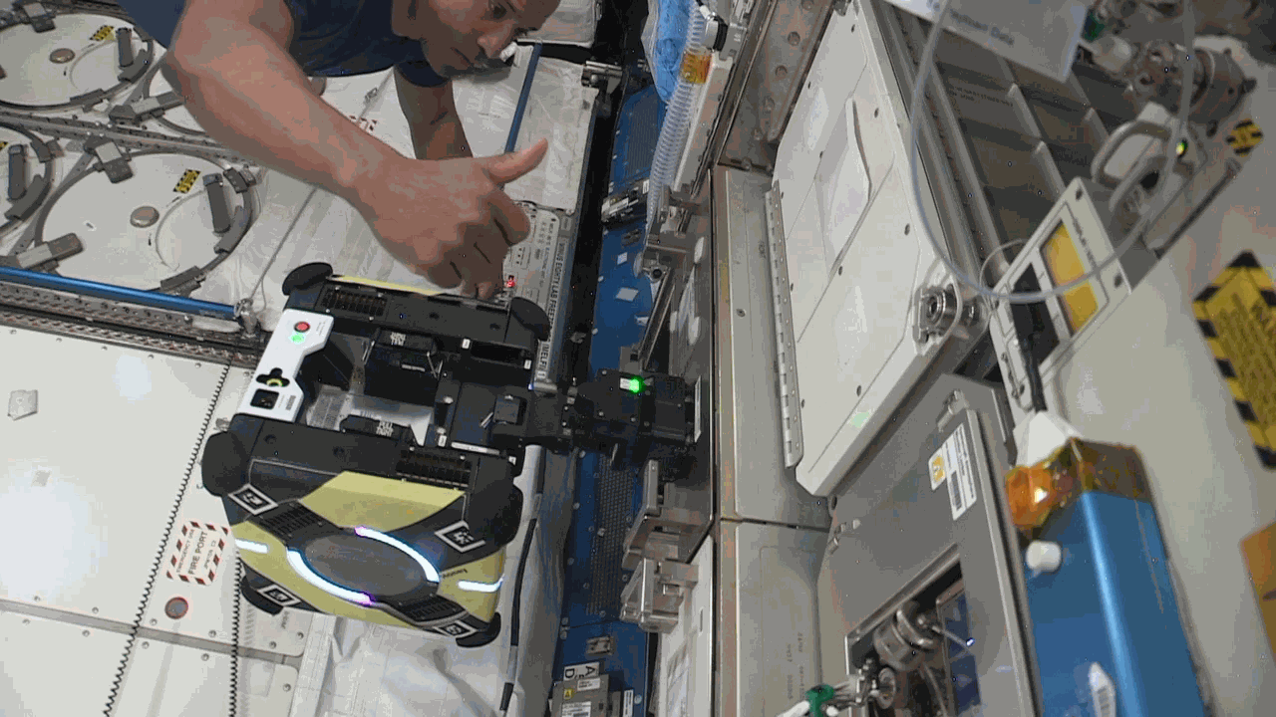

Slide 35
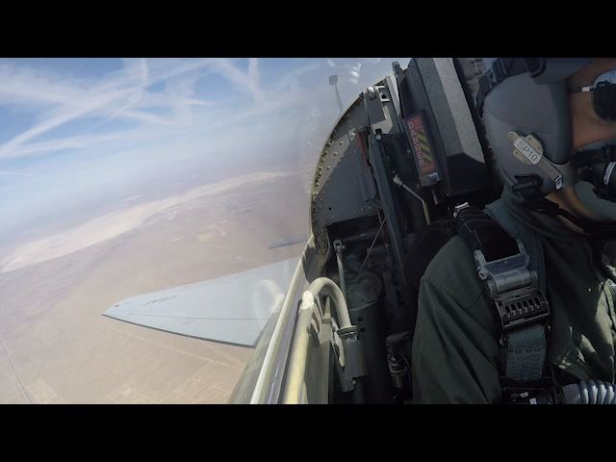

Slide 36
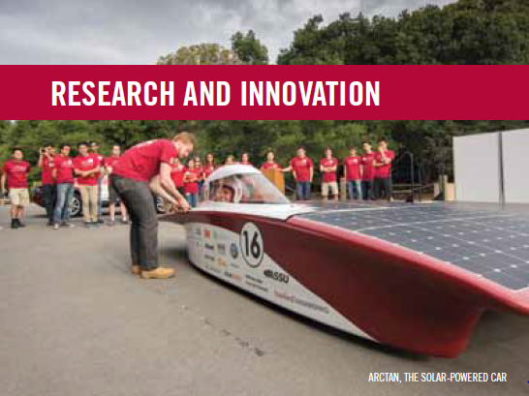
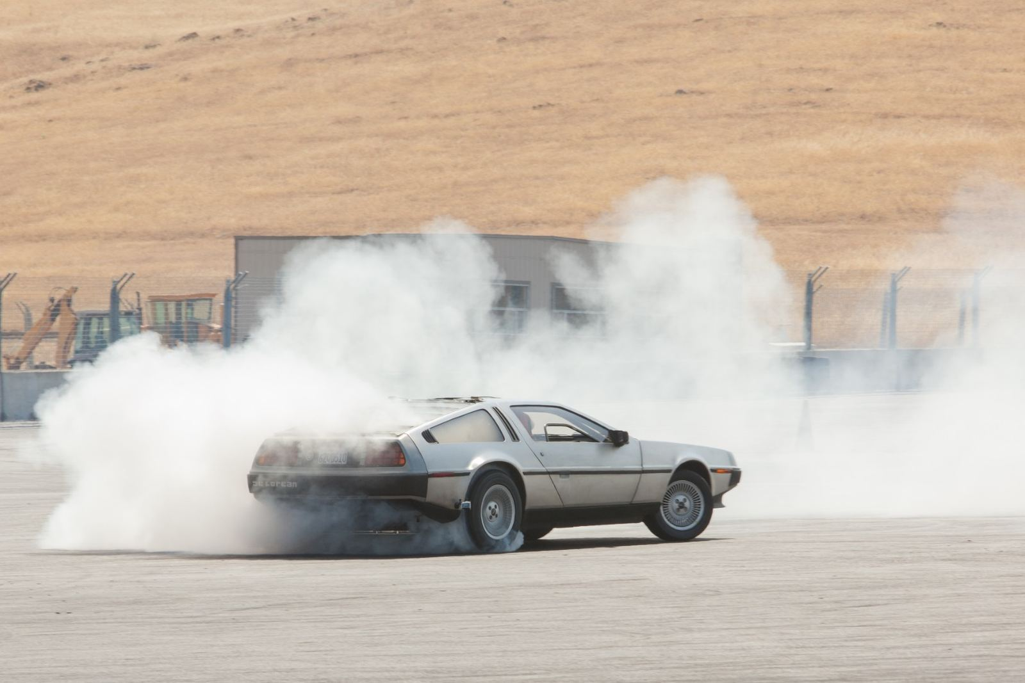
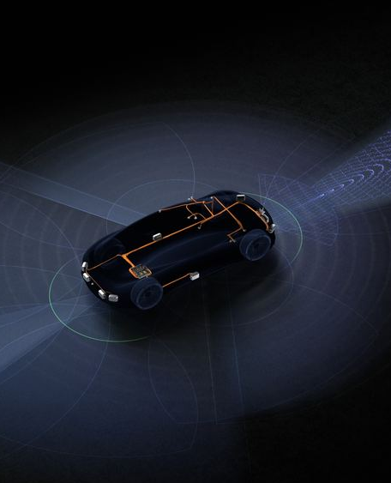
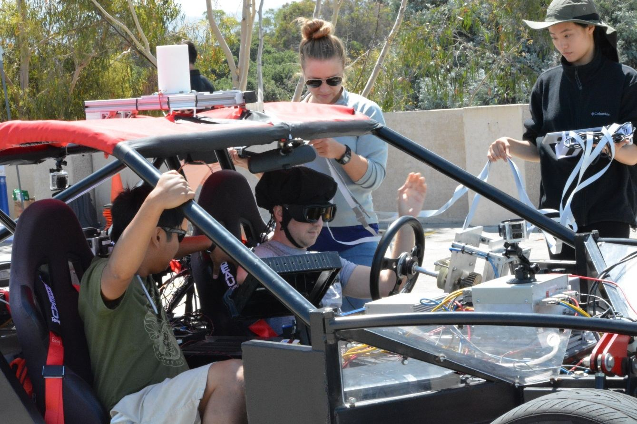
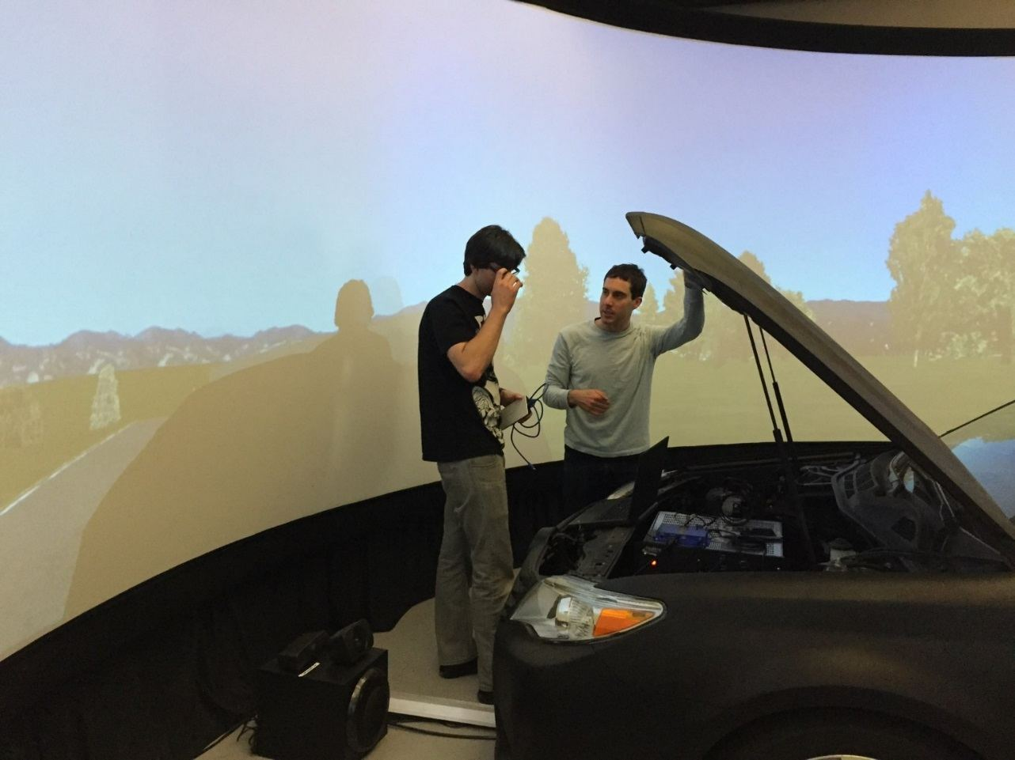
Center for Automotive Research at Stanford
Autonomous Vehicle Research
at NVIDIA
https://cars.stanford.edu/
https://research.nvidia.com/labs/avg

Slide 37
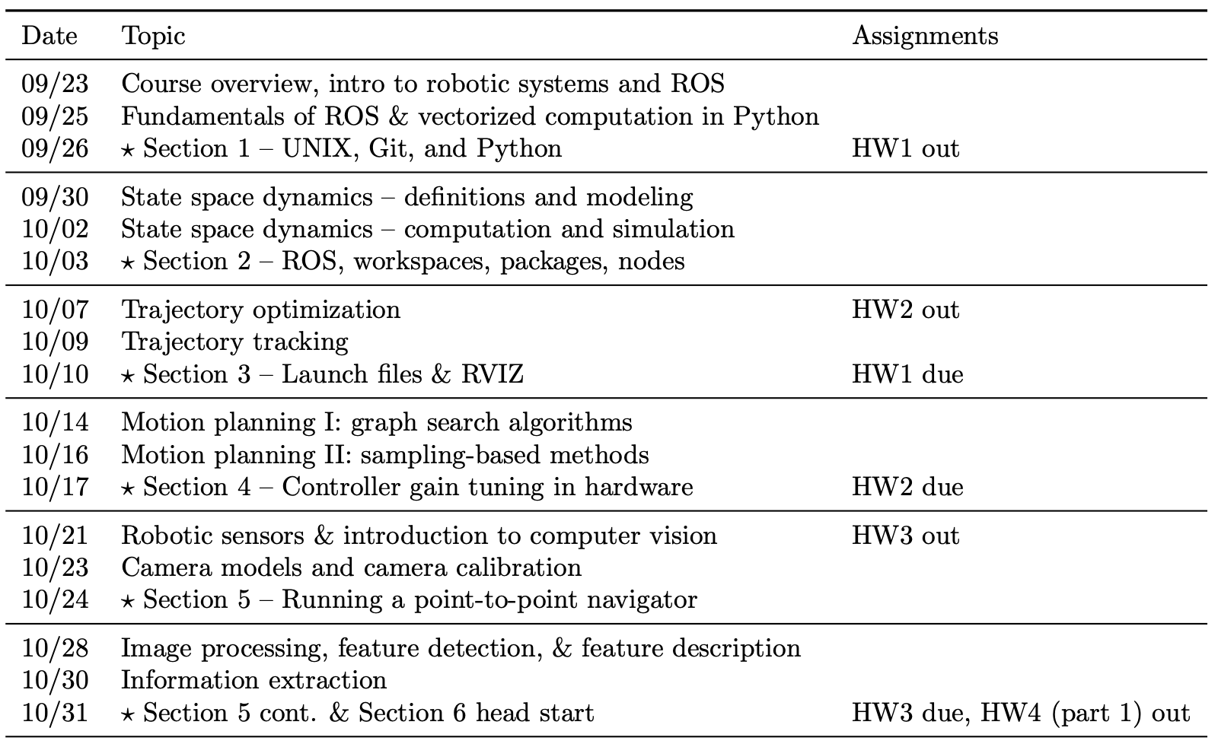

Schedule

Slide 38





Turtlebot3
Crazyflie
Imagine you have a robot with sensors, motors, and AI.
How do you make all the pieces talk to each other - reliably, in real time, and in a way others can build on?
That's where ROS comes in!
Velodyne LiDAR

Slide 39

Quadrotor

Slide 40

Manipulation

Slide 41

TurtleBot

Slide 42
The Challenge of Building Robots
Robots are complex systems
  Hardware
    Sensors (IMU, velocity, LiDAR, Camera, Microphone, …)
    Actuators (wheels, joints, grippers, valves, ...)
    Structures (Links, frame, …)
  Software
    Control
    Trajectory planning
    Object detection
    Localization
    …

Slide 43
What would we do without ROS?
Write custom code to connect sensors and actuators.
Reinvent tools for visualization, debugging, and simulation.
Struggle with versioning, testing, and sharing code.

Slide 44

What is ROS?
Middleware (Not an operating system)
ROS provides:
  Launching different components
  Communication between components → Publish/subscribe messaging system.
  Reusable components → Packages for navigation, vision, motion planning
  Tools for visualization & debugging → RViz, Gazebo, rqt.
  Community & ecosystem → Thousands of open-source packages.

Slide 45


Perception
Object Detection with OpenCV
Depth Sensing with Lidar

Slide 46

Localization and Mapping

Slide 47


Navigation
Waymo Navigation on Freeway
PR2 Navigation around a Fake Death

Slide 48

Manipulation
Manipulation with MoveIt!

Slide 49

Simulation and Visualization

Slide 50
Multidisciplinary Collaboration
All disciplines come together
  Mechanical engineers: Design the robot body and actuators
  Electrical engineers: Design actuators, sensors, and control
  Computer scientists / AI researchers: Implement perception and planning
  Design experts: Build human-robot interfaces via ROS APIs.

Slide 51








Robot Operating System – History
ROS 1
2014 - 2019
2016 - 2021
2018 - 2023
2020 - 2025
ROS 2
2019 - 2021
2020 - 2023
2022 - 2027
2017 - Present

Slide 52
Key Takeaways
ROS is a framework that connects all parts of a robot.
It saves time, encourages collaboration, and accelerates innovation.
ROS brings robot autonomy to reality.
The ROS ecosystem is vast and growing.
Next lecture: How ROS actually works — topics, nodes, packages, ...

Slide 53
Backup

Slide 54
Robot Operating System – History
ROS 1
2014 - 2019
2016 - 2021
2018 - 2023
2020 - 2025
ROS 2
2019 - 2021
2020 - 2023
2022 - 2027
2017 - Present

Slide 55

Robot Operating System – History
ROS 1
2014 - 2019
2016 - 2021
2018 - 2023
2020 - 2025
ROS 2
2019 - 2021
2020 - 2023
2022 - 2027
2017 - Present

Slide 56
Robot Operating System – History
ROS 1
2014 - 2019
2016 - 2021
2018 - 2023
2020 - 2025
ROS 2
2019 - 2021
2020 - 2023
2022 - 2027
2017 - Present

Slide 57


Why is ROS popular in academia?
Not reinventing the wheel is generally good
Robotics is hard! It’s great to offload some of the work to smart people
ROS is now 12 years
old and still going
strong

Slide 58
Robot Operating System – Overview
Community & Ecosystem
  Hardware Drivers
  Software
Tooling
  Visualization
  Debugging
Asynchronous Programming Model

Slide 59
Robot Operating System – ROS2
Community & Ecosystem
  Hardware Drivers
  Software

Slide 60

Robot Operating System – ROS2
Community & Ecosystem
  Hardware Drivers
  Software
Joysticks
Crazyflie
Velodyne LiDAR
Turtlebot3

Slide 61

Robot Operating System – ROS2
Community & Ecosystem
  Hardware Drivers
  Software
Gazebo Sim
SLAM Toolbox

Slide 62

Robot Operating System – ROS2
Community & Ecosystem
  Hardware Drivers
  Software
Tooling
  Visualization
  Debugging

Slide 63

Robot Operating System – ROS2
Community & Ecosystem
  Hardware Drivers
  Software
Tooling
  Visualization
  Debugging

Slide 64
Robot Operating System – ROS2
Community & Ecosystem
  Hardware Drivers
  Software
Tooling
  Visualization
  Debugging
Asynchronous Programming Model

Slide 65
Robot Operating System – ROS2
Community & Ecosystem
  Hardware Drivers
  Software
Tooling
  Visualization
  Debugging
Asynchronous Programming Model
Let’s write some code!

Slide 66



Are there “Alternatives” to ROS?
LCM
Drake
Player
YARP
Orocos
MRPT
And many others!

Slide 67
Next time: fundamentals of ROS
Robot Operating System

