Slide 1
Principles of Robot Autonomy I
Image processing, feature detection, and feature description

Slide 2

Attendance Form

Slide 3
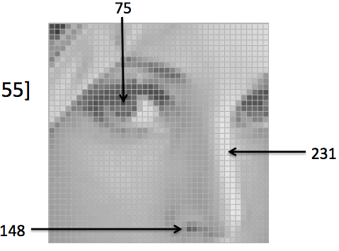
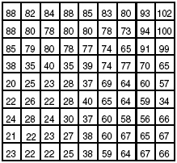

What I would improve if I had to give the lecture again
1st it was not clear for students to go from an image to a signal (add some graphic as above)
The descriptors were unclear, especially regarding how they are generated visually. Consider providing a step-by-step visual explanation of descriptor generation.
Conduct an in-class exercise to demonstrate that the descriptor operation is associative.
The slight gradient for the Marco descriptor in high-resolution images was not visible at all.
At to slides an example on how to apply a filter to an image and move it around – go from 1D to 2D may be very natural to understand.
My explanation of the properties of feature descriptors was not systematic, which may have caused confusion.
Visualizations on static images often confused students, particularly concepts like scale invariance, as the connection between the visual and the underlying principle was not fully clear.

Slide 4
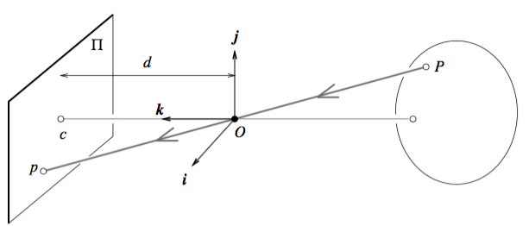
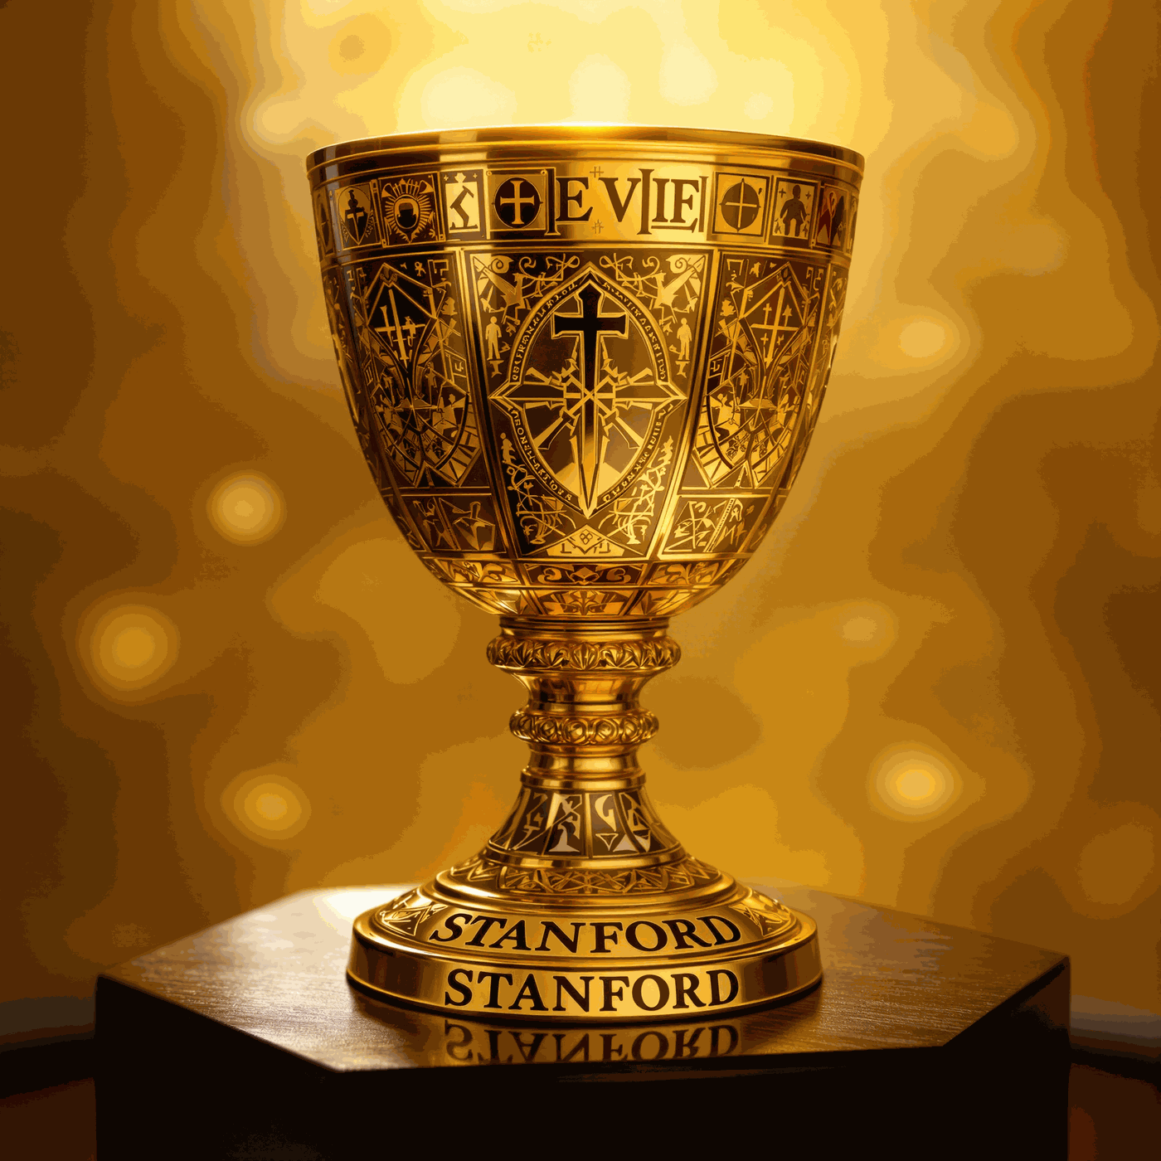
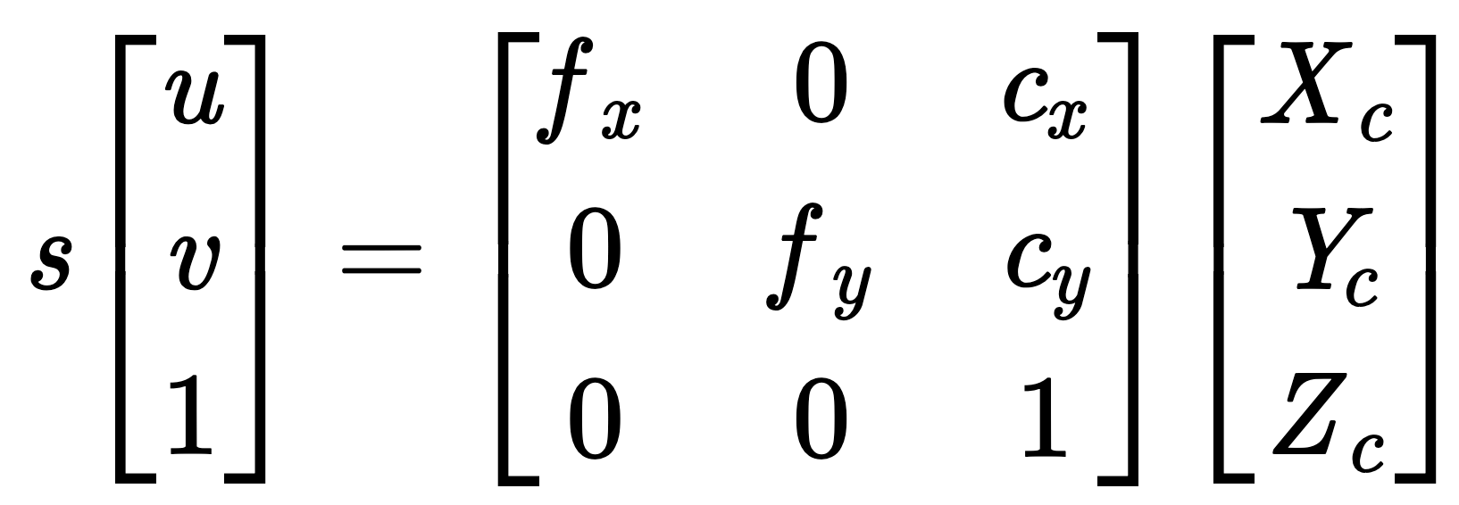
From 3D world to 2D images
So far we have focused on mapping 3D objects onto 2D images and on leveraging such mapping for calibration / scene reconstruction
Next step: how to represent images and infer visual content?

Slide 5
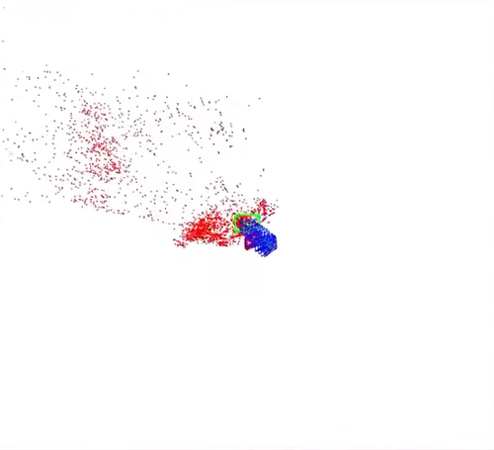

Visual Inertial Odometry
Campos, Carlos, Richard Elvira, Juan J. Gómez Rodríguez, José MM Montiel, and Juan D. Tardós. "Orb-slam3: An accurate open-source library for visual, visual–inertial, and multimap slam." IEEE transactions on robotics 37, no. 6 (2021): 1874-1890.

Slide 6
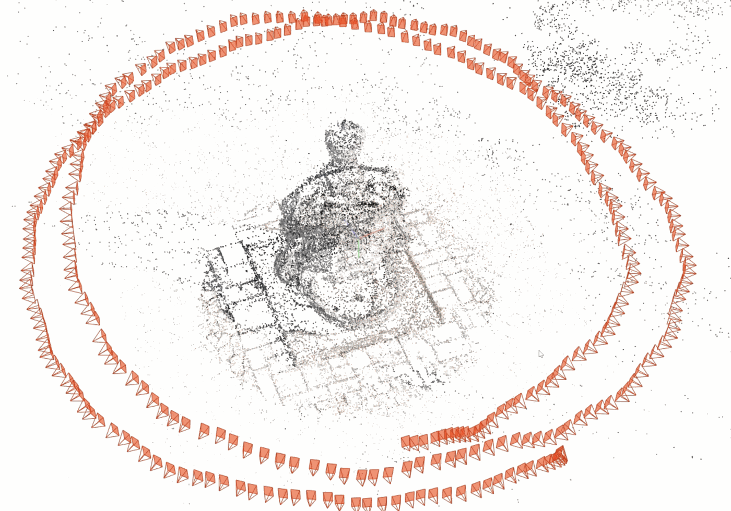
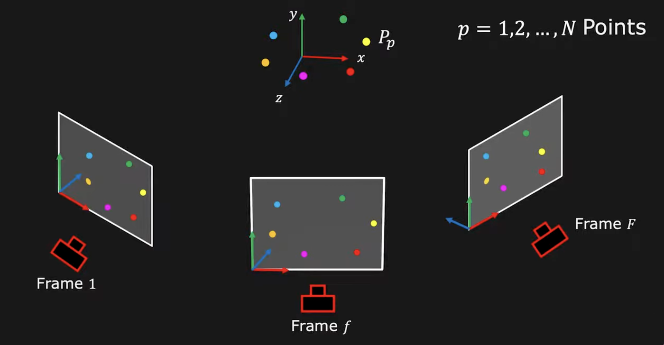
Motivation: Visual Inertial Odometry
Campos, Carlos, Richard Elvira, Juan J. Gómez Rodríguez, José MM Montiel, and Juan D. Tardós. "Orb-slam3: An accurate open-source library for visual, visual–inertial, and multimap slam." IEEE transactions on robotics 37, no. 6 (2021): 1874-1890.

Slide 7
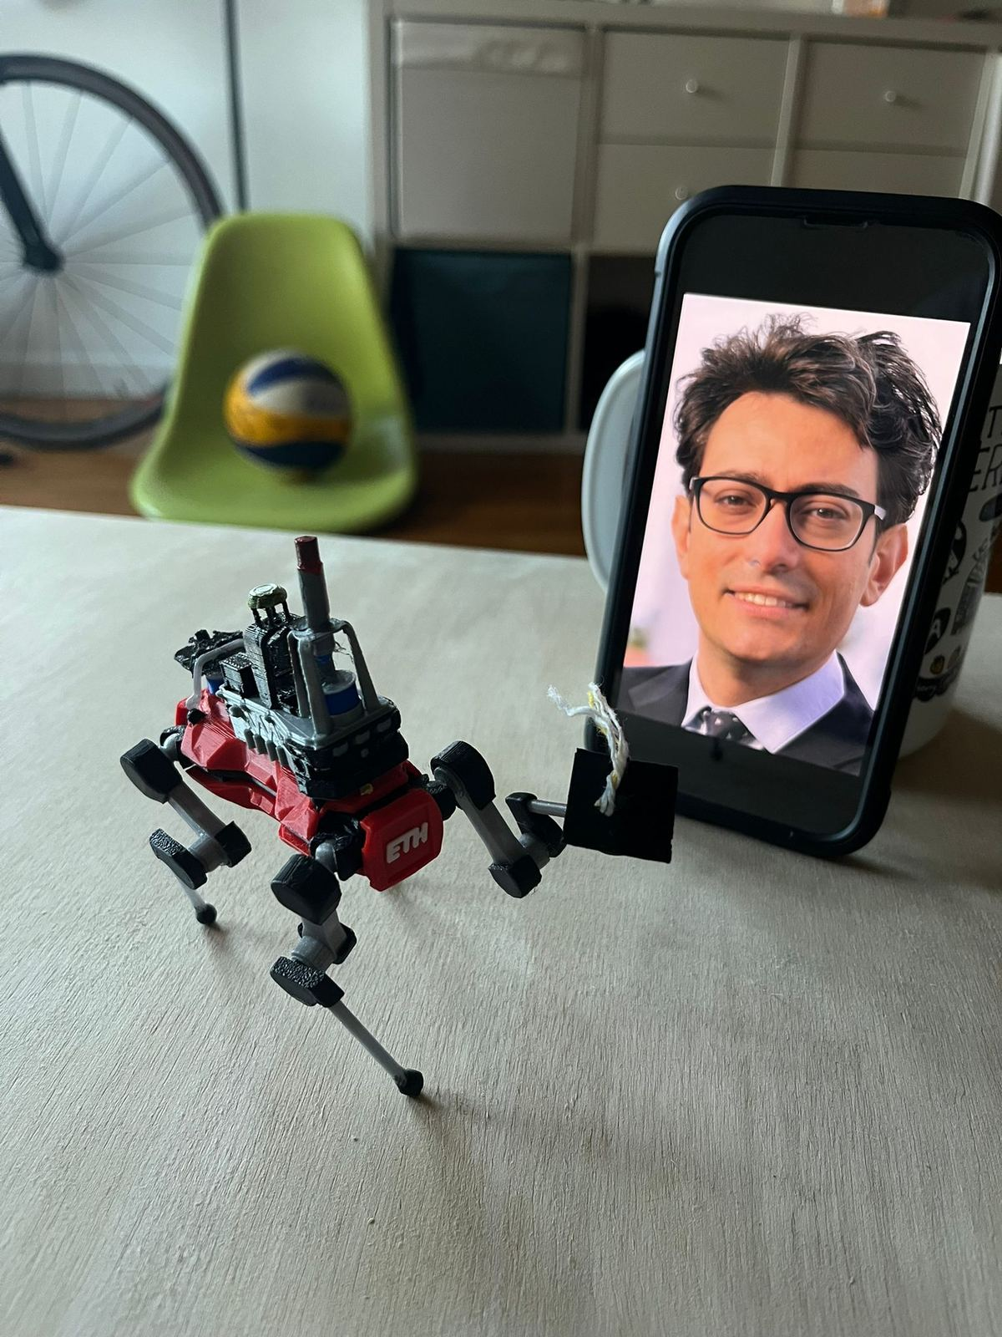
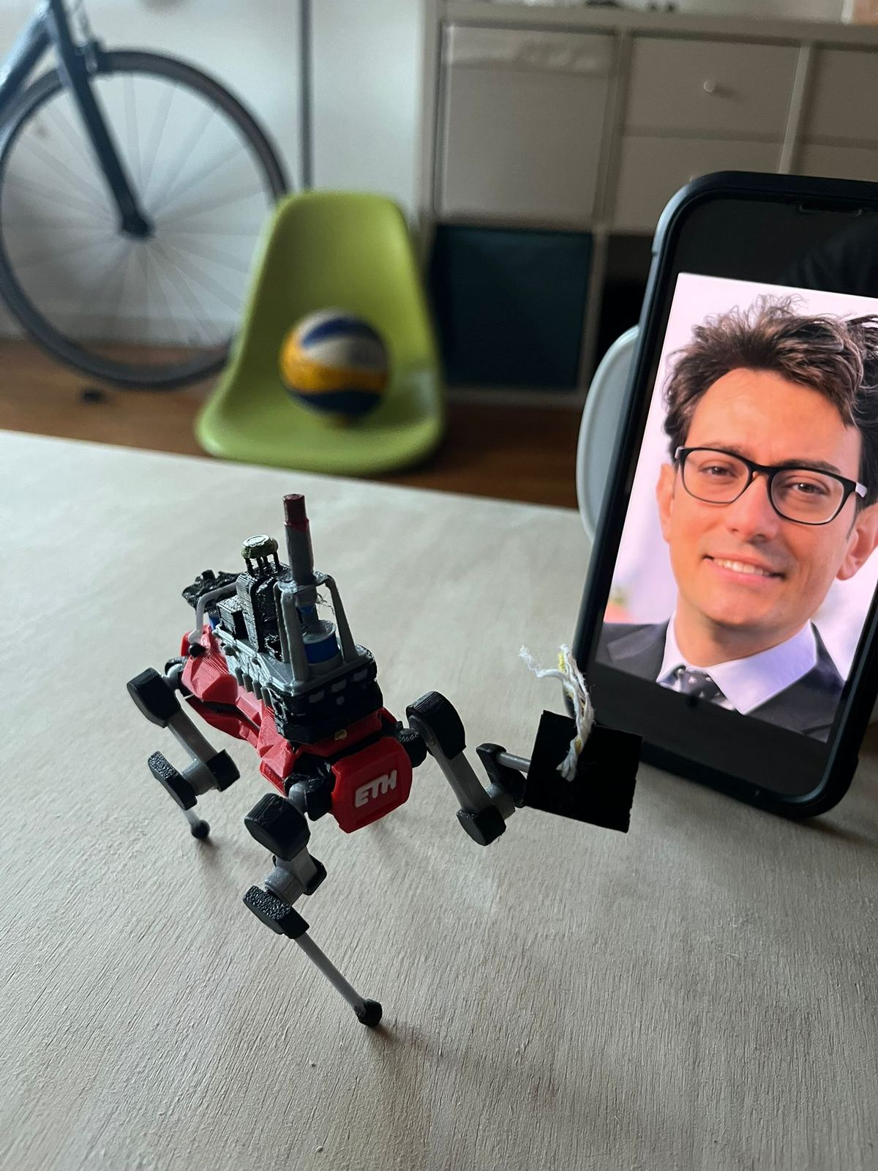
From 3D world to 2D images
Wang, Jianyuan, Minghao Chen, Nikita Karaev, Andrea Vedaldi, Christian Rupprecht, and David Novotny. "Vggt: Visual geometry grounded transformer." In Proceedings of the Computer Vision and Pattern Recognition Conference, pp. 5294-5306. 2025.

Slide 8
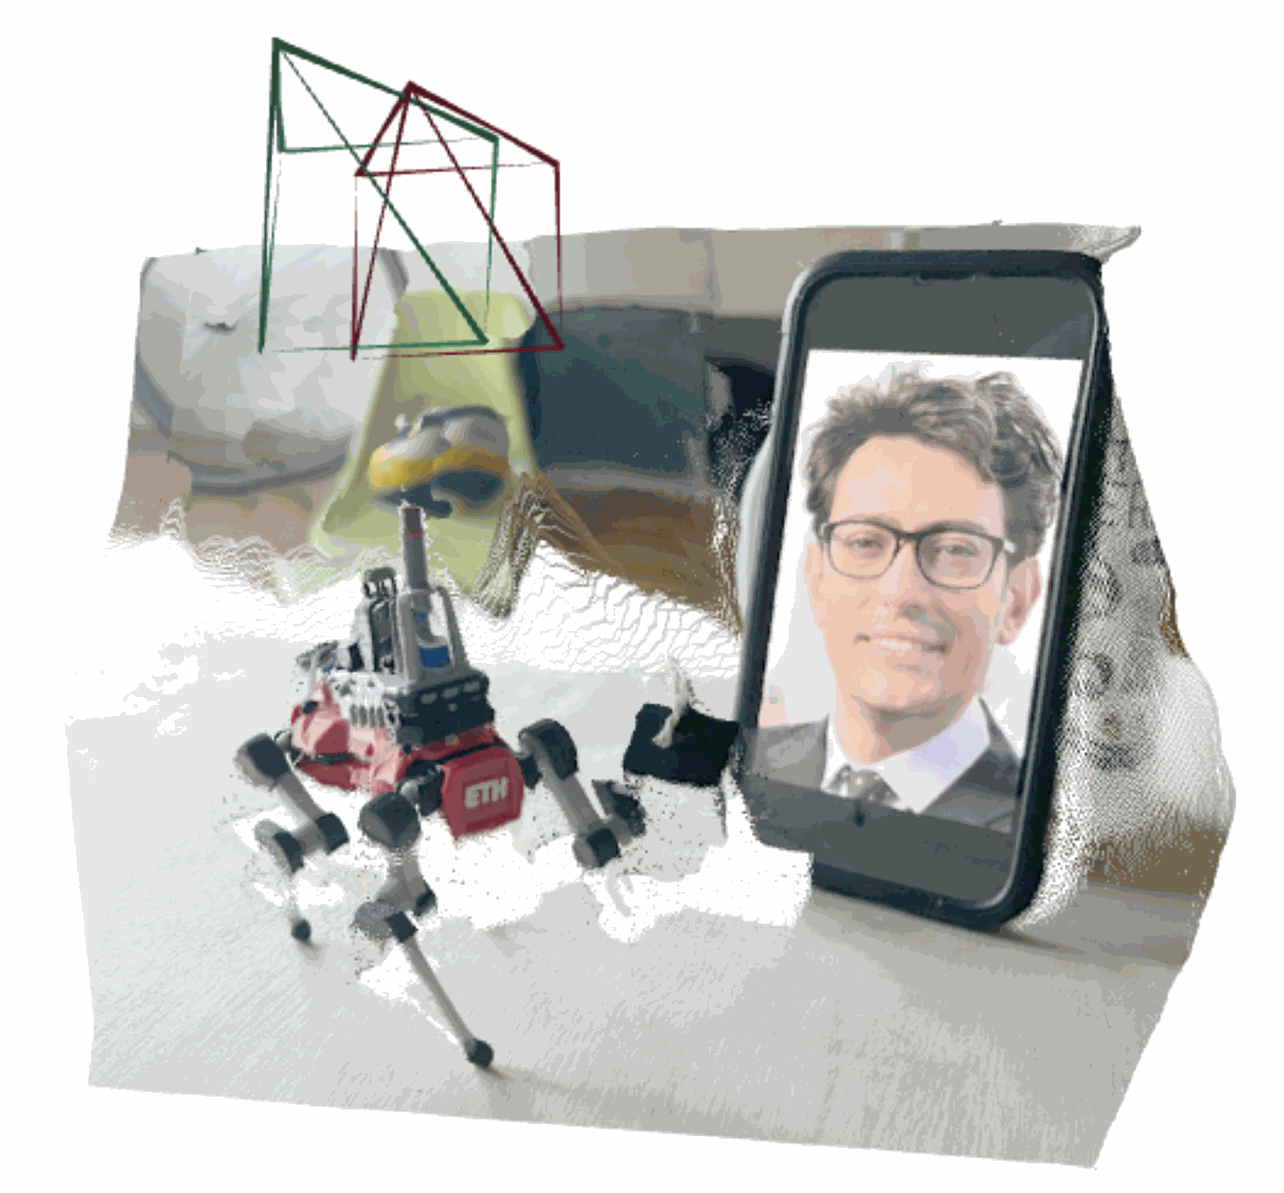
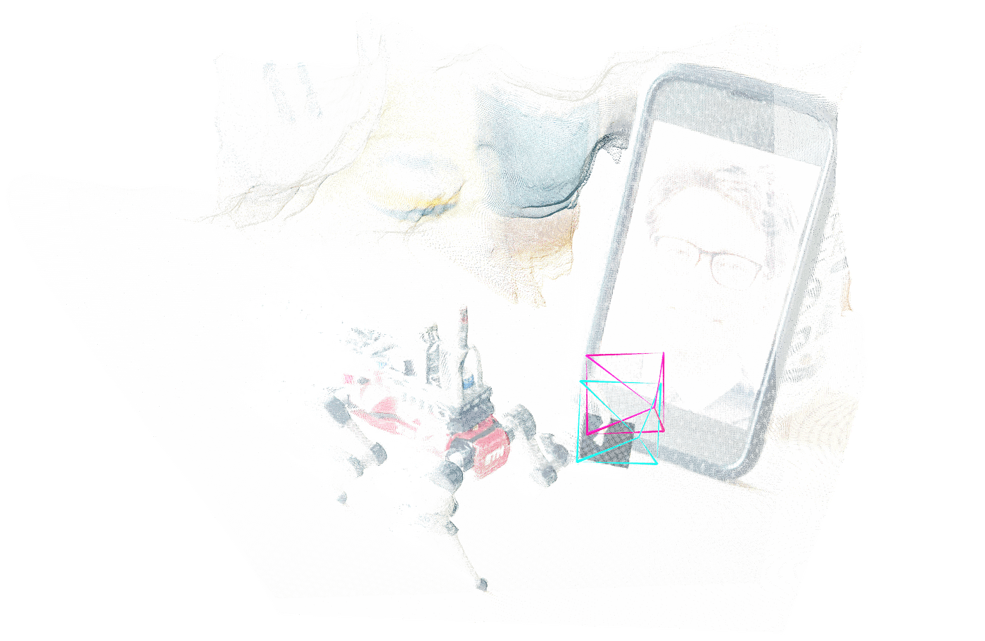
From 2D images to a 3D world
Wang, Jianyuan, Minghao Chen, Nikita Karaev, Andrea Vedaldi, Christian Rupprecht, and David Novotny. "Vggt: Visual geometry grounded transformer." In Proceedings of the Computer Vision and Pattern Recognition Conference, pp. 5294-5306. 2025.

Slide 9
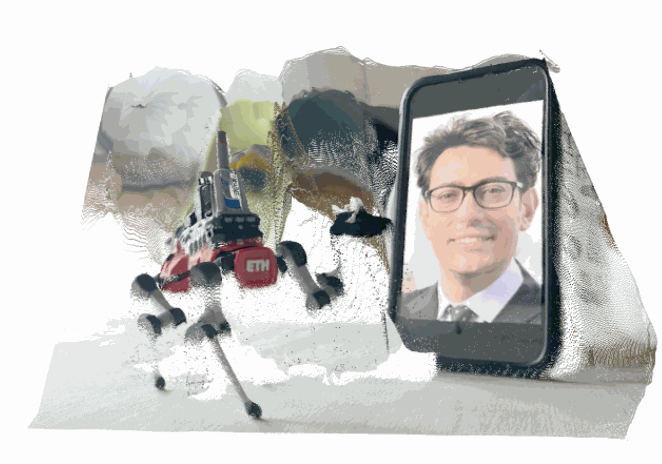
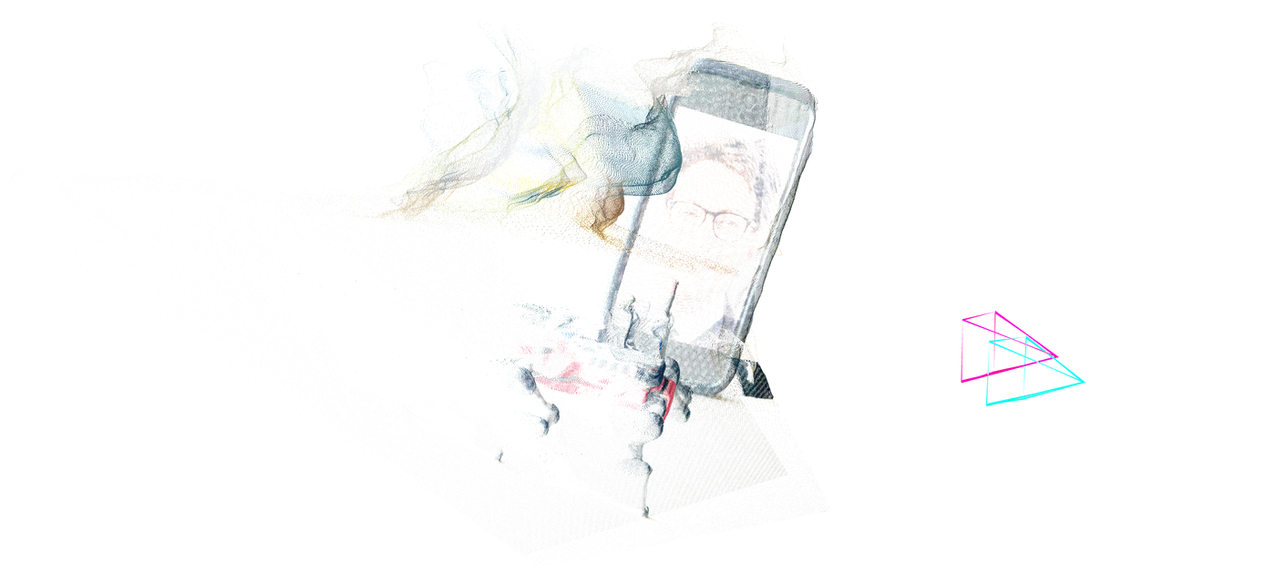
From 2D images to a 3D world
Wang, Jianyuan, Minghao Chen, Nikita Karaev, Andrea Vedaldi, Christian Rupprecht, and David Novotny. "Vggt: Visual geometry grounded transformer." In Proceedings of the Computer Vision and Pattern Recognition Conference, pp. 5294-5306. 2025.

Slide 10
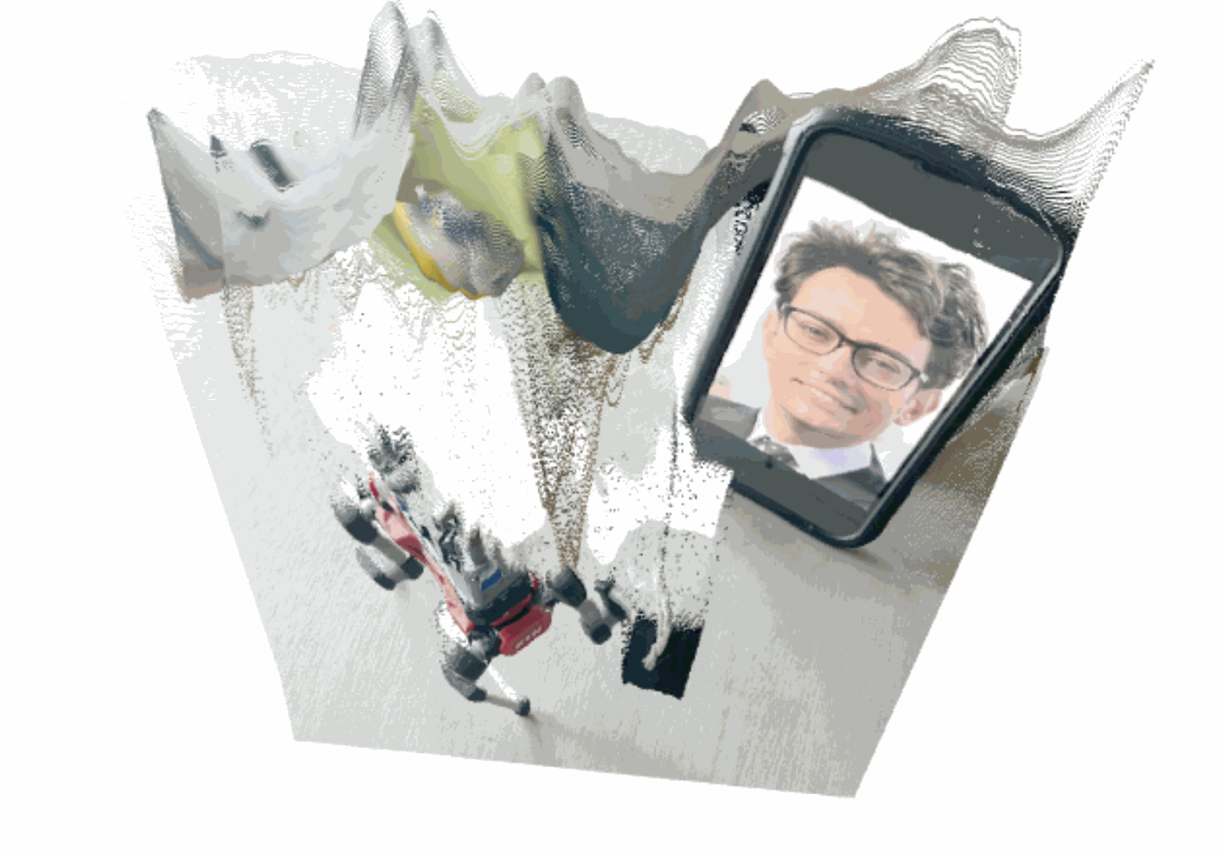
From 2D images to a 3D world
Ideas on improving the reconstruction ?
Wang, Jianyuan, Minghao Chen, Nikita Karaev, Andrea Vedaldi, Christian Rupprecht, and David Novotny. "Vggt: Visual geometry grounded transformer." In Proceedings of the Computer Vision and Pattern Recognition Conference, pp. 5294-5306. 2025.

Slide 11
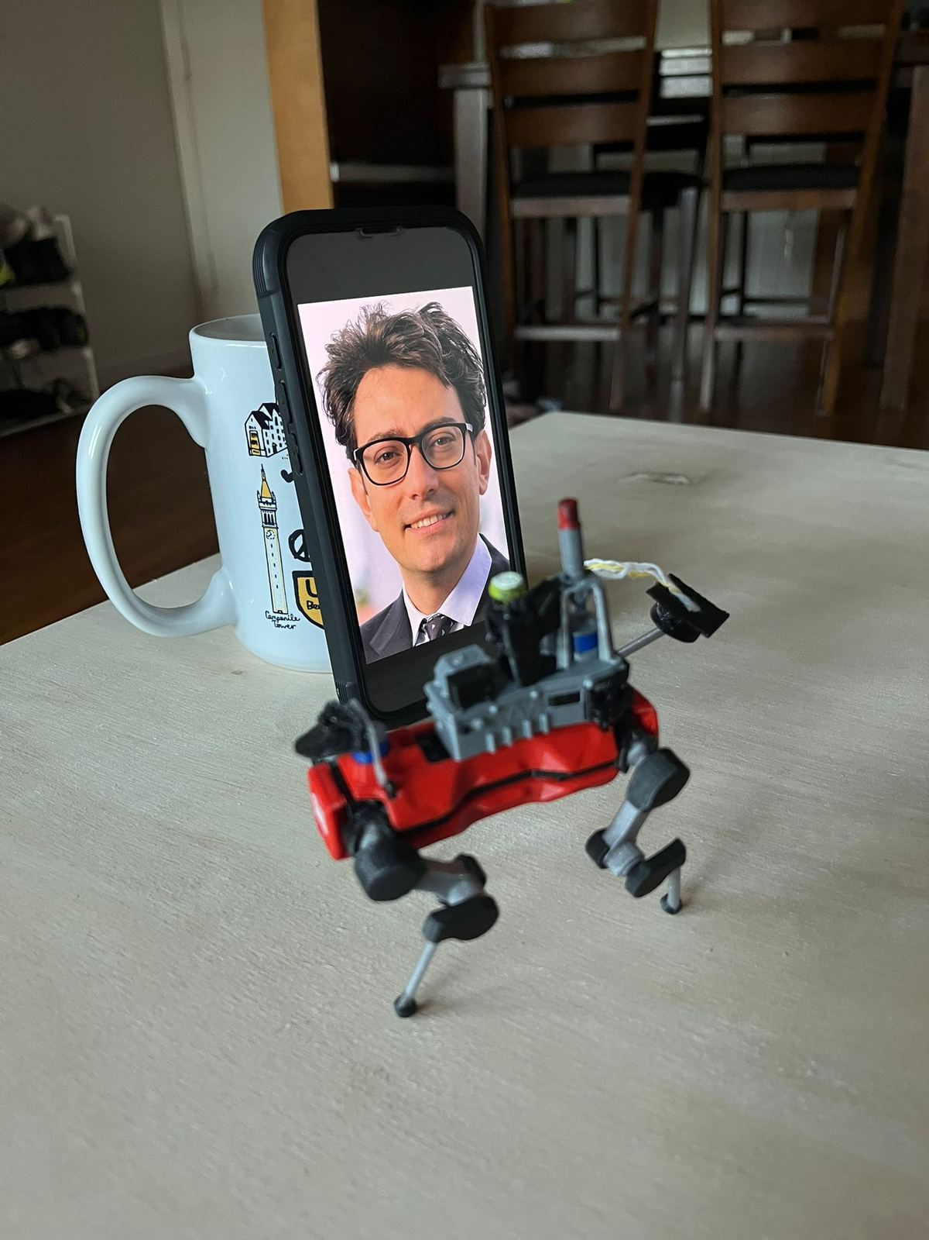
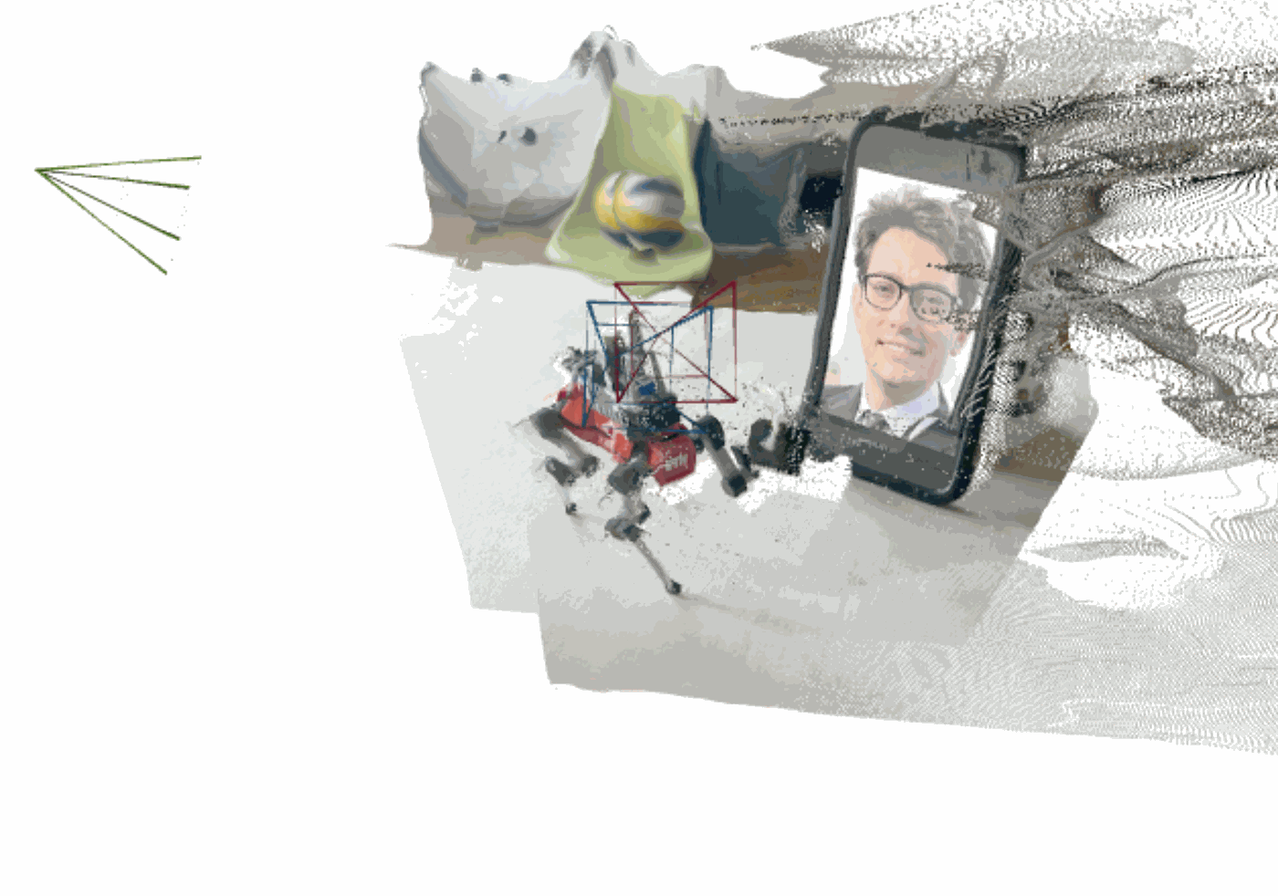
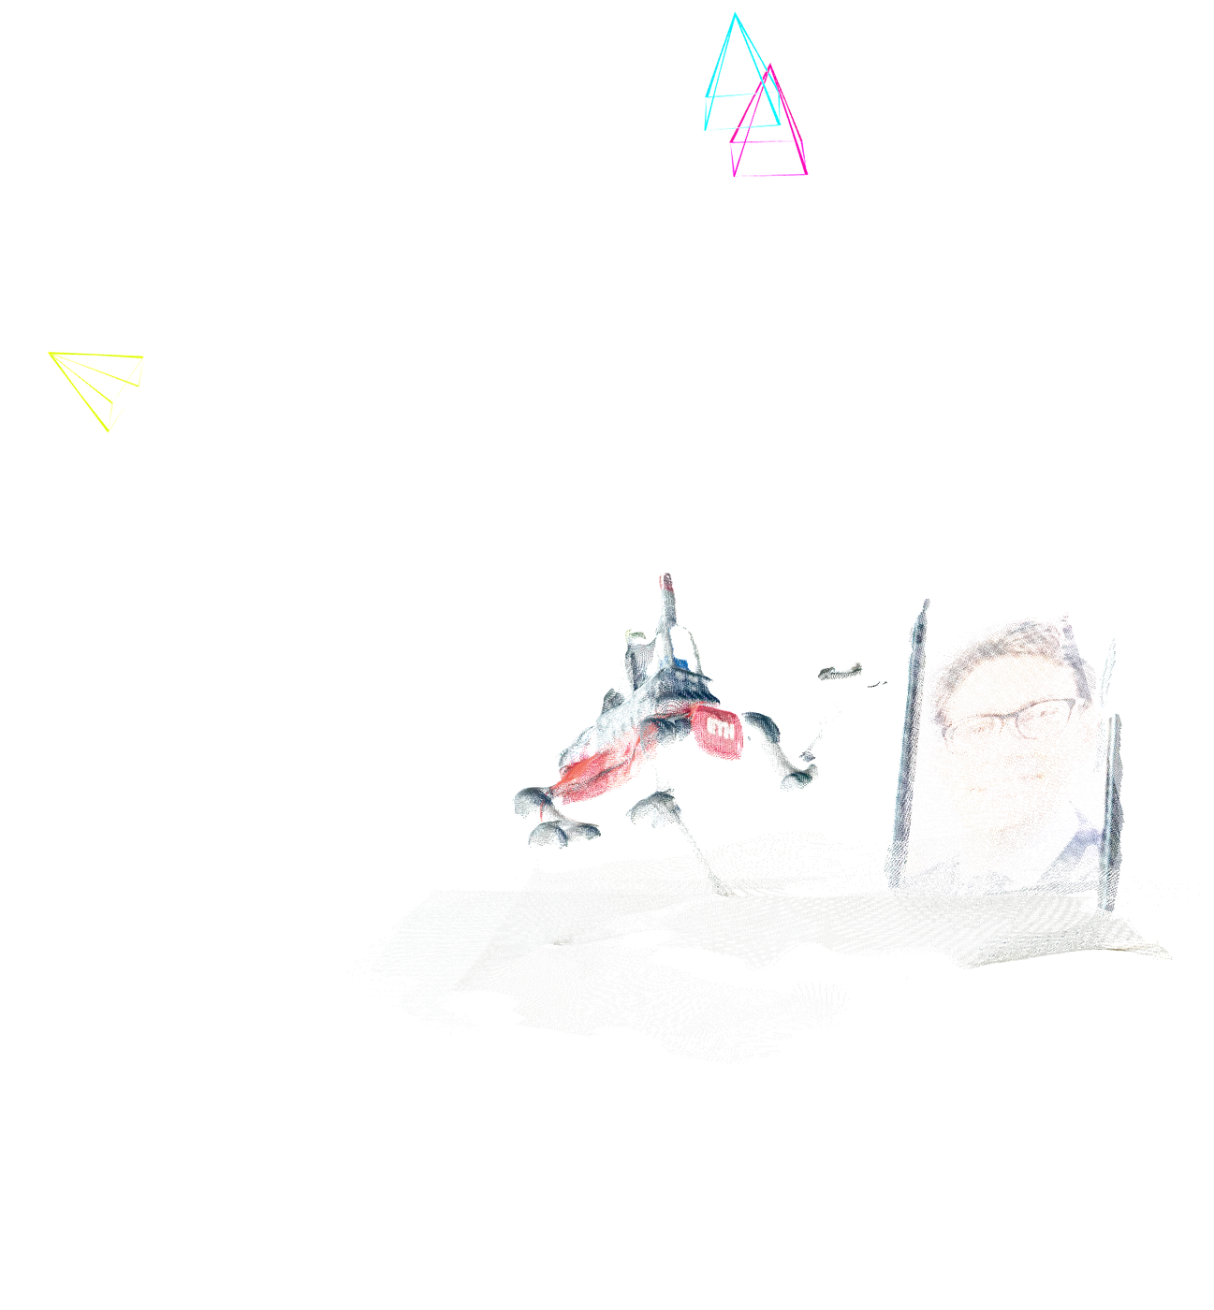
Lets and another image
Any other ideas ?
Wang, Jianyuan, Minghao Chen, Nikita Karaev, Andrea Vedaldi, Christian Rupprecht, and David Novotny. "Vggt: Visual geometry grounded transformer." In Proceedings of the Computer Vision and Pattern Recognition Conference, pp. 5294-5306. 2025.

Slide 12
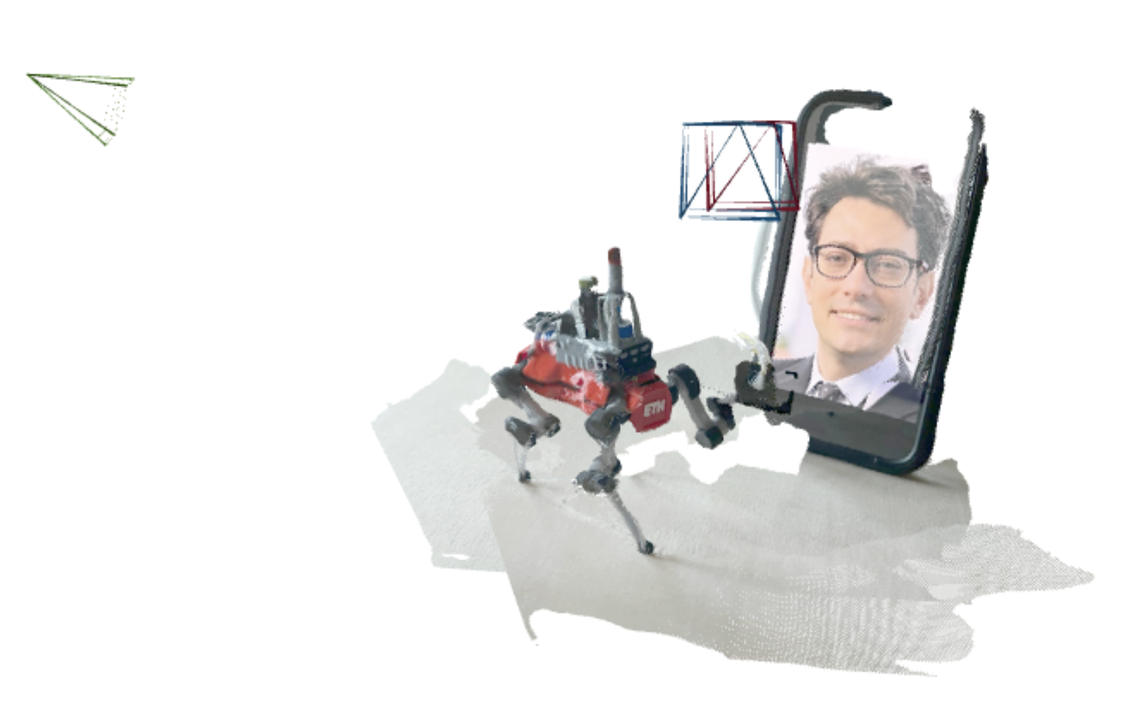
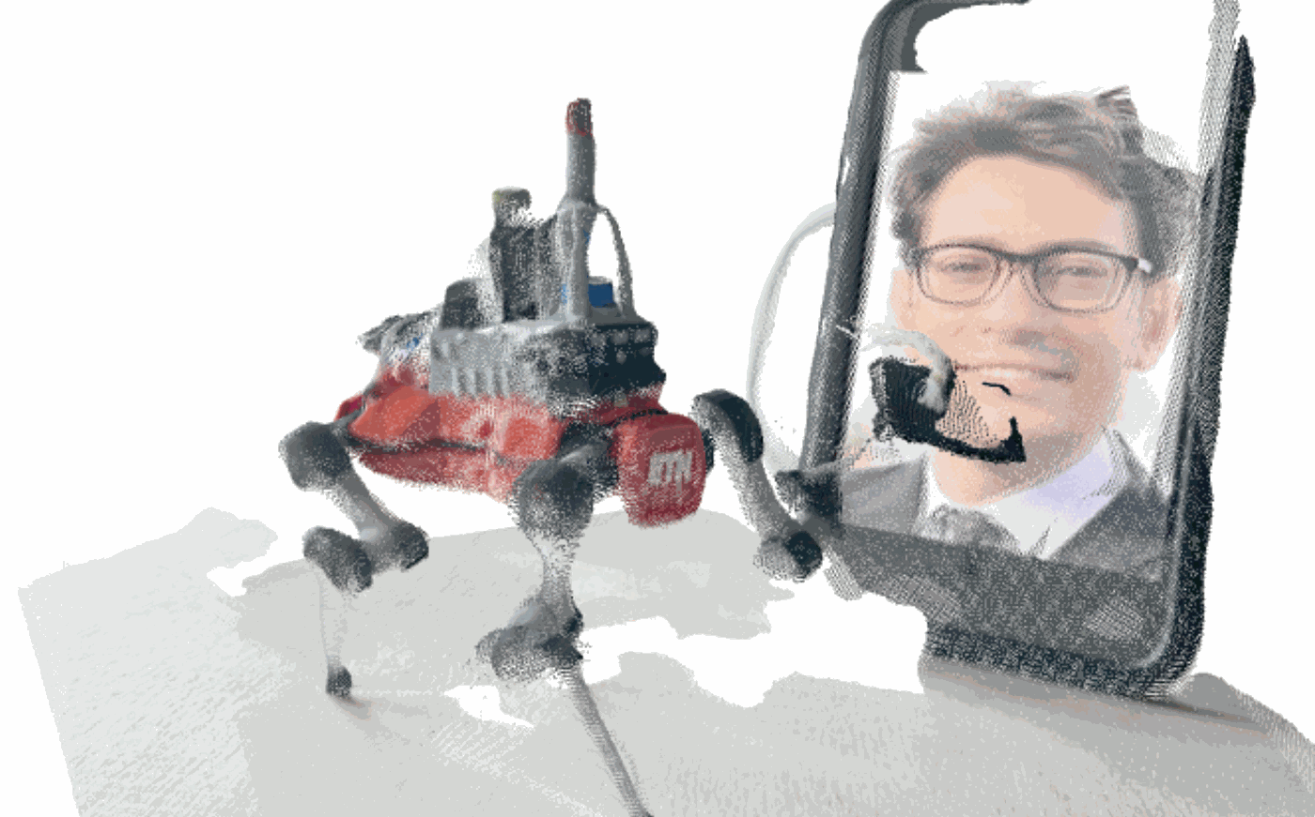
Confidence Threshold
Wang, Jianyuan, Minghao Chen, Nikita Karaev, Andrea Vedaldi, Christian Rupprecht, and David Novotny. "Vggt: Visual geometry grounded transformer." In Proceedings of the Computer Vision and Pattern Recognition Conference, pp. 5294-5306. 2025.

Slide 13
Agenda
Agenda
  Fundamental tools in image processing for filtering and detecting similarities
  Basic methods to detect and describe key features in images
Readings:
  Chapter 9, sections 9.1 – 9.3 in D. Gammelli, J. Lorenzetti, K. Luo, G. Zardini, M. Pavone. Principles of Robot Autonomy. 2026.

Slide 14
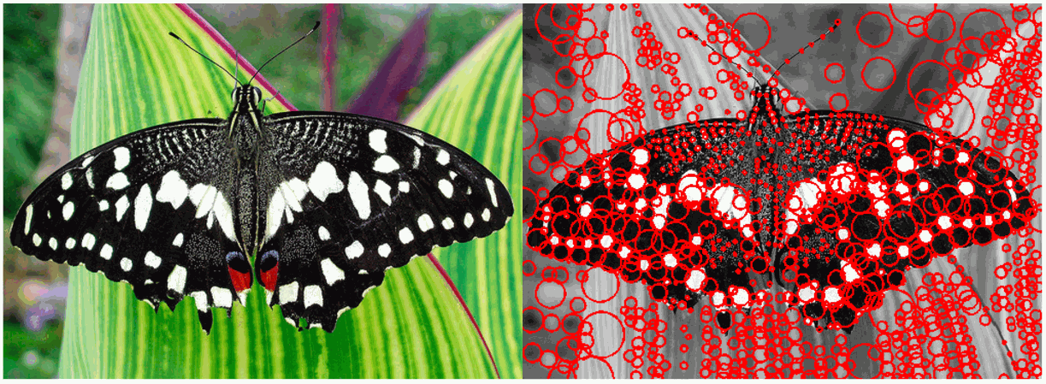
How to represent images?

Slide 15
Image processing pipeline
Signal treatment / filtering
Feature detection (e.g., DoG)
Feature description (e.g., SIFT)
Higher-level processing

Slide 16
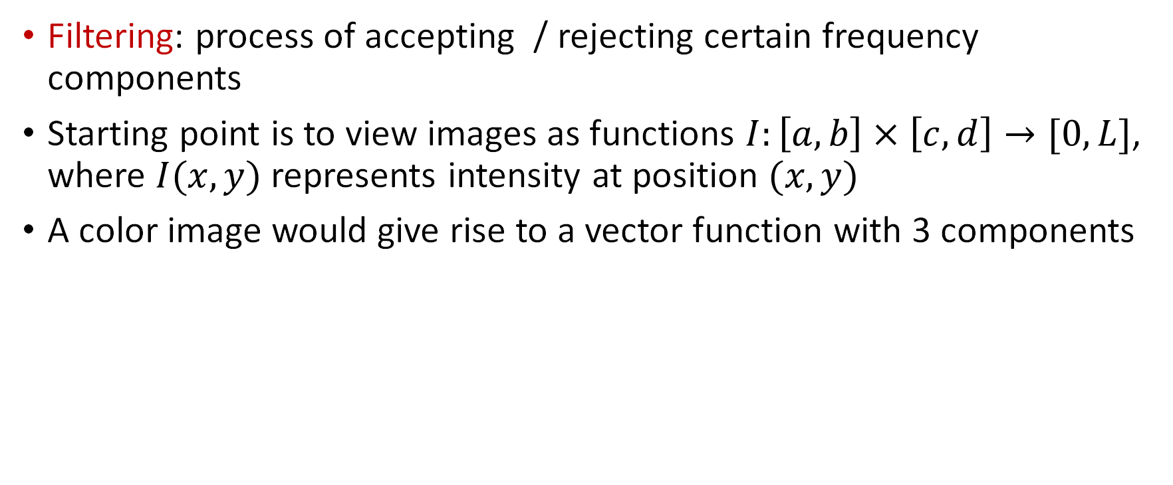
Image filtering
Filtering: process of accepting / rejecting certain frequency components
Starting point is to view images as functions $I:\left[a,b\right]×\left[c,d\right]→[0,L]$, where $I(x,y)$ represents intensity at position $(x,y)$
A color image would give rise to a vector function with 3 components
j
i
Represented as a matrix

Slide 17
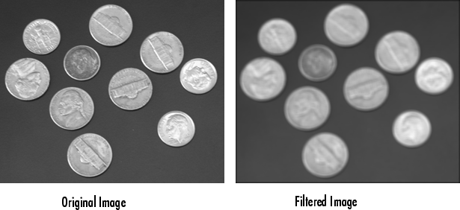
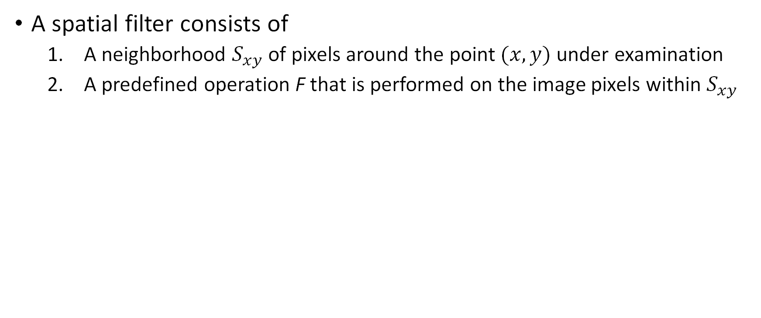
Spatial filters
A spatial filter consists of
  A neighborhood $S_{xy}$ of pixels around the point $(x,y)$ under examination
  A predefined operation F that is performed on the image pixels within $S_{xy}$

Slide 18
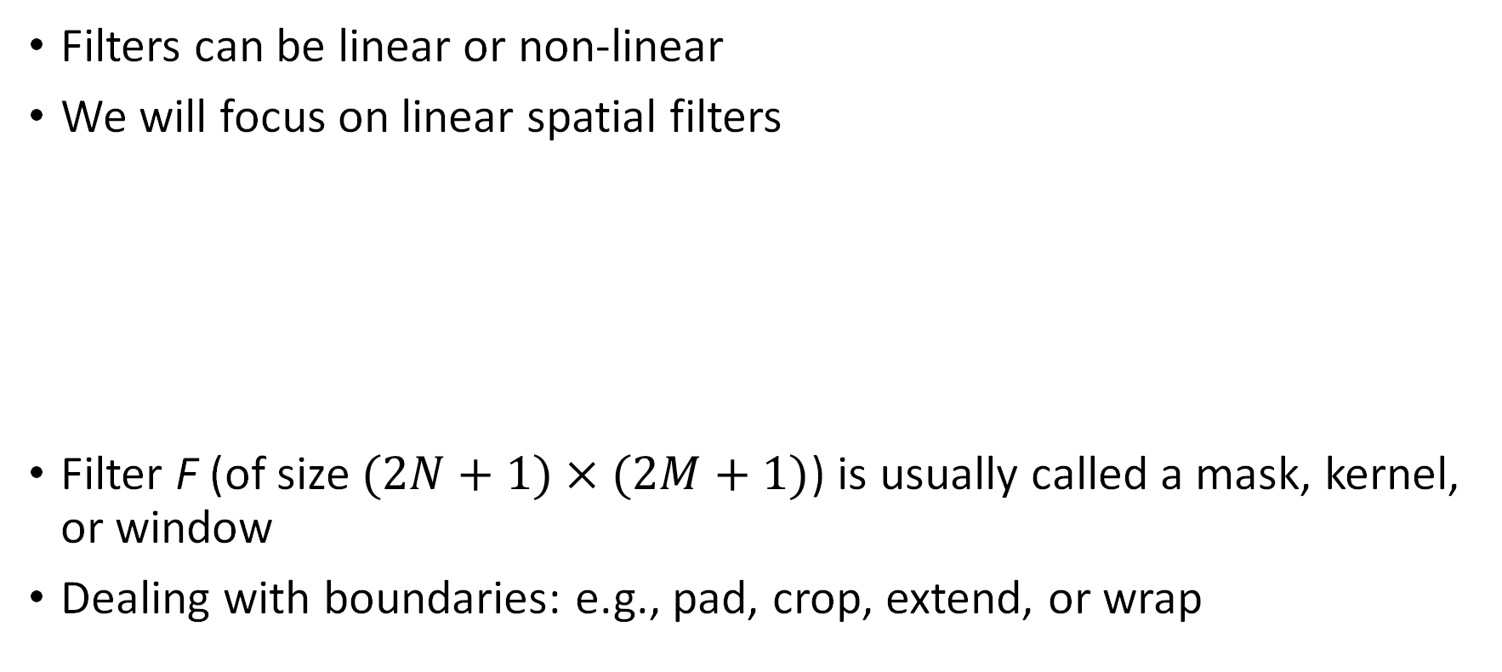
Linear spatial filters
Filters can be linear or non-linear
We will focus on linear spatial filters
Filter F (of size $(2N+1)×(2M+1)$) is usually called a mask, kernel, or window
Dealing with boundaries: e.g., pad, crop, extend, or wrap
Filtered image
Filter mask
Original image

Slide 19

Linear spatial filters
Filtered image
Filter mask
Original image

Slide 20
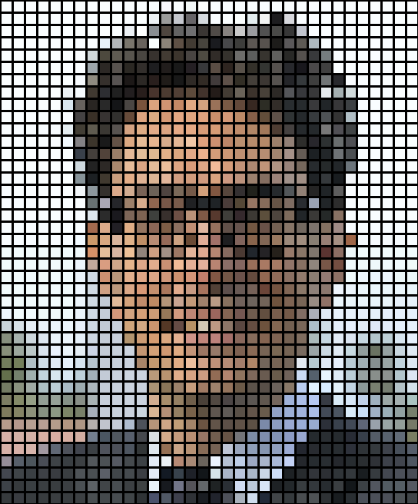
Linear spatial filters
Filtered image
Filter mask
Original image

Slide 21

Linear spatial filters
Filtered image
Filter mask
Original image

Slide 22
Image filtering
Filtering: process of accepting / rejecting certain frequency components
Starting point is to view images as functions $I:\left[a,b\right]×\left[c,d\right]→[0,L]$, where $I(x,y)$ represents intensity at position $(x,y)$
A color image would give rise to a vector function with 3 components
j
i
Represented as a matrix

Slide 23
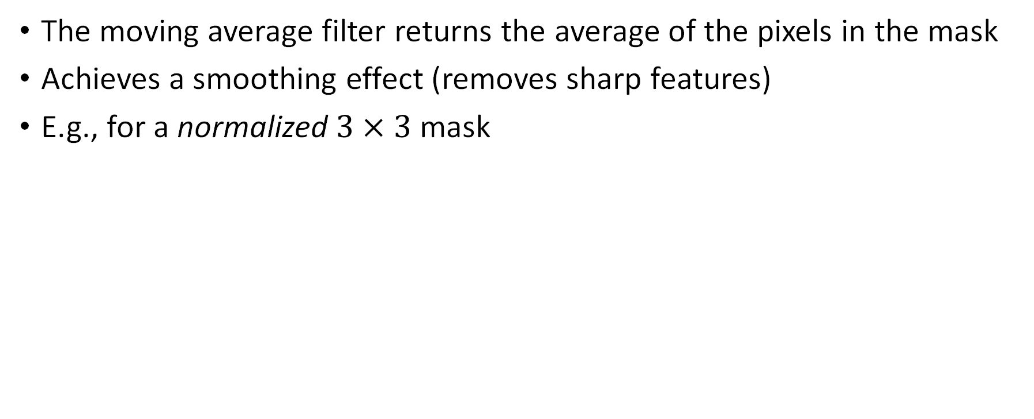
Filter example #1: moving average
The moving average filter returns the average of the pixels in the mask
Achieves a smoothing effect (removes sharp features)
E.g., for a normalized $3×3$ mask
What happens with the edges ?
Generated with a 5x5 mask

Slide 24
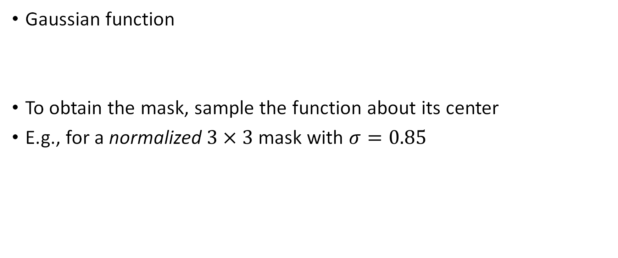
Filter example #2: Gaussian smoothing
Gaussian function
To obtain the mask, sample the function about its center
E.g., for a normalized $3×3$ mask with $σ=0.85$

Slide 25
Convolution
Still a linear filter, defined as
Same as correlation, but with negative signs for the filter indices
Correlation and convolution are identical when the filter is symmetric
Convolution enjoys the associativity property
Example: smooth image & take derivative = convolve derivative filter with Gaussian filter & convolve the resulting filter with the image

Slide 26
Convolution

Slide 27
Convolution

Slide 28
Convolution
Associativity

Slide 29
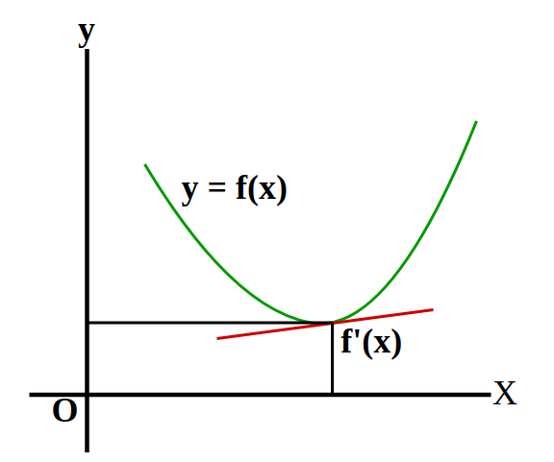
Differentiation Intuition
What is differentiation in the context of images ?

Slide 30
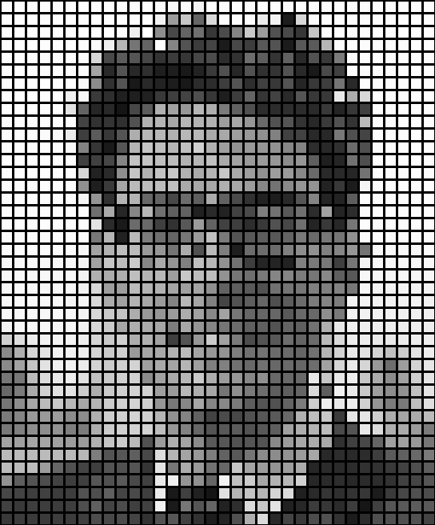
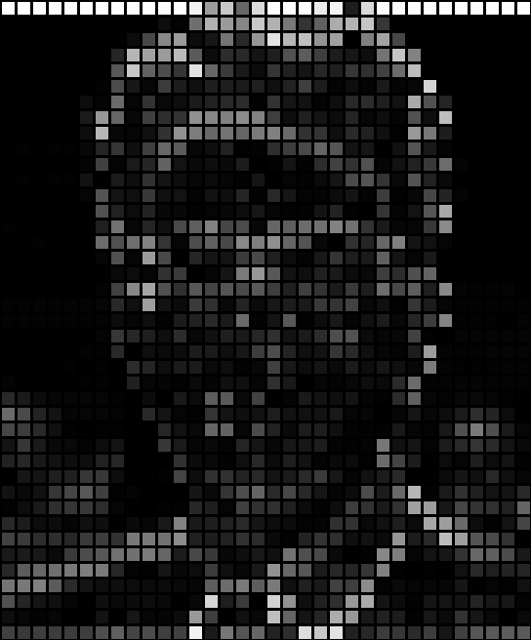
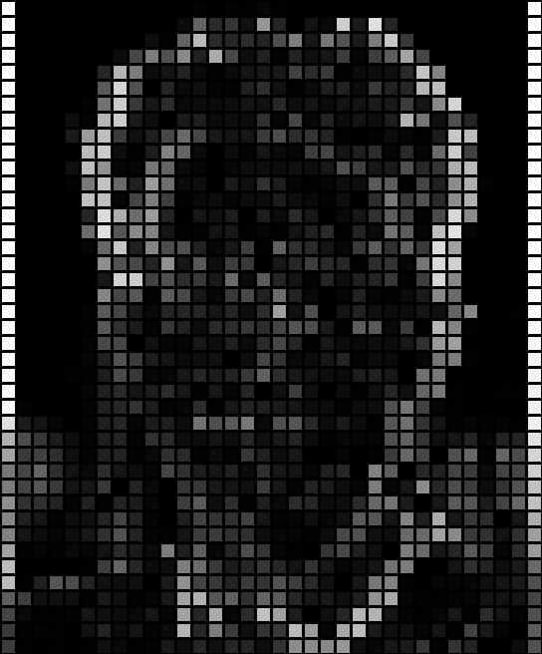
Differentiation Intuition

Slide 31

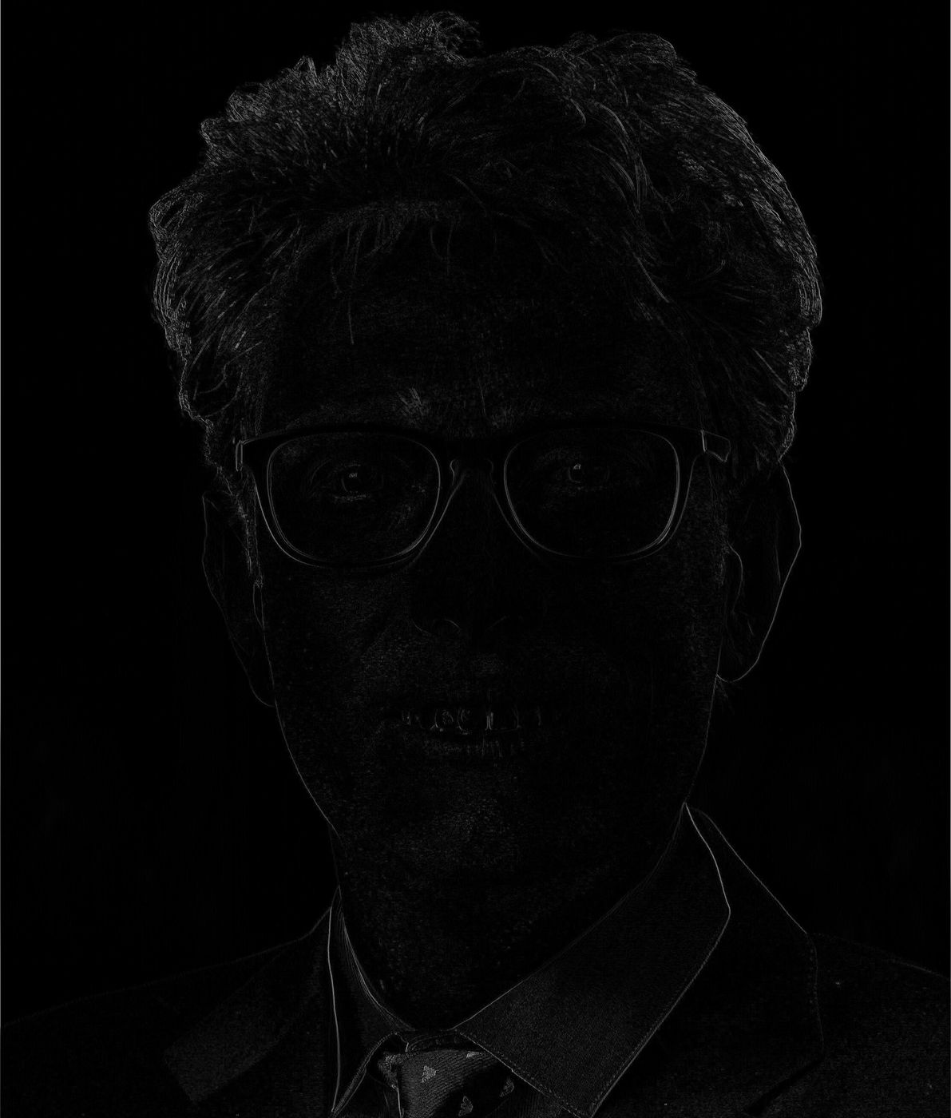
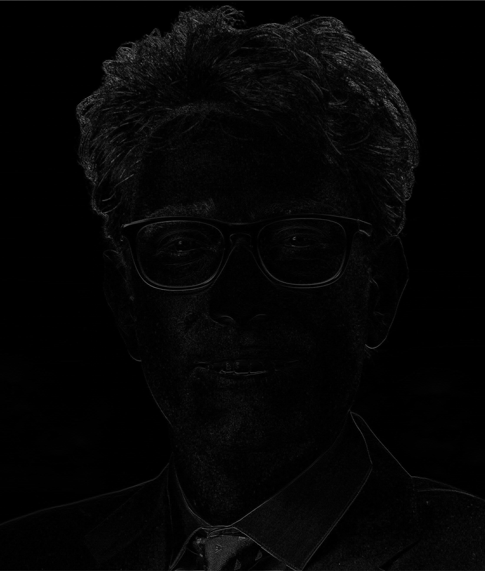

Differentiation Intuition
What filter size do we need?
What are the values ?

Slide 32
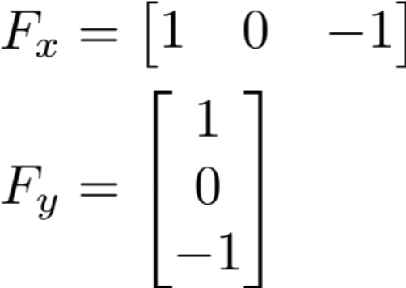
Differentiation
Derivative of discrete function (centered difference)
Derivative as a convolution operation; e.g., Sobel masks:
Along x direction
Along y direction
Note: masks are mirrored
In convolution

Slide 33
Similarity measures
Filtering can also be used to determine similarity across images (e.g., to detect correspondences)
Sum of absolute differences
Sum of squared differences

Slide 34
Detectors
Goal: detect local features, i.e., image patterns that differ from immediate neighborhood in terms of intensity, color, or texture
We will focus on
  Edge detectors
  Corner detectors

Slide 35
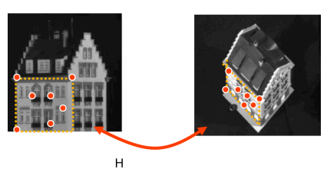
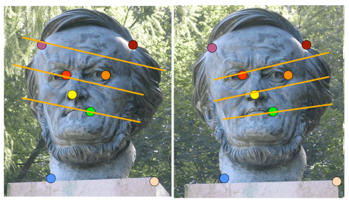
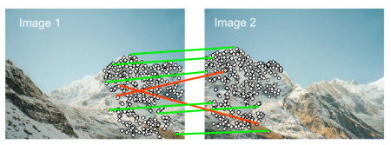
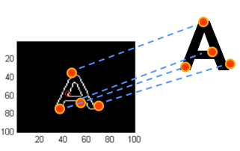
Use of detectors/descriptors: examples
Stereo reconstruction
Estimating homographic transformations
Panorama stitching
Object detection

Slide 36
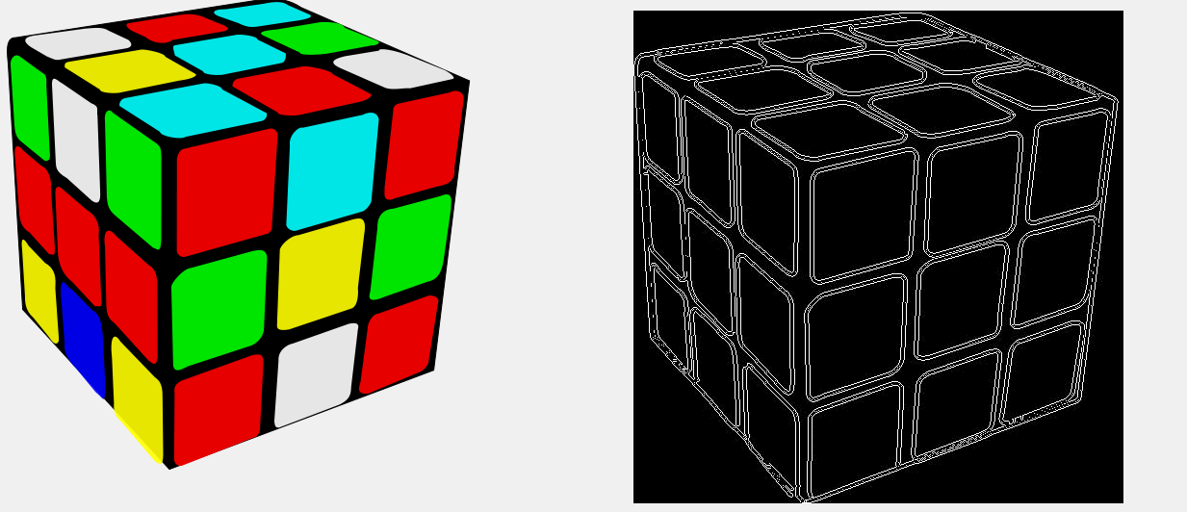
Edge detectors
Edge: region in an image where there is a significant change in intensity values along one direction, and negligible change along the orthogonal direction
In 1D
In 2D
Magnitude of 1st order derivative is large,
2nd order derivative is equal to zero

Slide 37
Criteria for “good” edge detection
Accuracy: minimize false positives and negatives
Localization: edges must be detected as close as possible to the true edges
Single response: detect one edge per real edge in the image

Slide 38
Strategy to design an edge detector
Two steps:
  Smoothing: smooth the image to reduce noise prior to differentiation (step 2)
  Differentiation: take derivatives along x and y directions to find locations with high gradients

Slide 39
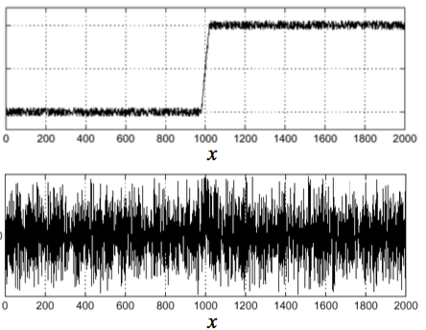
1D case: differentiation without smoothing

Slide 40
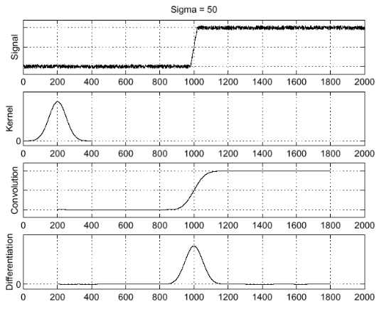
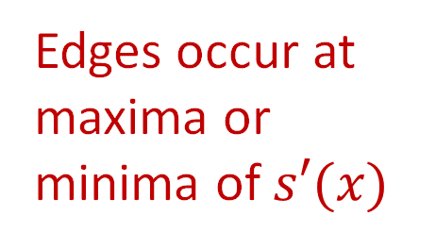
1D case: differentiation with smoothing
Edges occur at maxima or minima of $s′(x)$

Slide 41
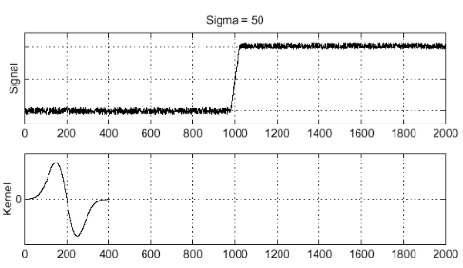
A better implementation
Convolution theorem:

Slide 42
Edge detection in 2D
Find the gradient of smoothed image in both directions
Compute the magnitude and discard pixels below a certain threshold
  Non-maximum suppression: identify local maxima of

Slide 43
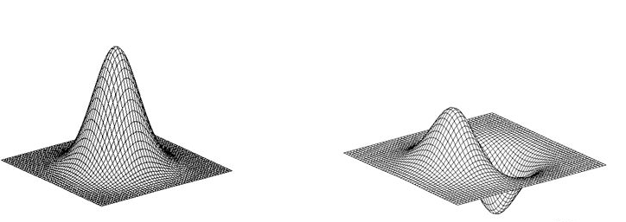
Derivative of Gaussian filter

Slide 44
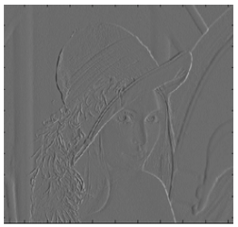
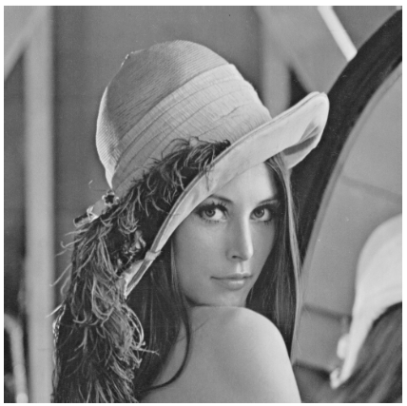
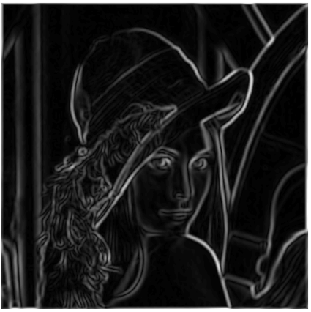
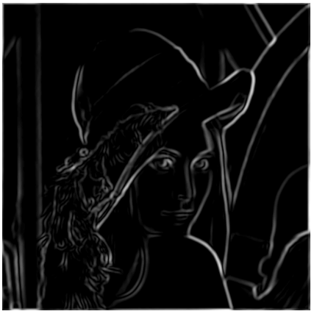
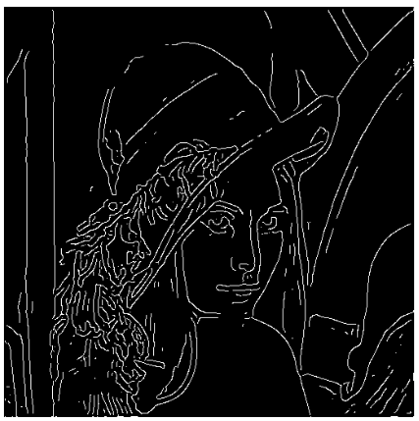

Canny edge detector
Suppression

Slide 45
Corner detectors
Key criteria for “good” corner detectors
Repeatability: same feature can be found in multiple images despite geometric and photometric transformations
Distinctiveness: information carried by the patch surrounding the feature should be as distinctive as possible

Slide 46

Repeatability
Without repeatability, matching is impossible

Slide 47

Distinctiveness
Without distinctiveness, it is not possible to establish reliable correspondences; distinctiveness is key for having a useful descriptor

Slide 48



Finding corners
Corner: intersection of two or more edges
Geometric intuition for corner detection: explore how intensity changes as we shift a window
Flat: no changes in
any direction
Edge: no change along
the edge direction
Corner: changes in
all directions

Slide 49

Harris detector: example

Slide 50
Properties of Harris detectors
Widely used
Detection is invariant to
  Rotation -> geometric invariance
  Linear intensity changes -> photometric invariance
Detection is not invariant to
  Scale changes
  Geometric affine changes
Corner
All points classified as edges!

Slide 51
Properties of Harris detectors
Widely used
Detection is invariant to
  Rotation -> geometric invariance
  Linear intensity changes -> photometric invariance
Detection is not invariant to
  Scale changes
  Geometric affine changes
Corner
Scale-invariant detection, such as
Harris-Laplacian
in SIFT (specifically, Difference of Gaussians (DoG))
All points classified as edges!

Slide 52

Descriptors
Goal: describe keypoints so that we can compare them across images or use them for object detection or matching
Desired properties:
  Invariance with respect to pose, scale, illumination, etc.
  Distinctiveness

Slide 53


Simplest descriptor
Naïve descriptor: associate with a given keypoint an $n×m$ window of pixel intensities centered at that keypoint
Window can be normalized to make it invariant to illumination
Main drawbacks
Sensitive to pose
Sensitive to scale
Poorly distinctive

Slide 54

Popular detectors / descriptors
SIFT (Scale-Invariant Feature Transformation)
  Invariant to rotation and scale, but computationally demanding
  SIFT descriptor is a $128$-dimensional vector!
SURF
FAST
BRIEF
ORB
BRISK
LIFT

Slide 55

A different paradigm: using CNNs to detect and describe features

Slide 56

Next time

