Slide 1
Principles of Robot Autonomy I
Information extraction

Slide 2
Agenda
Agenda
  Introducing SiFT
  Extracting information from sensor measurements
Readings:
  Chapters 11 in PoRA lecture notes

Slide 3
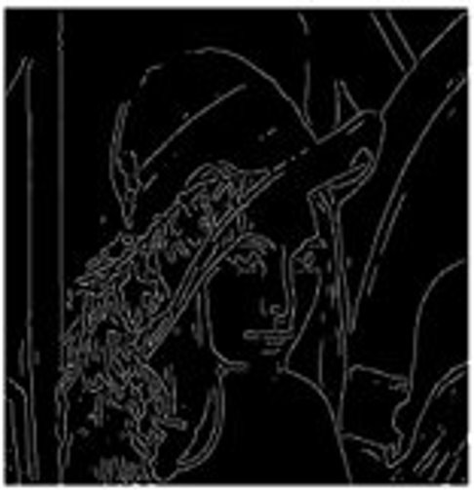
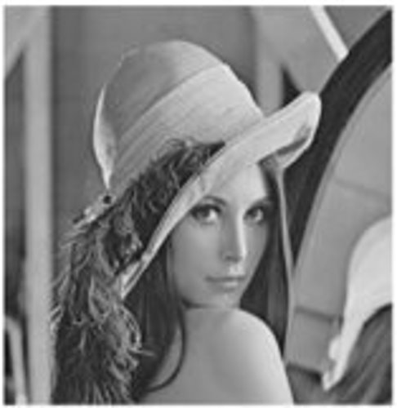
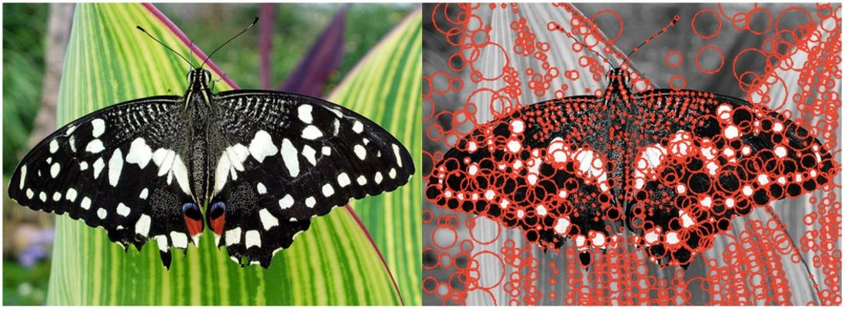
Last lecture: Recap
Image processing, feature detection and description, such as:
  Correlation / convolution filtering operations (left figure)
  Feature descriptors for detecting salient keypoints (right figure)
Keypoints from e.g., SIFT
Canny edge detector
(filter + convolution)

Slide 4
Recap Feature Detection
Repeatability: same feature can be found in multiple images despite geometric and photometric transformations
Distinctiveness: information carried by the patch surrounding the feature should be as distinctive as possible

Slide 5
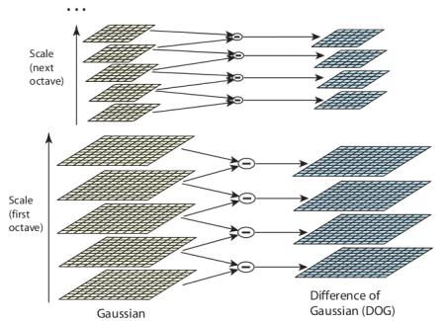
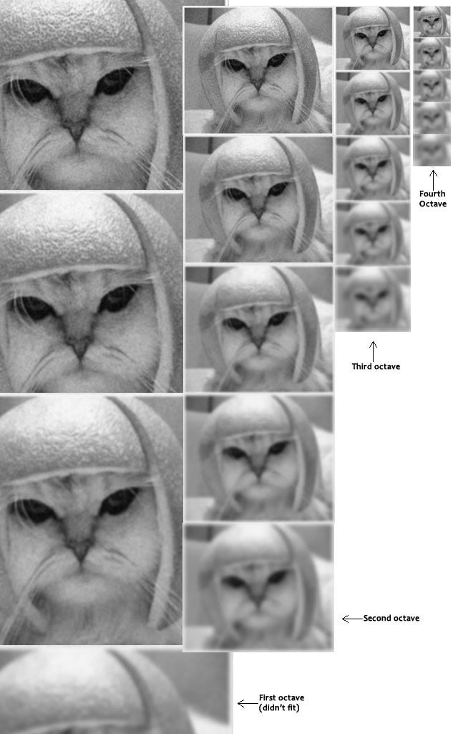
Introducing SiFT Detector
https://www.youtube.com/watch?v=4AvTMVD9ig0
https://docs.opencv.org/4.x/da/df5/tutorial_py_sift_intro.html

Slide 6
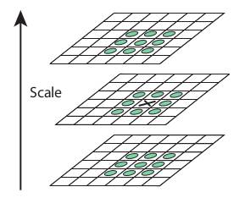
Introducing SiFT Detector
https://www.youtube.com/watch?v=4AvTMVD9ig0
https://docs.opencv.org/4.x/da/df5/tutorial_py_sift_intro.html

Slide 7
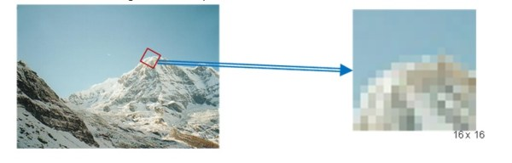
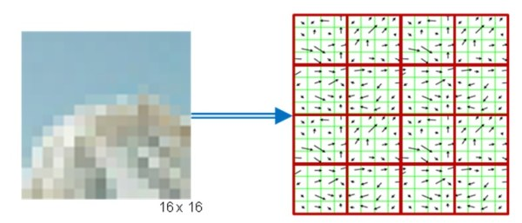
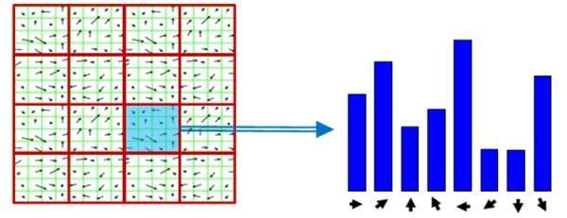
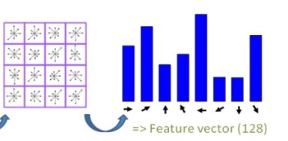
Introducing SiFT Descriptor
https://gilscvblog.com/2013/08/18/a-short-introduction-to-descriptors/

Slide 8
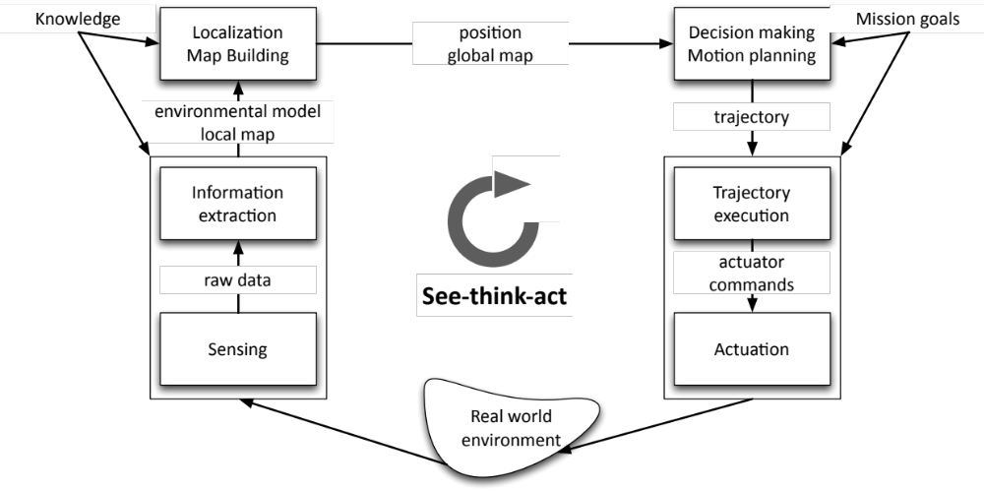
The see-think-act cycle

Slide 9
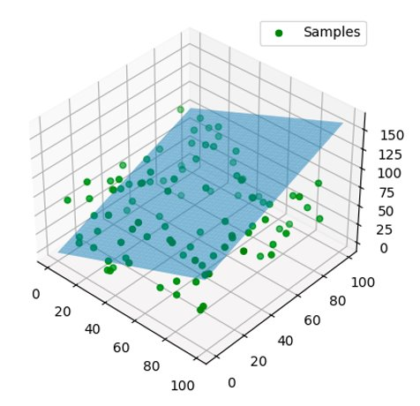
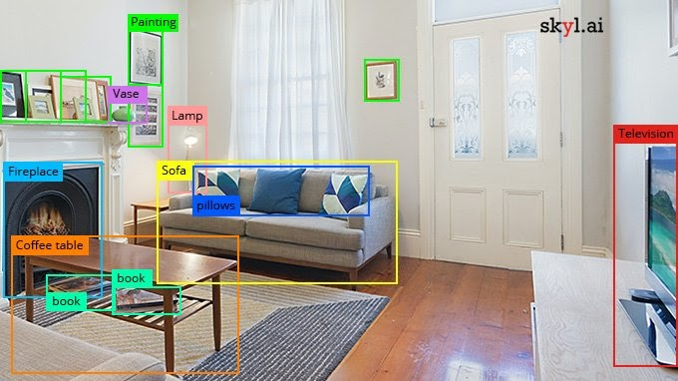
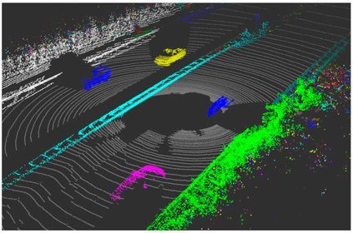
Information extraction
Today's focus: extracting actionable information from images
  Geometric primitives (e.g., lines and circles): useful, for example, for robot localization and mapping
  Scene understanding and object recognition: useful, for example , for localization within a topological map and for high-level reasoning
Example (Geometric primitive):
Plane Fitting
Example (Scene understanding):
Object detection

Slide 10
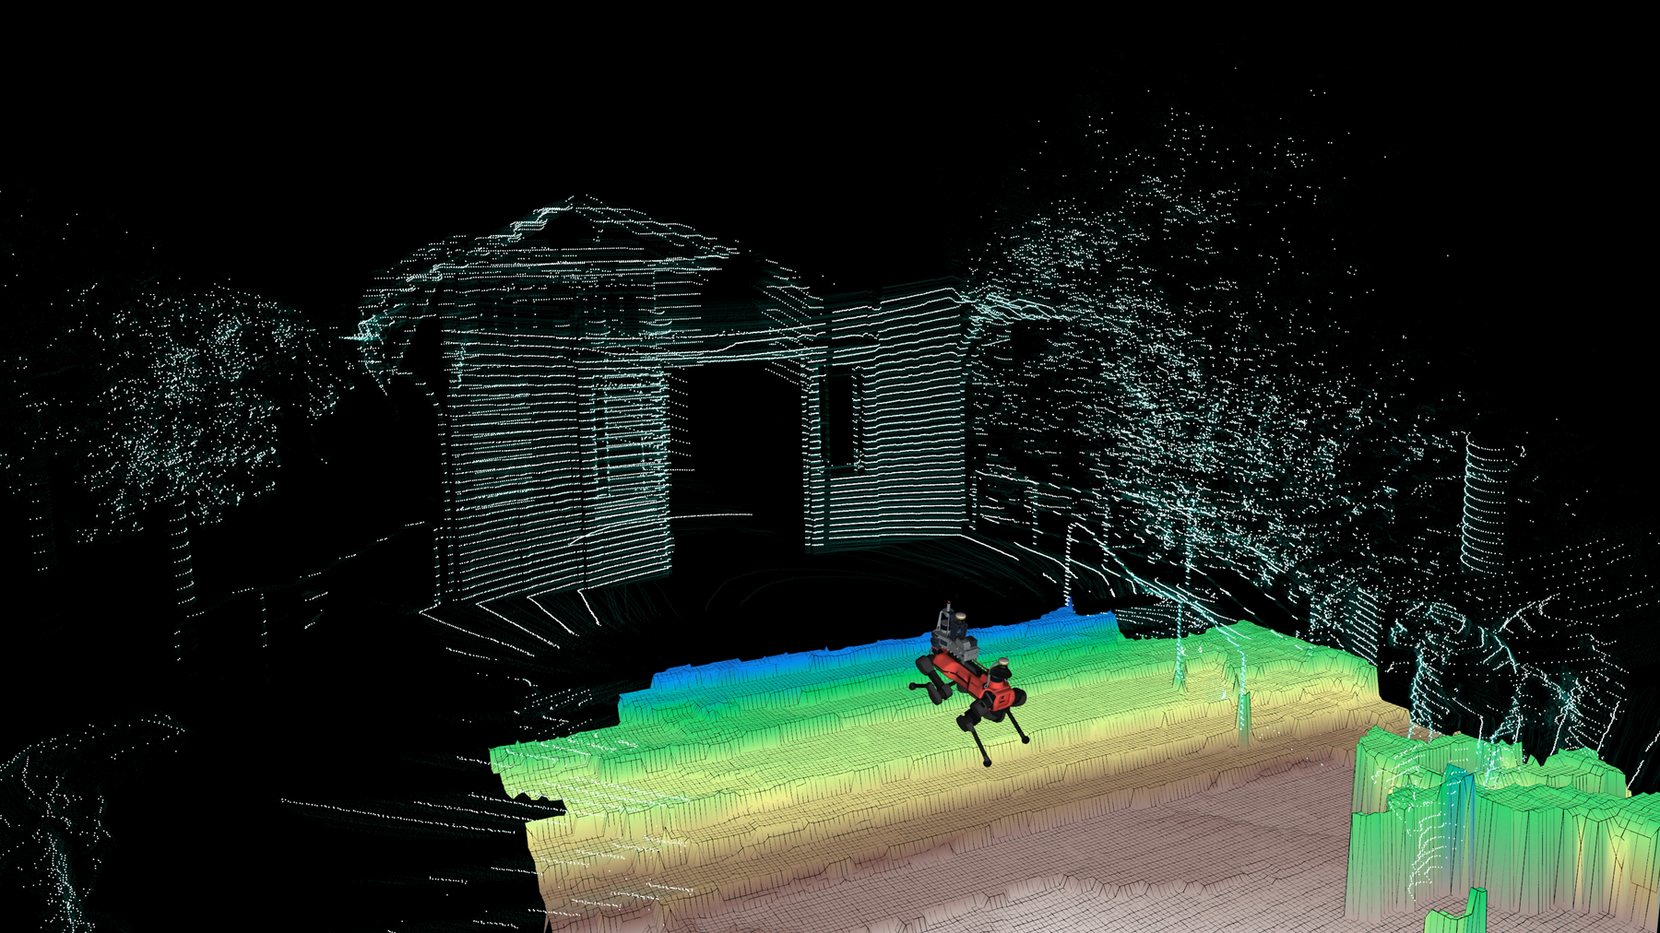
LiDAR data

Slide 11
See – Think – Act
1. Our robot sees points
(x,y,z)
2. We fit an elevation map to the data
3. We act based on the map representation

Slide 12
Geometric information extraction
Geometric feature extraction: extract geometric primitives from sensor data (e.g., range data)
Examples: line, circles, corners, planes, etc.
We focus on line extraction from range data (a quite common task); other geometric feature extraction tasks are conceptually analogous
The two main problems of line extraction from range data
  Which points belong to which line? → segmentation
  Given an association of points to a line, how to estimate line parameters? → fitting

Slide 13
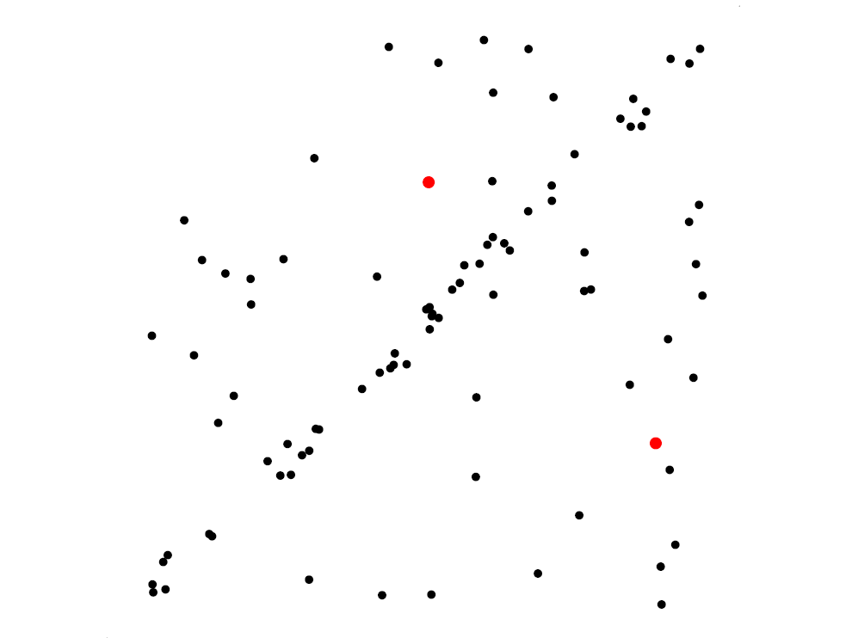
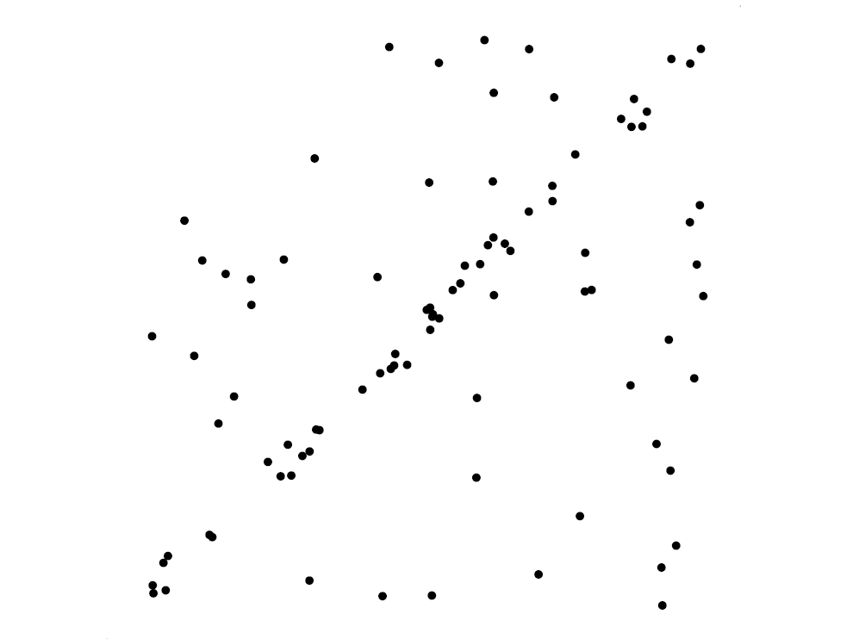
Intuition Line Fitting

Slide 14
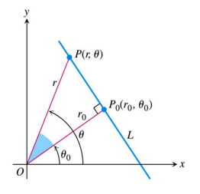
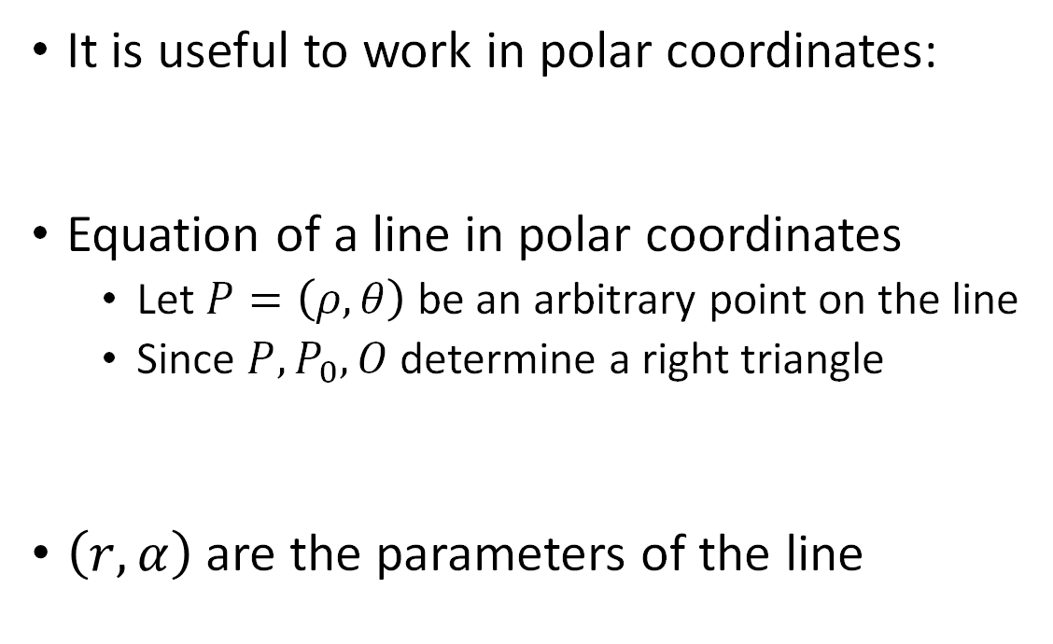
Step #2: line fitting
Goal: fit a line to a set of sensor measurements
It is useful to work in polar coordinates:
Equation of a line in polar coordinates
  Let $P=\left(ρ, θ\right)$ be an arbitrary point on the line
  Since $P,P_{0}, O$ determine a right triangle
$\left(r, α\right)$ are the parameters of the line

Slide 15
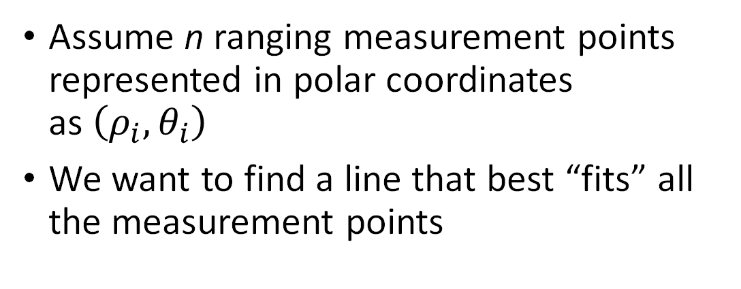
Step #2: line fitting
Since there is measurement error, the equation of the line is only approximately satisfied
Error
Assume n ranging measurement points represented in polar coordinates as$\left(ρ_{i}, θ_{i}\right)$
We want to find a line that best “fits” all the measurement points

Slide 16
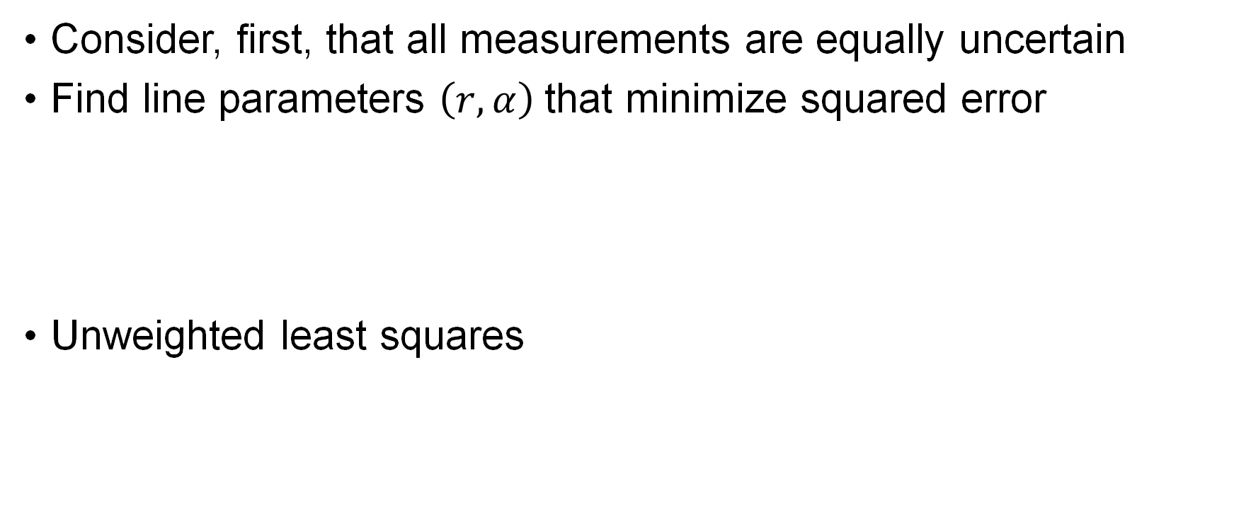
Step #2: line fitting
Consider, first, that all measurements are equally uncertain
Find line parameters $\left(r, α\right)$that minimize squared error
Unweighted least squares

Slide 17
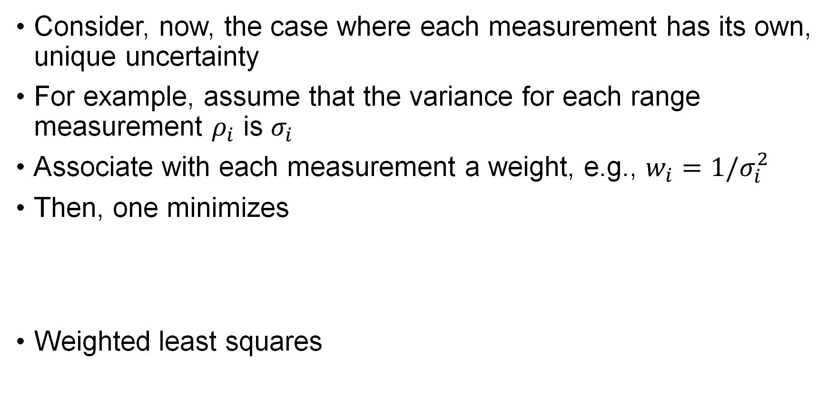
Step #2: line fitting
Consider, now, the case where each measurement has its own, unique uncertainty
For example, assume that the variance for each range measurement $ρ_{i}$ is $σ_{i}$
Associate with each measurement a weight, e.g., $w_{i}=1/σ_{i}^{2}$
Then, one minimizes
Weighted least squares

Slide 18
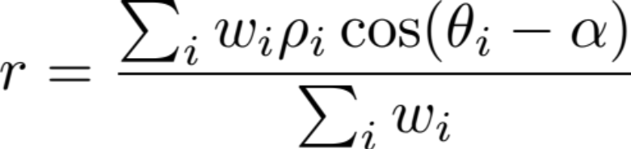
Step #2: line fitting solution
Assume that the n ranging measurements are independent
Solution:

Slide 19
Step #1: line segmentation
Several algorithms are available
  Split-and-merge
  RANSAC
  Hough-Transform
We will focus on RANSAC

Slide 20
RANSAC
RANSAC: Random Sample Consensus
General method to estimate parameters of a model from a set of observed data in the presence of outliers, where outliers should have no influence on the estimates of the values
Typical applications in robotics: line extraction from 2D range data, plane extraction from 3D point clouds, feature matching for structure from motion, etc.
RANSAC is iterative and non-deterministic: the probability of finding a set free of outliers increases as more iterations are used

Slide 21
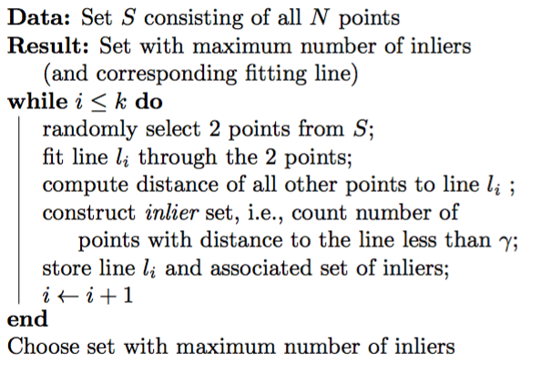
RANSAC

Slide 22
RANSAC

Slide 23
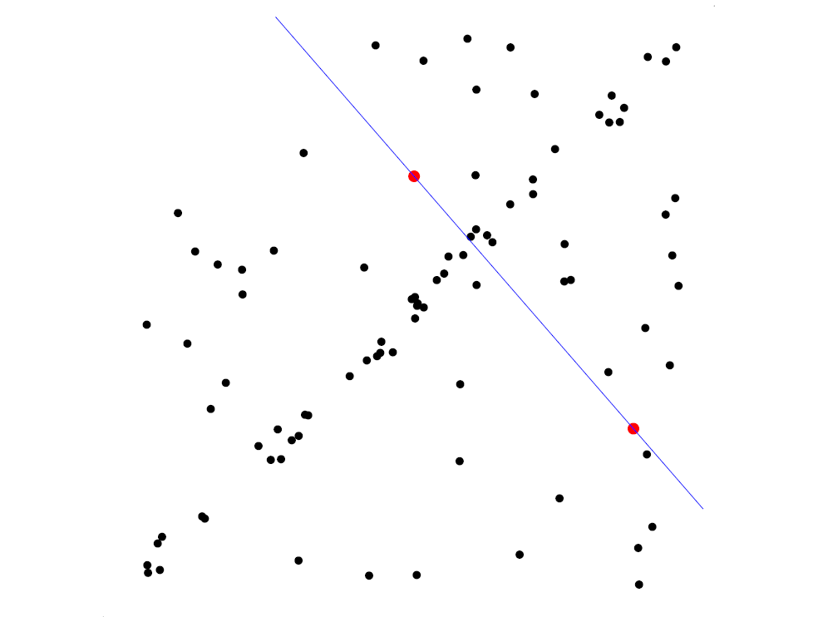
RANSAC

Slide 24
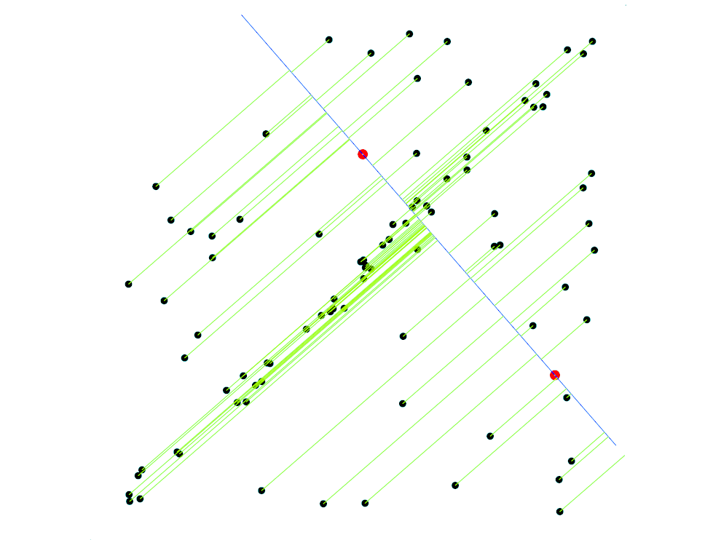
RANSAC

Slide 25
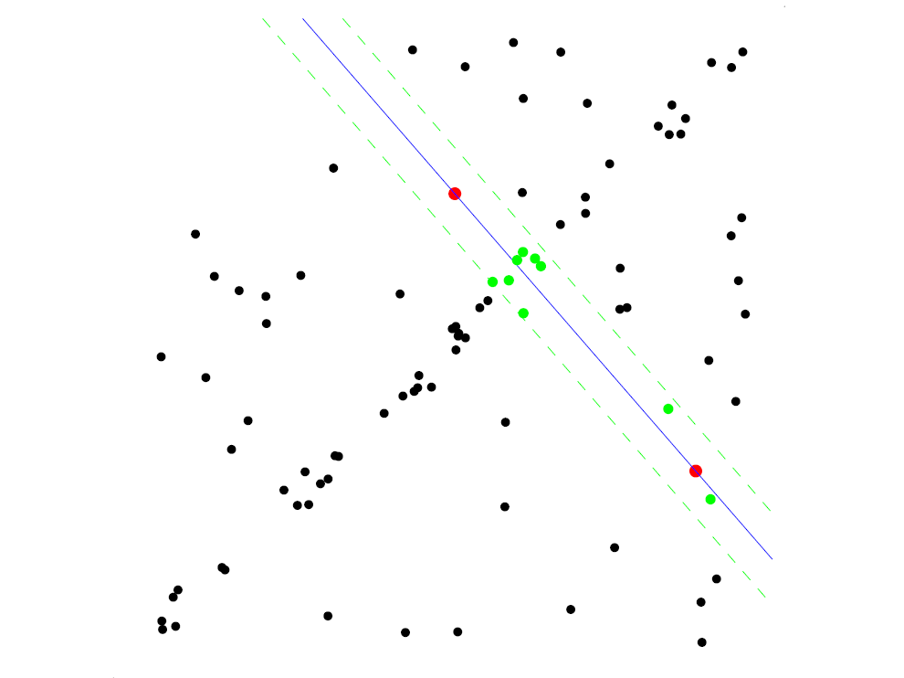
RANSAC

Slide 26
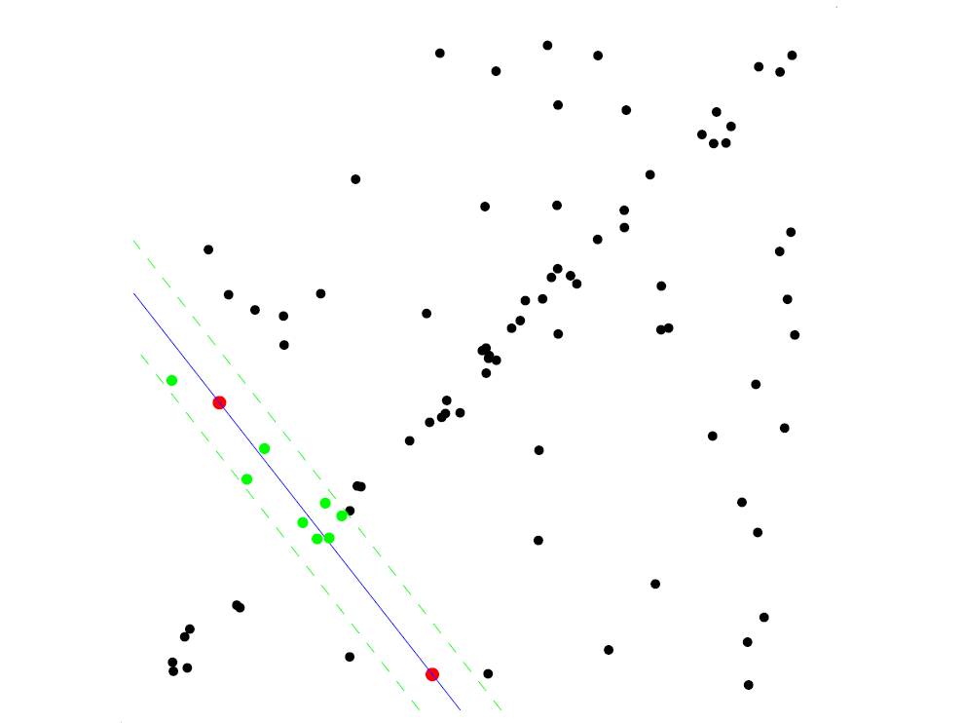
RANSAC

Slide 27
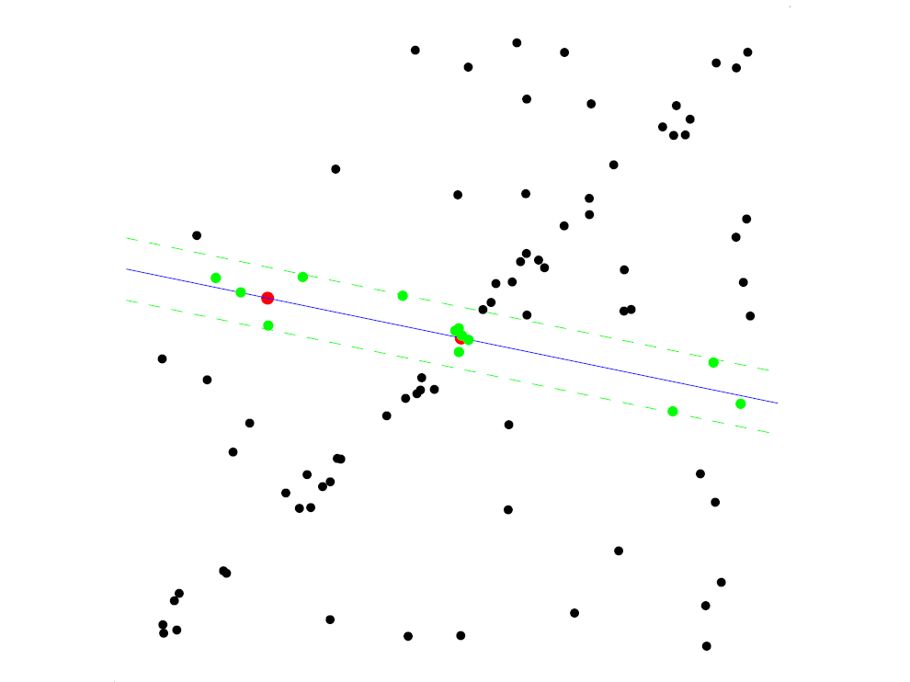
RANSAC

Slide 28
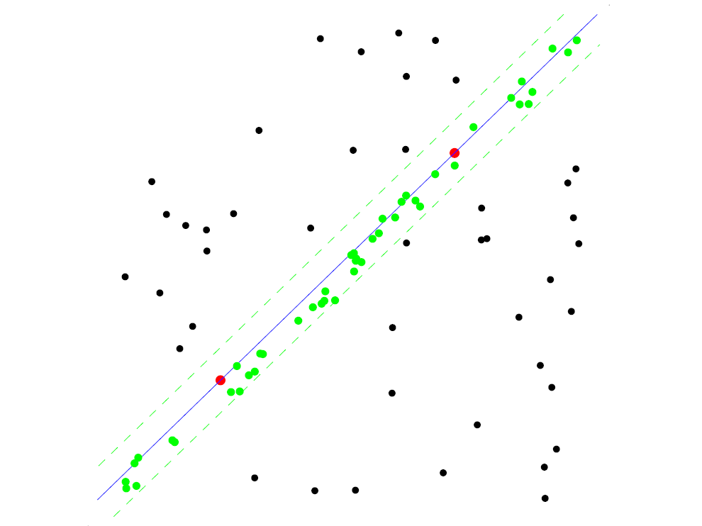
RANSAC

Slide 29
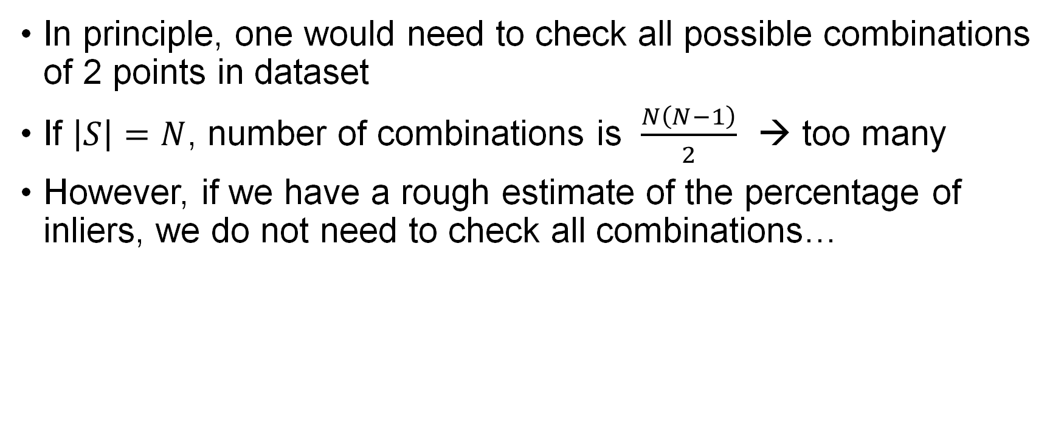
RANSAC iterations
In principle, one would need to check all possible combinations of 2 points in dataset
If $\left|S\right|=N$, number of combinations is $\frac{N\left(N−1\right)}{2}$ → too many
However, if we have a rough estimate of the percentage of inliers, we do not need to check all combinations…

Slide 30
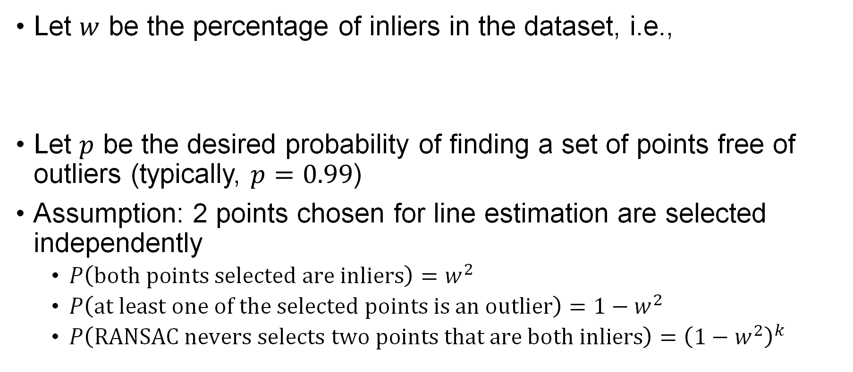
RANSAC iterations: statistical characterization
Let $w$ be the percentage of inliers in the dataset, i.e.,
Let $p$ be the desired probability of finding a set of points free of outliers (typically, $p=0.99$)
Assumption: 2 points chosen for line estimation are selected independently
  $P\left(both points selected are inliers\right)=w^{2}$
  $P\left(at least one of the selected points is an outlier\right)=1−w^{2}$
  $P\left(RANSAC nevers selects two points that are both inliers\right)={\left(1−w^{2}\right)}^{k}$

Slide 31
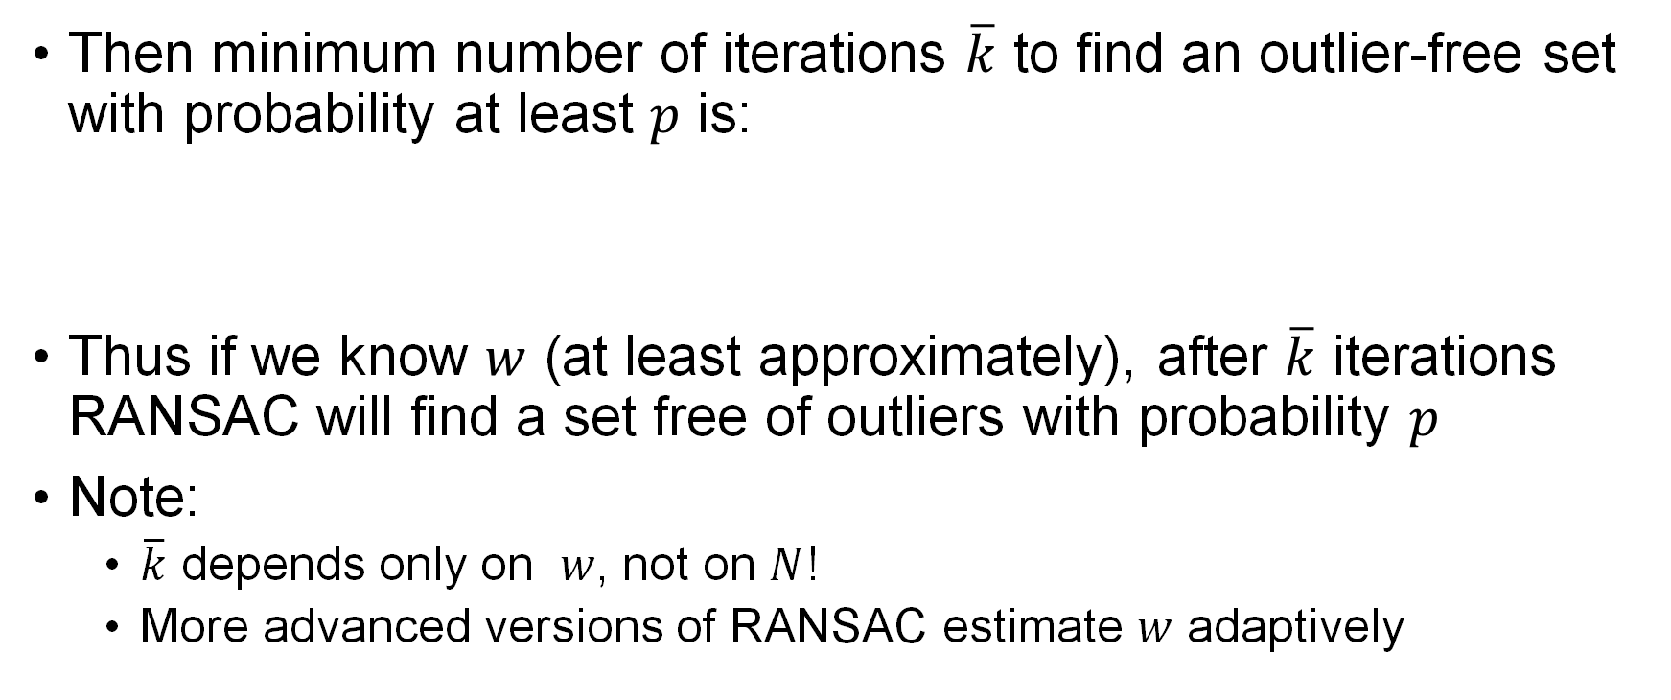
RANSAC iterations: statistical characterization
Then minimum number of iterations $\overline{k}$ to find an outlier-free set with probability at least $p$ is:
Thus if we know $w$ (at least approximately), after $\overline{k}$ iterations RANSAC will find a set free of outliers with probability $p$
Note:
  $\overline{k}$ depends only on $w$, not on $N$!
  More advanced versions of RANSAC estimate $w$ adaptively

Slide 32
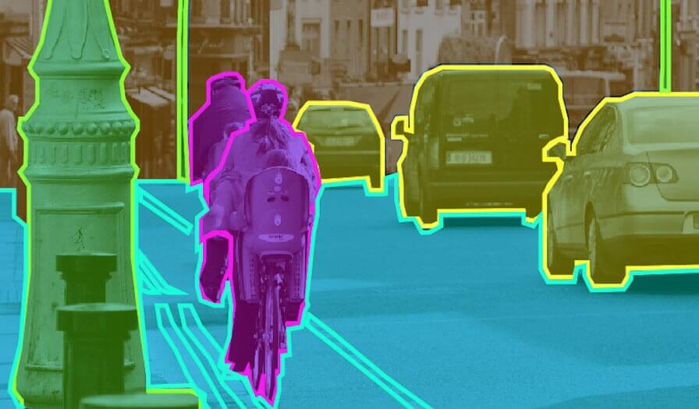
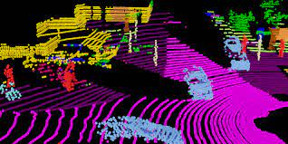
Semantic information extraction
Semantic information: higher-level scene information in sensor data (e.g., images) like objects, their locations, and relationships
Encompasses a broad class of perception algorithms:
  Object detection, semantic segmentation, object recognition, tracking
  Conceptually: seeks to ground raw sensor data into structured information useful for downstream robot reasoning and action
Image-based semantic segmentation
LiDAR-based semantic segmentation

Slide 33
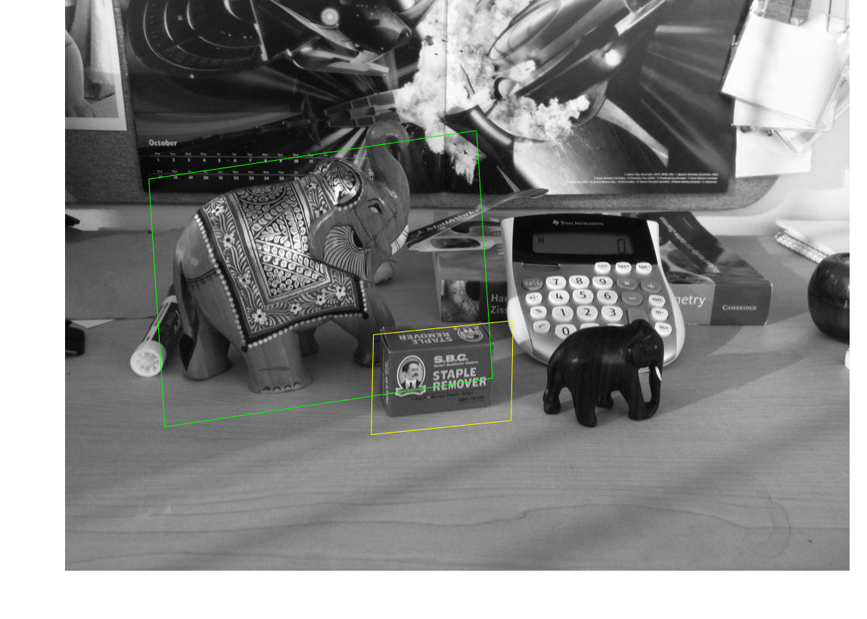
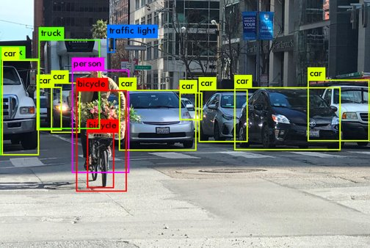
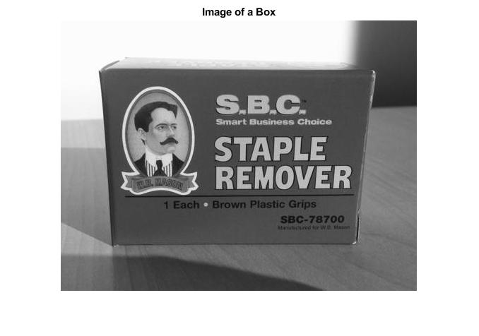
Object detection
Example of semantic extraction: object detection
  Given a source image of an object, localize the object in the target image
  What if the object is rotated, translated, scaled, partially occluded?
  Solution: rely on stable feature detectors / descriptors for object detection
Today's detector
(feature-based, still relevant!)
Modern detectors
(learned-based, DNNs)

Slide 34
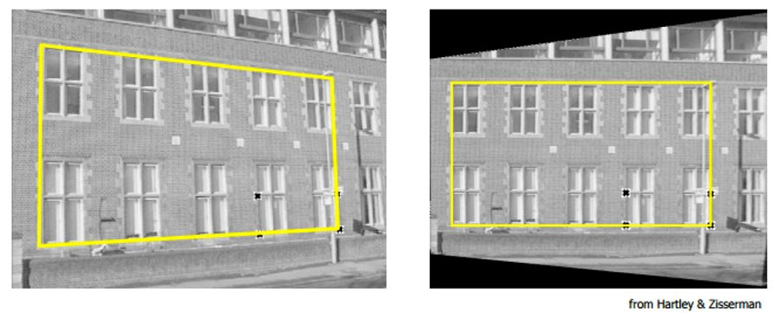
Object detection
The main problems in feature-based object detection are:
  Feature matching: detect and match object features across images
  Model fitting: fit homography to predict object location in the target image
Aside on homography
  Maps plane in one image to plane in another image
  Relevant for step "b." above
Projecting bounding box using homography

Slide 35
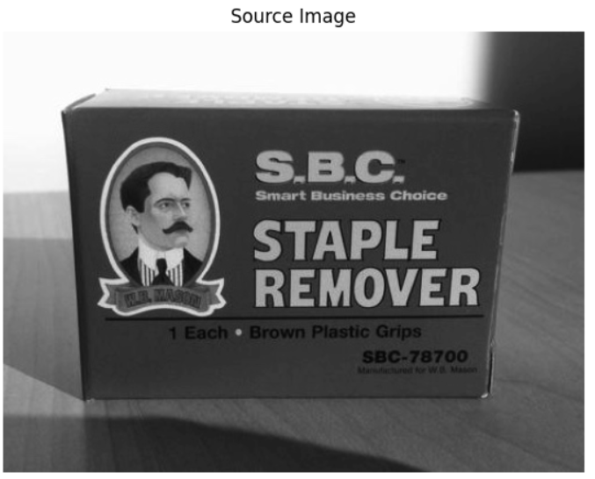
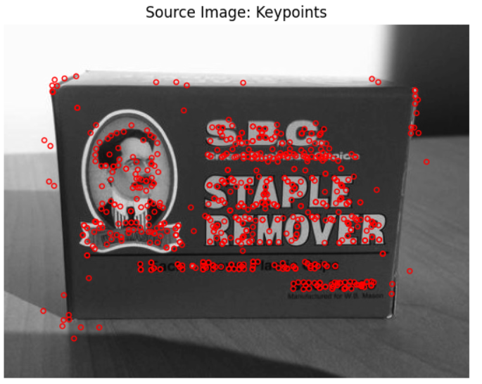
Step #1: Detect keypoints
Goal: Detect stable and salient keypoints of the object
Will make use of feature detectors and descriptors
  Choices include SIFT, SURF, FAST, BRISK, ORB, amongst others
  Many will work, some more efficiently or reliably depending on the setting
  In this example, we use SIFT
SIFT
Scale invariance of SIFT

Slide 36
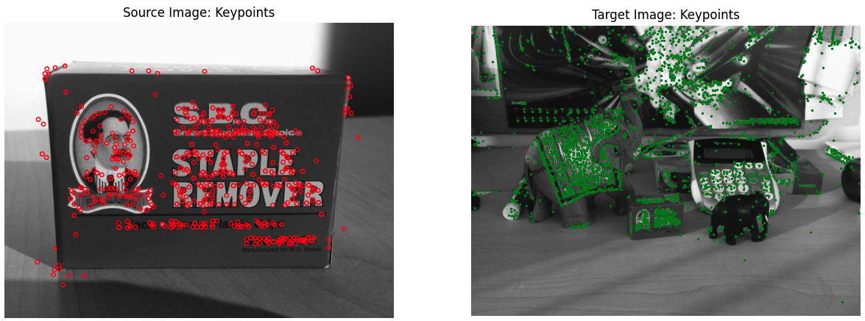
Step #1: Detect keypoints
Goal: Detect stable and salient keypoints of the object
Will make use of feature detectors and descriptors
  Choices include SIFT, SURF, FAST, BRISK, ORB, amongst many others
  Many will work, some more efficiently and/or reliably in a desired setting
  In this example, we use SIFT
Q: But, how do we associate keypoints in the source image to keypoints in the target image?

Slide 37
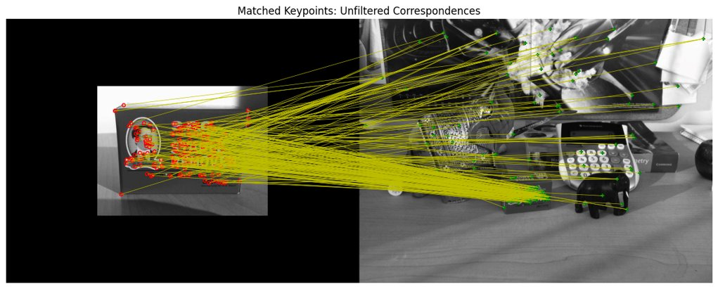

Step #2: Match keypoints
Goal: Attempt to match keypoints across images
Matching criterion depends on choice of descriptor
  E.g., SIFT uses L2-norm, while ORB uses Hamming distance
  Threshold match scores to get an initial set of correspondences
Careful, manually set "good" match thresholds
will often produce outliers!

Slide 38
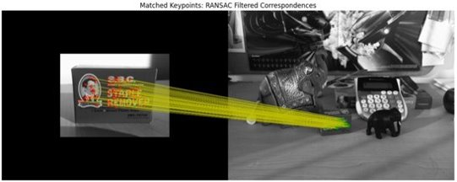
Step #3: Model fitting and outlier rejection
Goal: Estimate homography between images and filter outliers
Another application of RANSAC: fit the model (i.e., homography) while simultaneously rejecting outlier matches
Given hypothesis homography (H), a keypoint match
is considered an "inlier" if
RANSAC in a nutshell:
Find best homography H with the most inliers
Reject outliers under best homography H

Slide 39
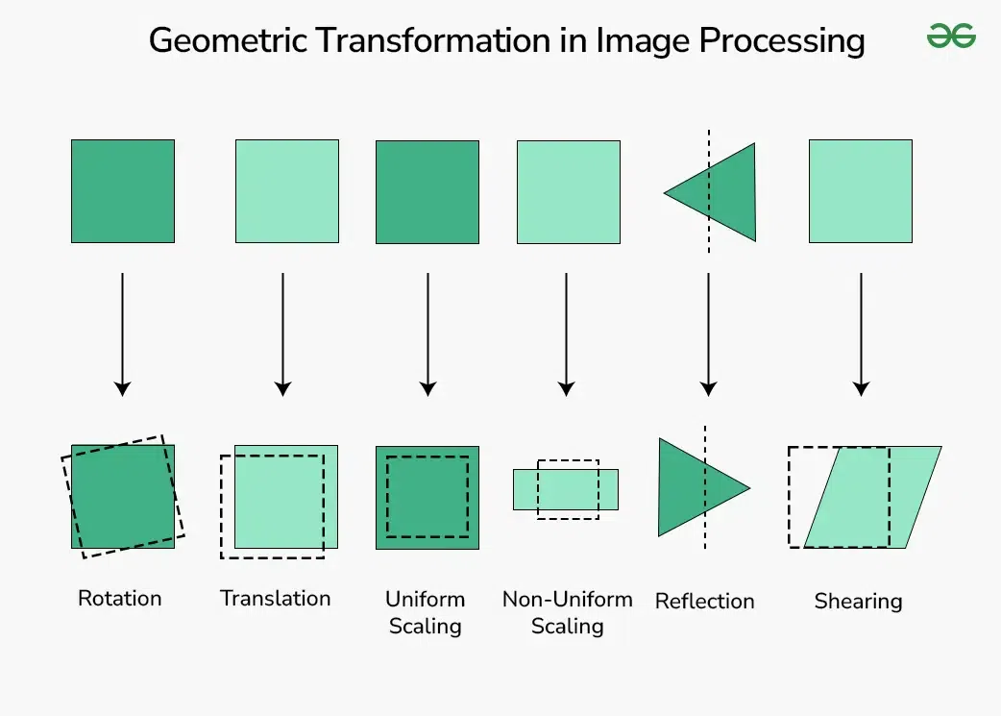
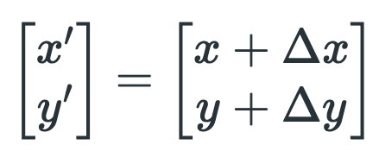
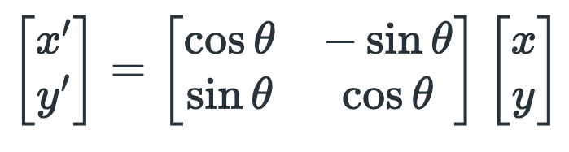
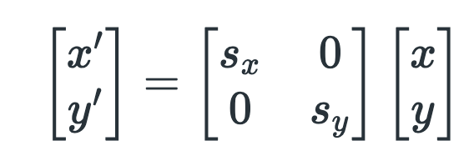
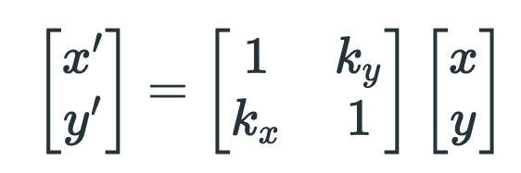
Recap Transform

Slide 40
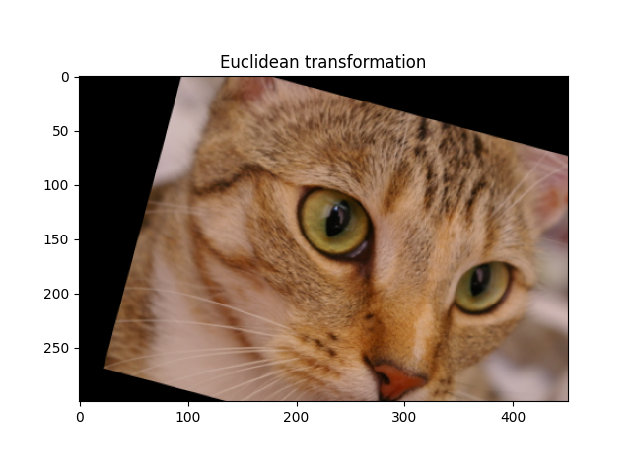




Recap Transform
https://scikit-image.org/docs/0.24.x/auto_examples/transform/plot_transform_types.html
Lines & Parallelism
Affine Transform
Projective / Perspective / Homography Transform

Slide 41

Step #4: Detect the object
Goal: Use homography (H) to localize object in target image
  Simply project object centroid and/or bounding box corners from source image to target image
  Note: Homographies are expressive but do not maintain parallelism – we may not get a bounding "box" in the target image! Other transformations (e.g., affine), are possible too

Slide 42

Object tracking
Once objects are detected, how can we track them over time?
  Re-running object detection from scratch at each frame can be slow!
  Instead, object tracking exploits existing knowledge of the object (e.g., detected position) to track its motion over a sequence of images
  The problem is equivalent to estimating pixel velocities (optical flow)
Sparse optical flow
(tracking keypoints)
Dense optical flow
(tracking all pixels)

Slide 43
Object tracking
Once objects are detected, how can we track them over time?
  Re-running object detection from scratch at each frame can be slow!
  Instead, object tracking exploits existing knowledge of the object (e.g., detected position) to track its motion over a sequence of images
  The problem is equivalent to estimating pixel velocities (optical flow)
Sparse optical flow
(tracking keypoints)
Dense optical flow
(tracking all pixels)

Slide 44




Object tracking
  Intuition: pixel motion is small across frames
    Assumption: only need to search within a local region
  We can express the optical flow problem as:
  Solving the optical flow equation gives pixel velocities ,
    Many sparse and dense optical flow techniques have been developed, for example, the Lucas-Kanade method (sparse) and the Gunnar-Farneback method (dense)
source
Optical flow equation*
(Taylor expansion step)

Slide 45
Object recognition
Object recognition: capability of naming discrete objects in the world
Why is it hard? Many reasons, including:
  Real world is made of a jumble of objects, which all occlude one another and appear in different poses
  There is a lot of variability intrinsic within each class (e.g., dogs)
In this class, we will look at two methods:
  Template matching (classic)
  Neural network methods (treated as a black box, see next lecture)

Slide 46

Template matching
How can we find this guy?
Source: Sanja Fidler

Slide 47
Template matching
Slide and compare!
Filter F
Image I
Source: Sanja Fidler

Slide 48

Template matching
In practice, remember correlation:
One can equivalently write: $I^{′}\left(x,y\right)=f^{T}{⋅t}_{ij}$
To ensure that perfect matching yields one, we consider normalized correlation, that is
$$I^{′}\left(x,y\right)=\frac{f^{T}{⋅t}_{ij}}{\left\|f\right\|\left\|t_{ij}\right\|}$$
Vector representation of filter
Vector representation of
neighborhood patch

Slide 49

Template matching
Result:
Source: Sanja Fidler

Slide 50
Template matching
Result:
Source: Sanja Fidler

Slide 51
Template matching
Problem: what if the object in the image is much larger or much smaller than our template?
Solution: re-scale the image multiple times, and do correlation on every size!
This leads to the idea of image pyramids

Slide 52

Image pyramids: scaling down
Naïve solution: keep only some rows and columns
E.g.: keep every other column to reduce image by 1/2 in width direction
Source:
Sanja Fidler

Slide 53

Image pyramids: scaling down
Naïve solution: keep only some rows and columns
E.g.: keep every other column to reduce image by 1/2 in width direction
Source:
Sanja Fidler

Slide 54

Image pyramids: scaling down
Solution: blur the image via Gaussian, then subsample
Intuition: remove high frequency content in the image
Source:
Sanja Fidler

Slide 55

Image pyramids: scaling down
Solution: blur the image via Gaussian, then subsample
Intuition: remove high frequency content in the image
Source:
Sanja Fidler

Slide 56

Image pyramids: scaling down
Solution: blur the image via Gaussian, then subsample
Intuition: remove high frequency content in the image
Source:
Sanja Fidler

Slide 57
Image pyramids
A sequence of images created with Gaussian blurring and down-sampling is called a Gaussian pyramid
The other step is to perform up-sampling (nearest neighbor, bilinear, bicubic, etc.)

Slide 58


However, classical methods can be brittle!
Sensitive to variations in rotation, etc.
Loss of spatial information
Lack of robustness (to partial occlusions, deformations, etc.)

Slide 59
Using learned features
Solution: Use learned features!
We can use convolutional neural networks (CNNs) to detect and describe features
Convolutional neural networks (CNNs): deep learning models for processing structured grid data, such as images, by using layers of convolutional operations to automatically learn hierarchical features and patterns

Slide 60


Uses in modern computer vision
Using CNNs for computer vision tasks took off ~2012 with the success of the AlexNet architecture for image classification on the ImageNet dataset
Today, learned features are used in many applications: image classification, object detection, image segmentation, object tracking, image generation etc.
Modern models also include GANs, transformers, etc.
Classification:
Goldfish
Semantic segmentation

Slide 61

Next time

