Slide 1

Principles of Robot Autonomy I
Deep learning for computer vision
Guest Lecture by Dr. Boris Ivanovic

Slide 2
Today’s itinerary
  Stats/ML review
  Neural network basics
  Convolutional neural networks
  Robotic applications

Slide 3
Efficient feature extraction
CIFAR-10
32x32x3
vs.
Inception-v3
299x299x3
If we know the input is image data, we can assume some spatial locality ➔ weight sharing

Slide 4
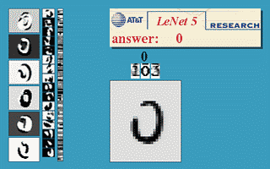
Convolutional neural networks (CNN)
Traditionally consist of 4 types of layers:
Convolutional layers (CONV)
Nonlinearity layers (RELU)
Pooling layers (POOL)
Fully-connected layers (FC)
LeNet (1998)

Slide 5
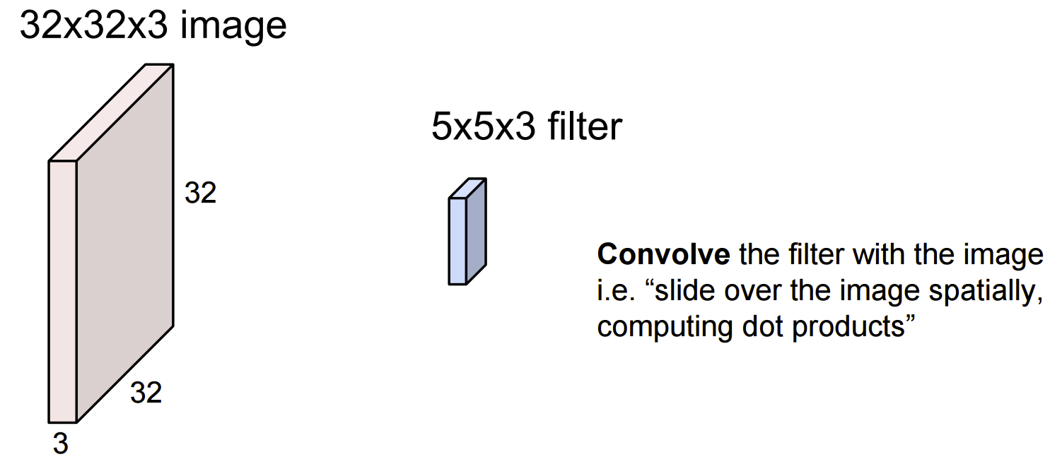
Convolution layer

Slide 6
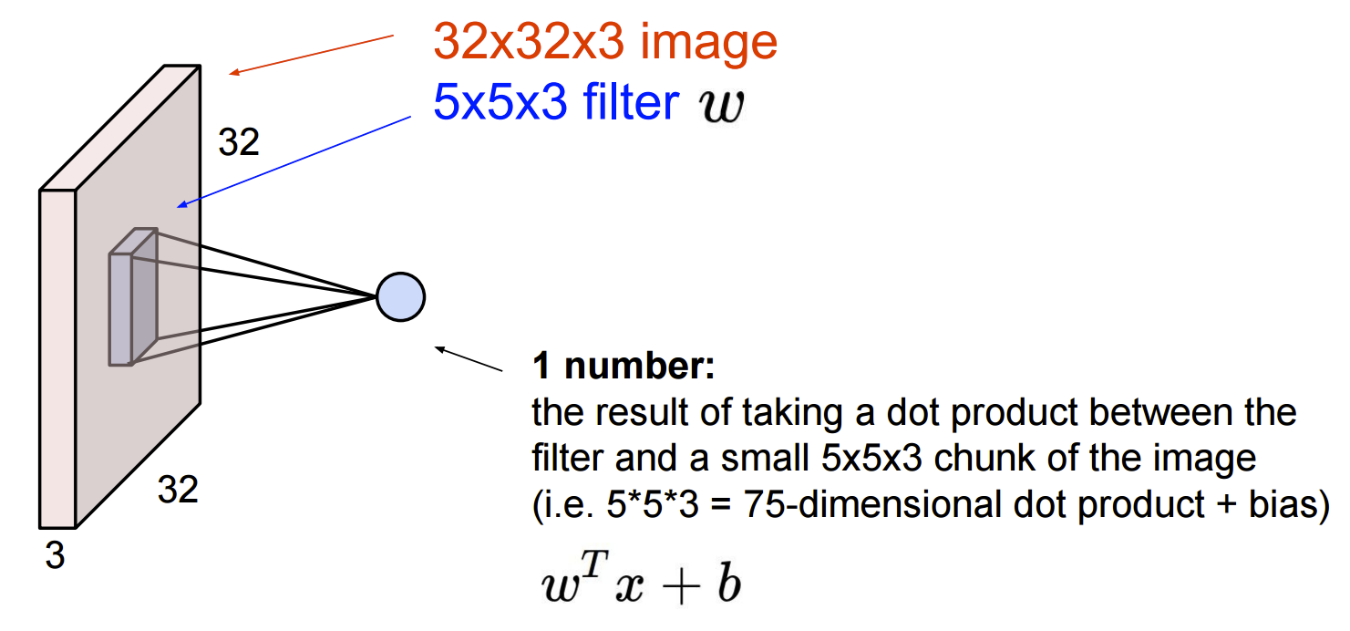
Convolution layer

Slide 7
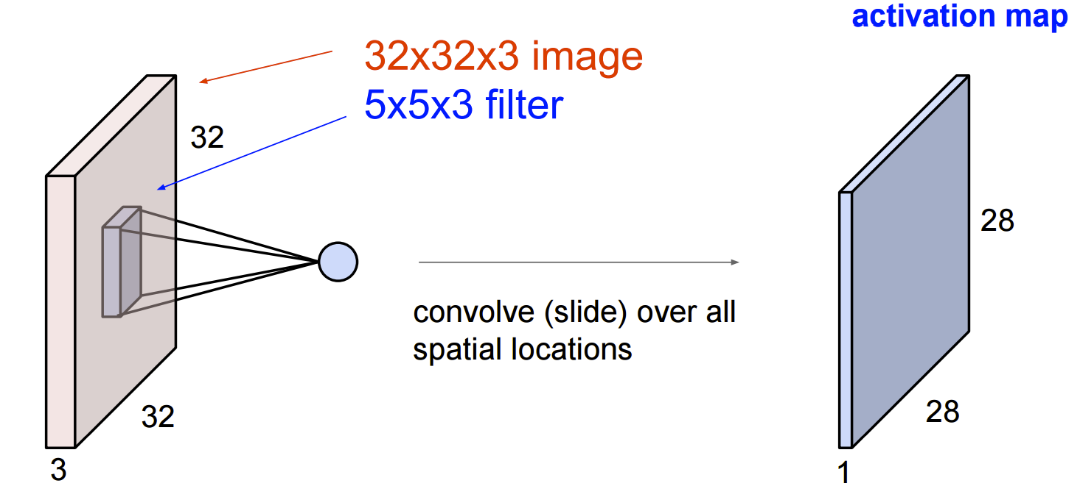
Convolution layer

Slide 8
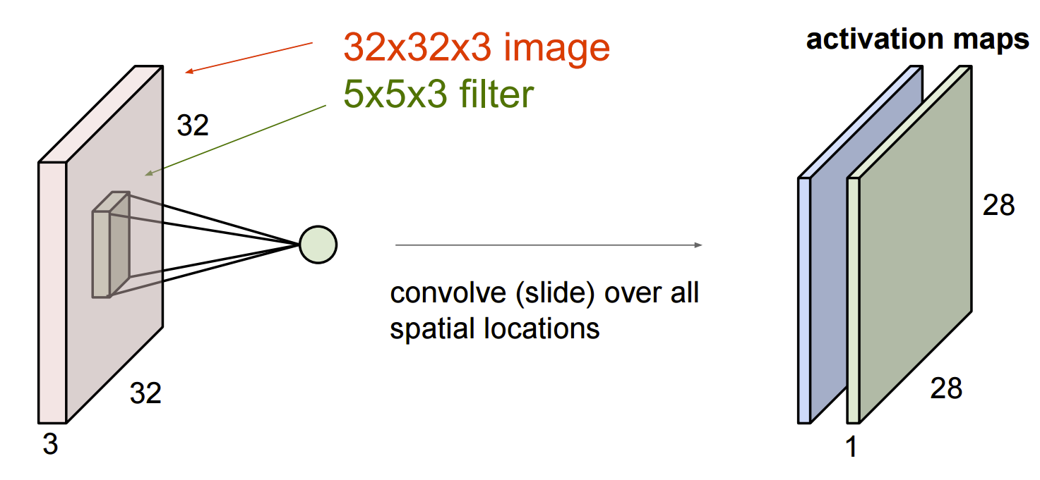
Convolution layer

Slide 9
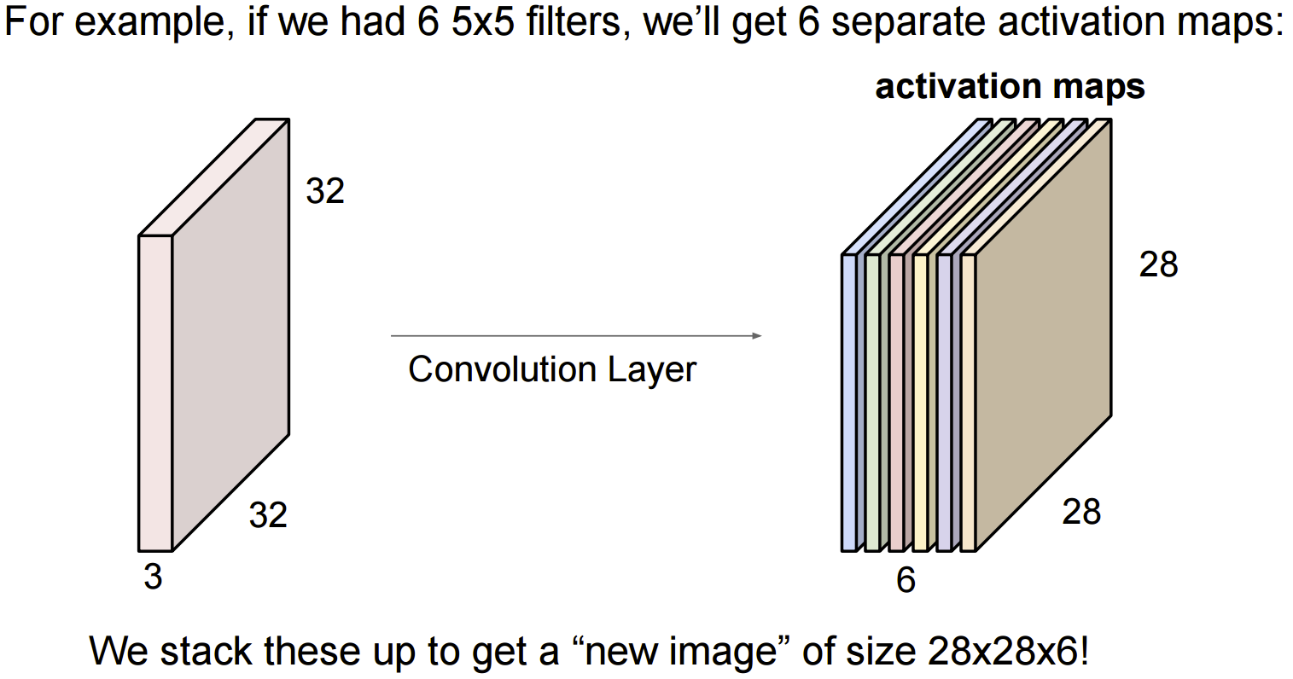
Convolution layer

Slide 10
Convolution Layer Visualization
http://cs231n.github.io/convolutional-networks/

Slide 11
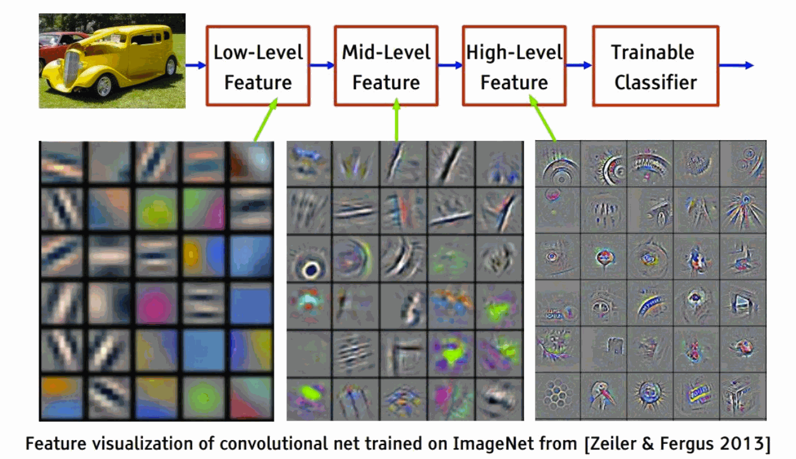
Feature hierarchy

Slide 12
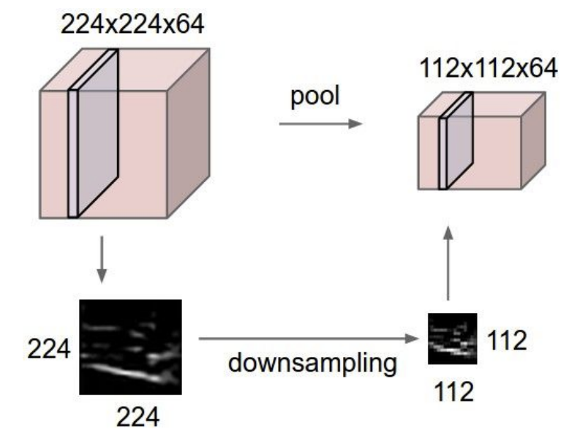
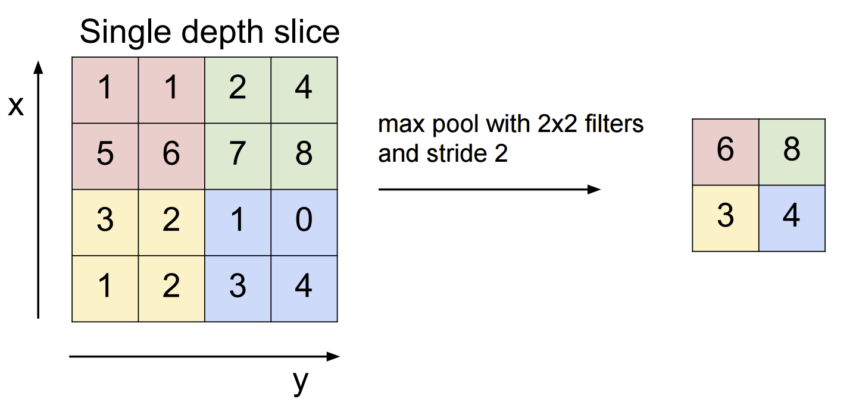
Pooling layer
As we move higher up the feature “food chain” we can save ourselves some computational effort by lowering the resolution
Types of pooling:
MAX pooling
MEAN pooling

Slide 13
Fully connected layer
We’ve seen this one before!
Image “summary vector” with all of the redundant pixel info boiled out
Linear classifier (softmax)

Slide 14
Putting it all together – CNN
http://cs231n.stanford.edu/

Slide 15
Live Demo - Inner Workings of a CNN
https://adamharley.com/nn_vis/cnn/3d.html
There’s also a 2D version: https://adamharley.com/nn_vis/cnn/2d.html

Slide 16
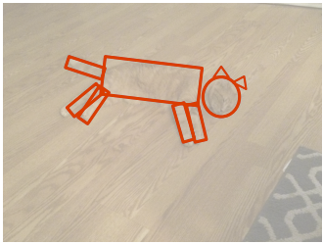
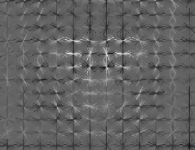
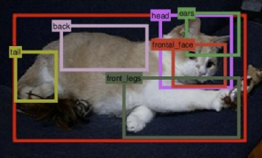
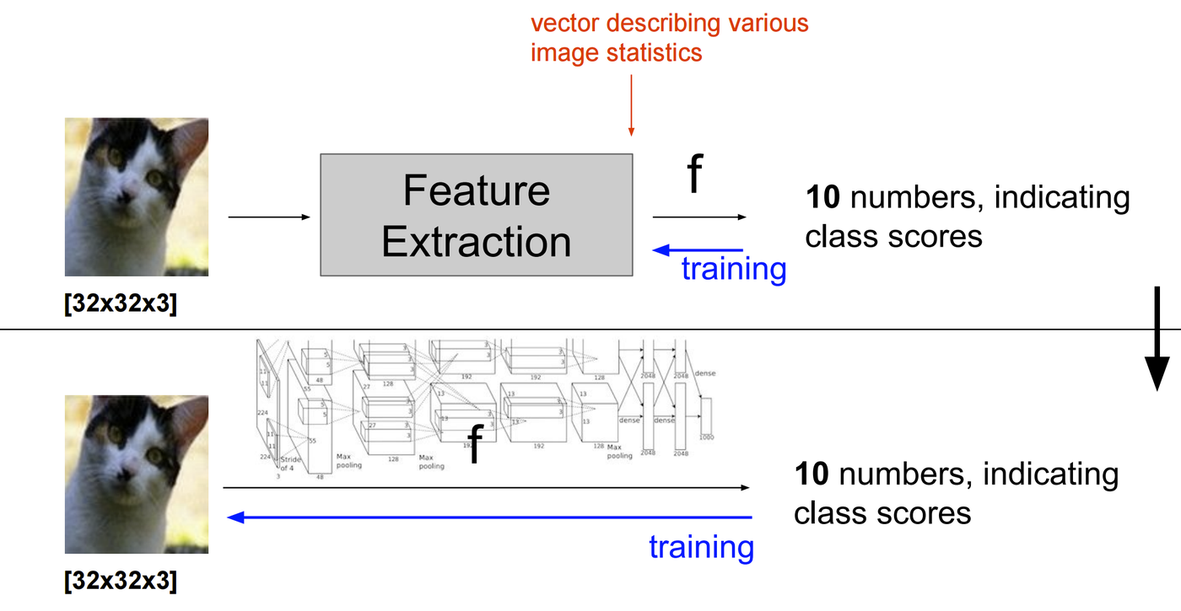
Classification showdown
vs.
Who wins?

Slide 17
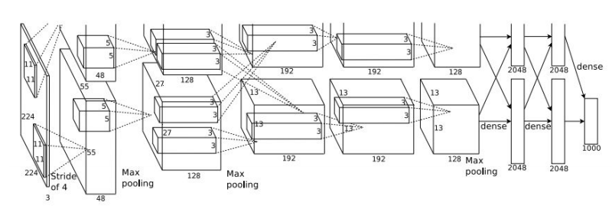
End-to-end learning wins!
AlexNet (2012)
Disclaimer: hand-crafted features may still be the right choice for your niche application

Slide 18
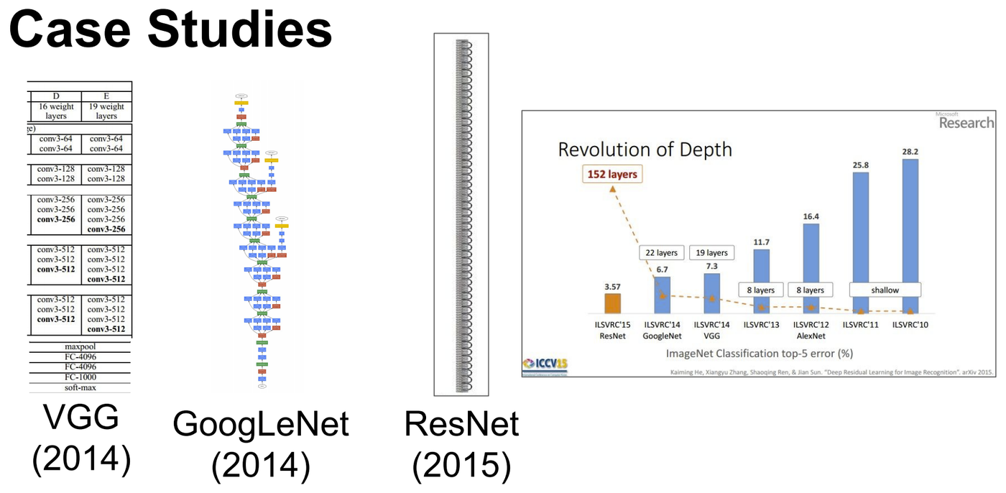
Modern architectures (deeper and deeper)

Slide 19
Modern architectures (deeper and deeper)
Inception-v3 (2016)

Slide 20
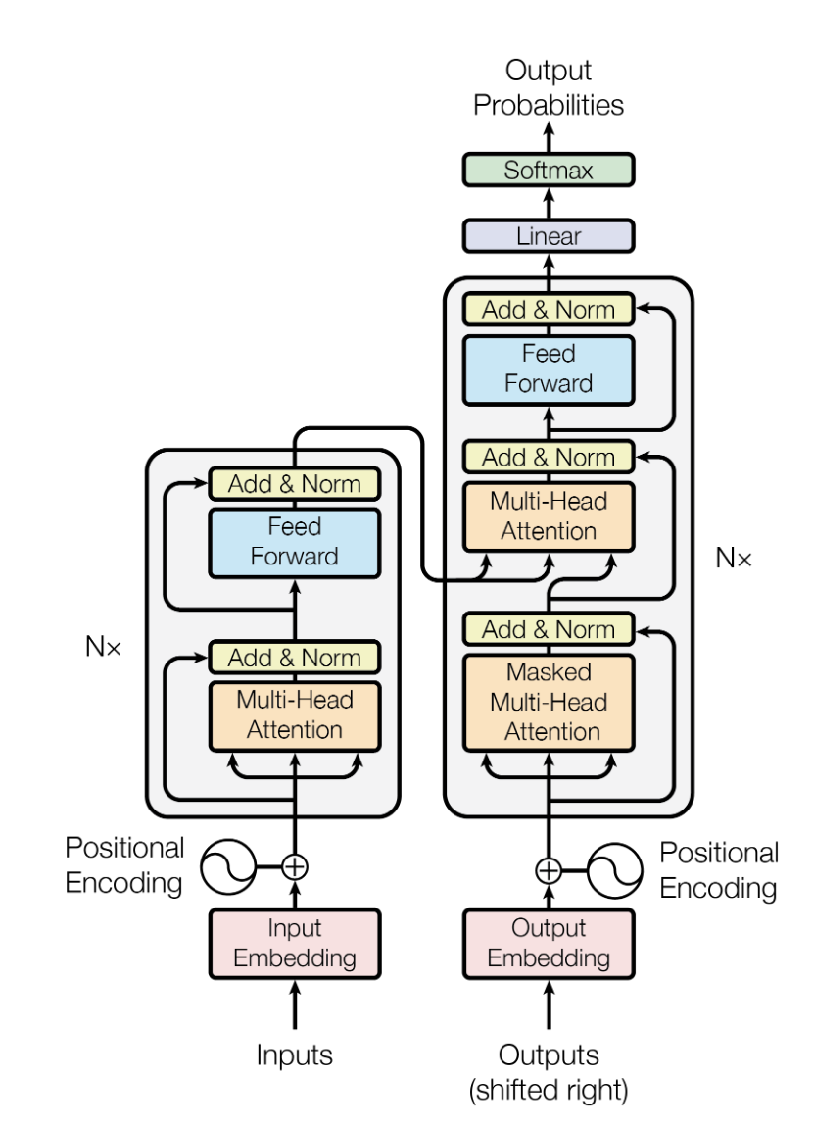
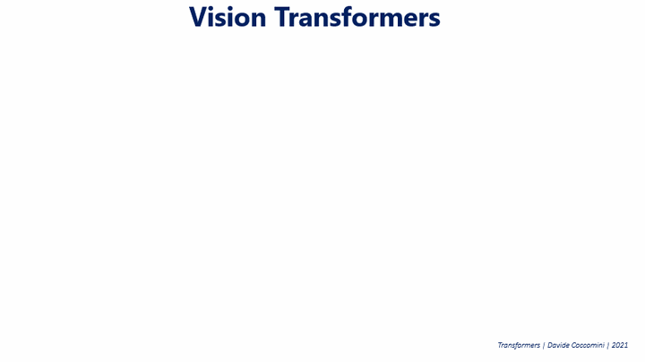
Even more modern architectures
Transformer (2017)
Vision Transformer (2020)

Slide 21
Today’s itinerary
  Stats/ML review
  Neural network basics
  Convolutional neural networks
  Robotic applications

Slide 22
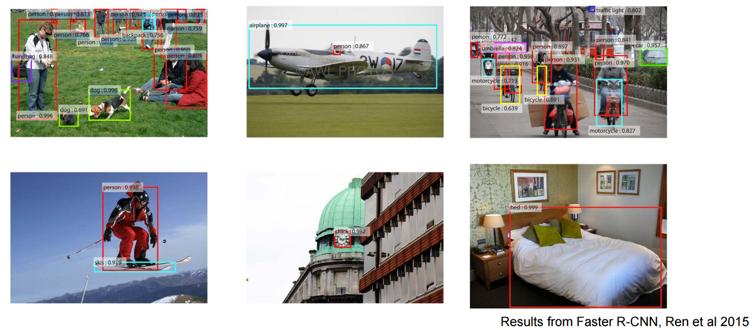
Object localization and detection

Slide 23
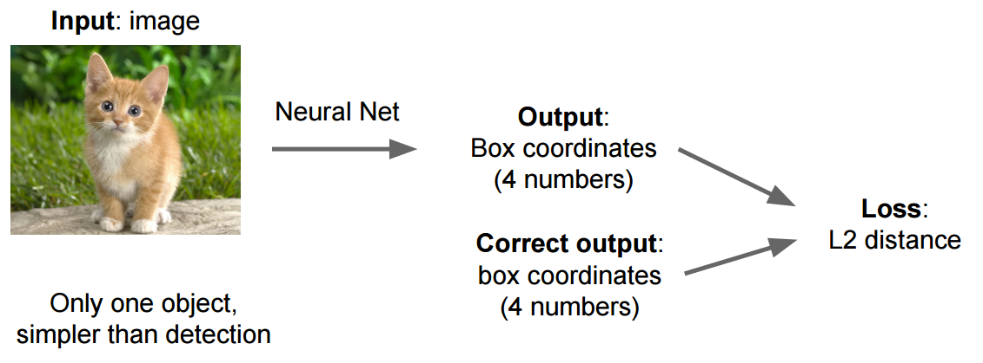
Object localization
Instead of outputting only a class (with associated loss function),
also regress on 4 numbers defining the edges of a bounding box

Slide 24
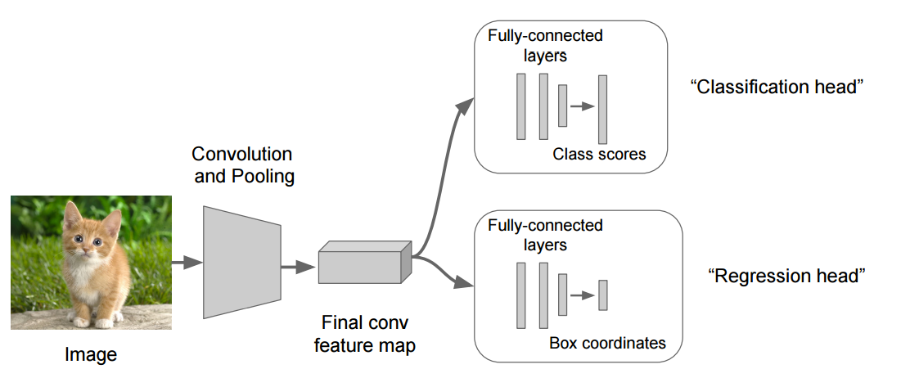
Localization and detection
Instead of outputting only a class (with associated loss function),
also regress on 4 numbers defining the edges of a bounding box

Slide 25
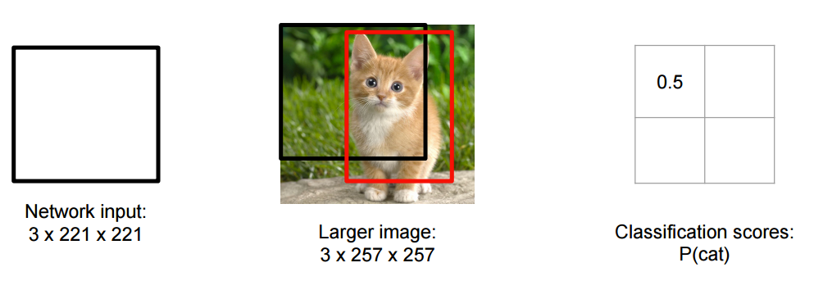
Object detection
Sliding window: using a classifier as the basis for a detector

Slide 26
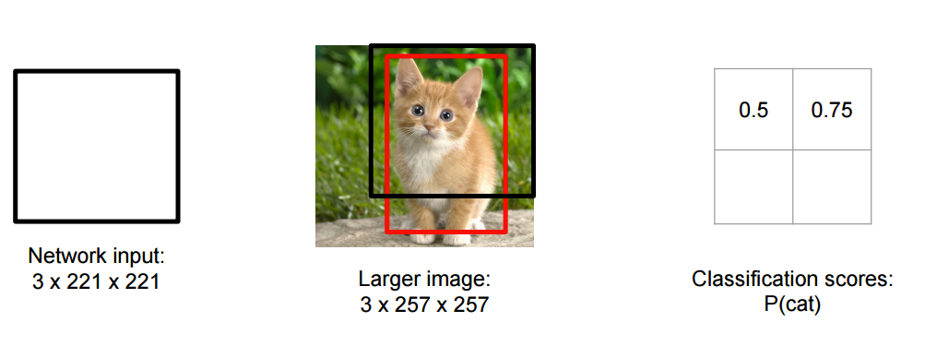
Object detection
Sliding window: using a classifier as the basis for a detector

Slide 27
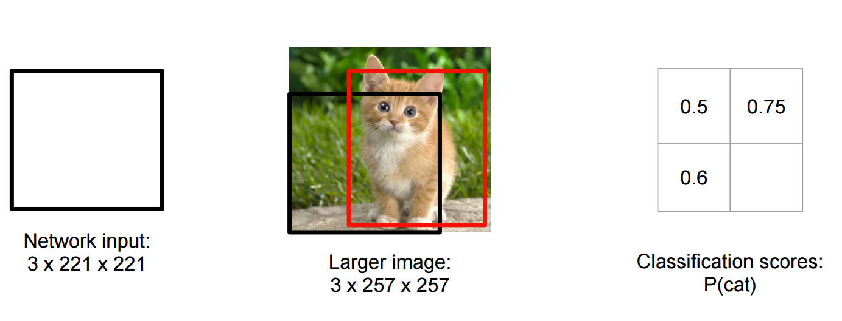
Object detection
Sliding window: using a classifier as the basis for a detector

Slide 28
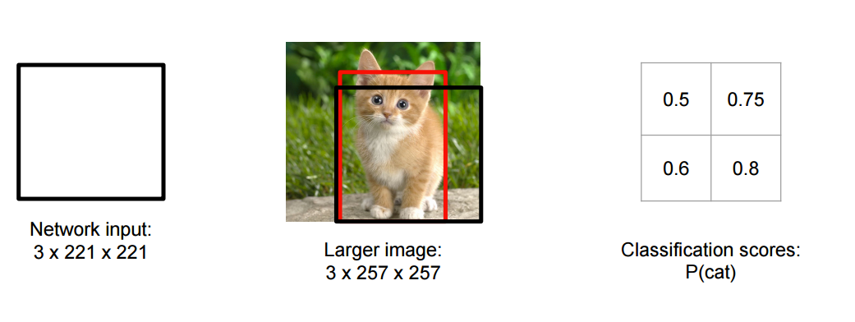
Object detection
Sliding window: using a classifier as the basis for a detector

Slide 29
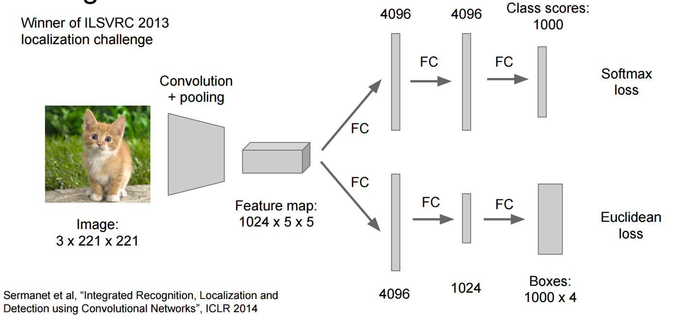
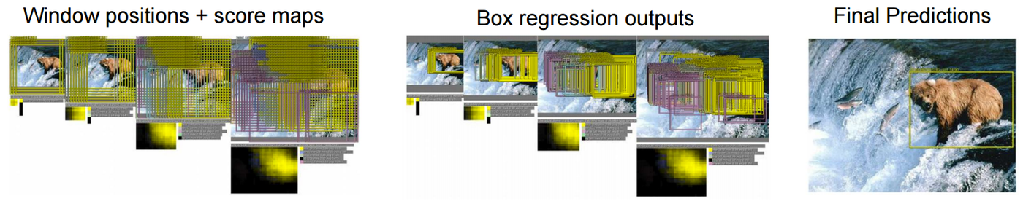
Object detection – sliding window
Overfeat (Sermanet et al. 2014)

Slide 30
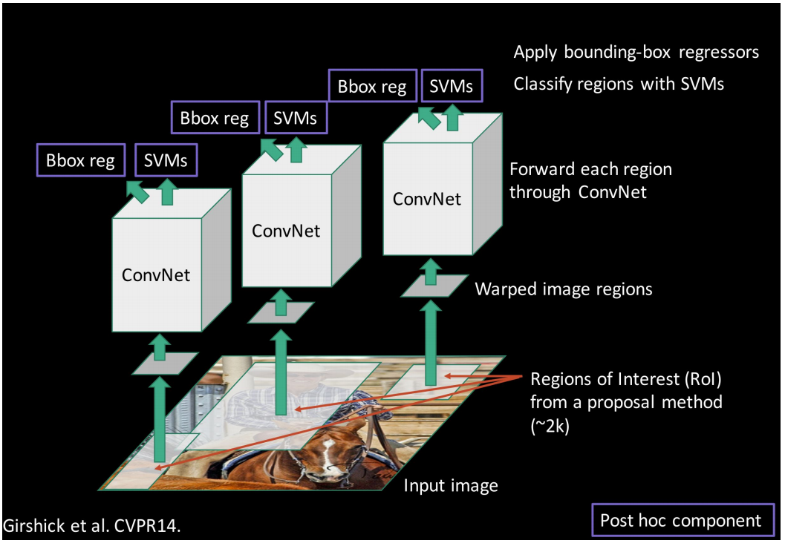
Object detection – more efficient approaches
“Proposal” method to identify “blobby” regions of interest
(could be another NN)
Two-headed classifer/bounding box regressor

Slide 31
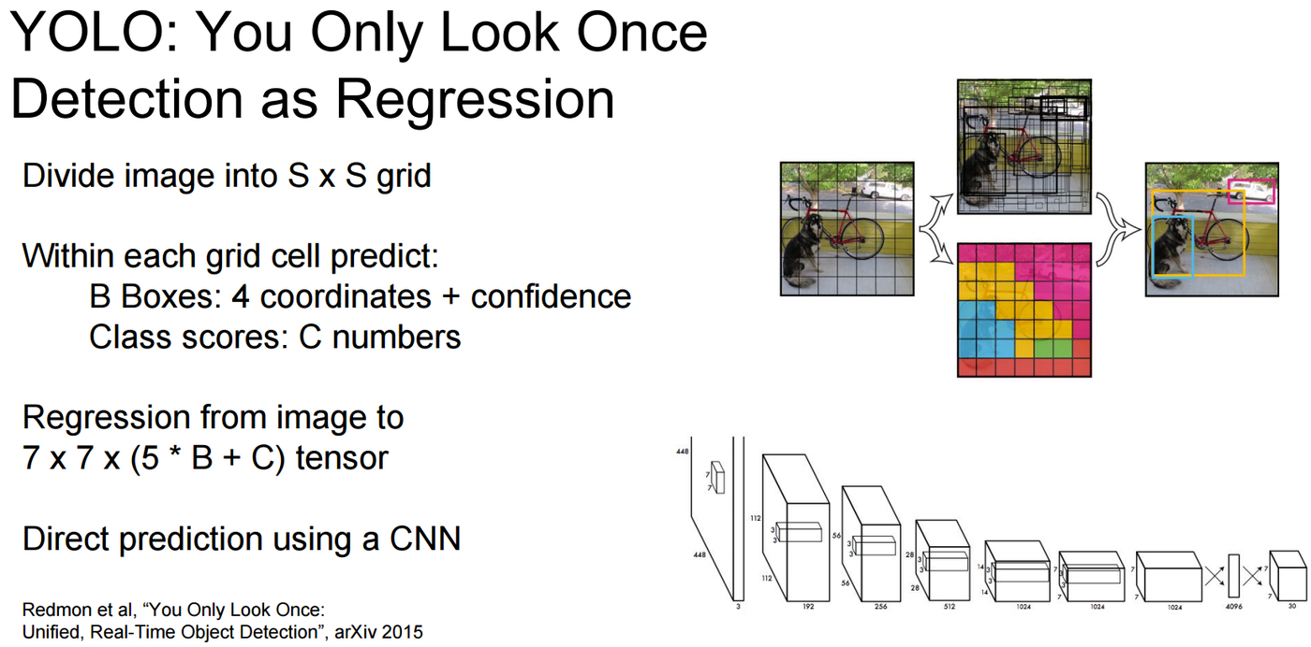
Object detection – more efficient approaches

Slide 32
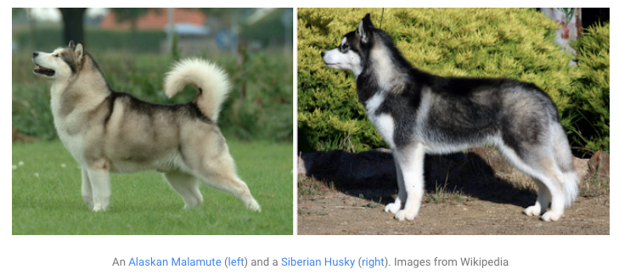
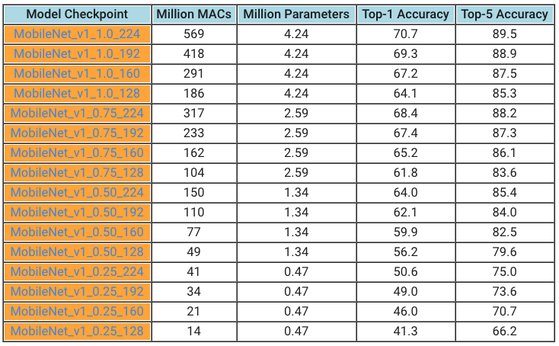
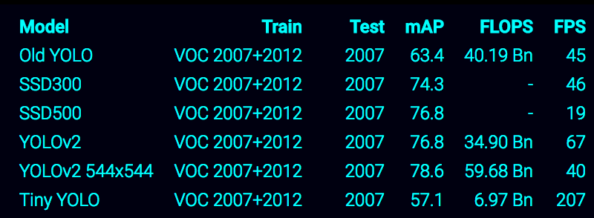
Robotics – need for speed!
Inception-ResNet-v2
MobileNets (2017)
Tiny YOLO (2017)

Slide 33
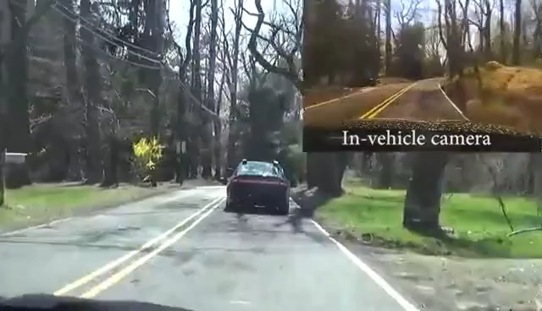
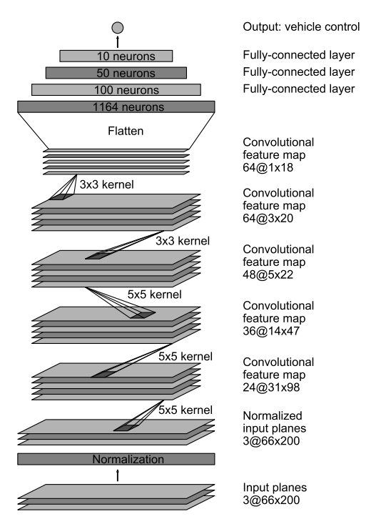
End-to-end: from pixels to motor commands
DAVE-2 (NVIDIA 2016)
Somewhat less scary:
https://www.youtube.com/watch?v=HJ58dbd5g8g

Slide 34
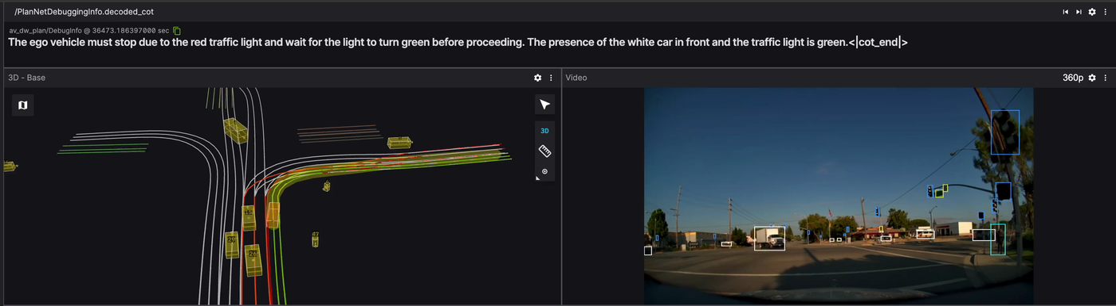

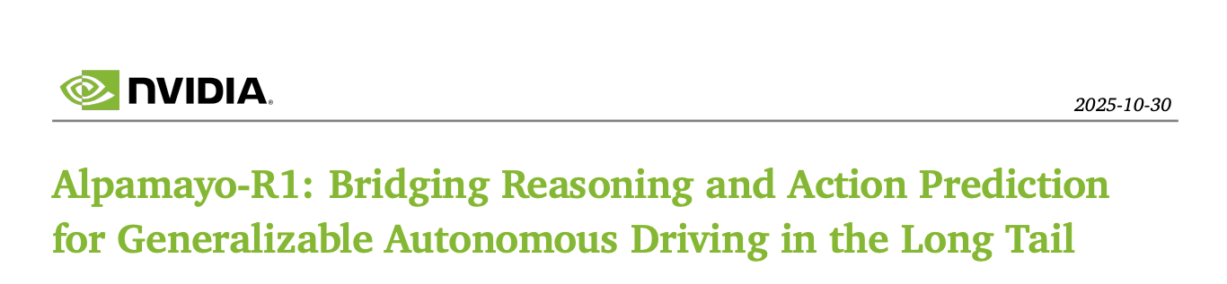
End-to-end: from sensors to reasoning+action
Alpamayo-R1 (NVIDIA 2025)
https://research.nvidia.com/publication/2025-10_alpamayo-r1

Slide 35
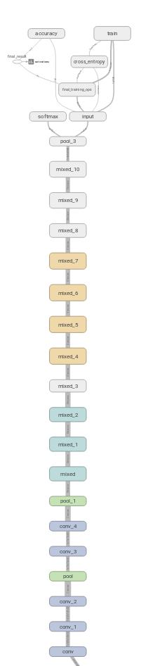
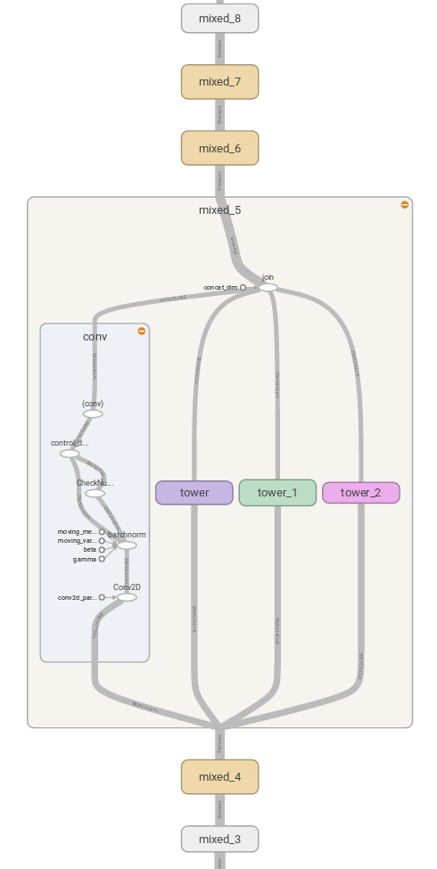
Tools of the trade
Software packages for automatic differentiation/gradient computation
  Caffe (old)
  Torch (old)
  Theano (old)
  PyTorch (Meta, Heavyweight #1)
  TensorFlow (Google, Heavyweight #2)
  MXNet/Chainer/… (Others, better at some things for specific applications)
Specify an abstract computation graph (inputs and outputs of NN equations); software does the rest!
TensorFlow: a lot of chain rule in this picture

Slide 36
Lots of stuff left out
Generative vs. discriminative models
Train/validation/test sets
Learning rate and other hyperparameter tuning
Recurrent neural networks for sequential data (e.g., videos)
Reinforcement learning and ML outside of purely visual recognition-focused tasks
Consider STATS216, CS229, CS231n, CS224n, CS331b to learn more!

Slide 37
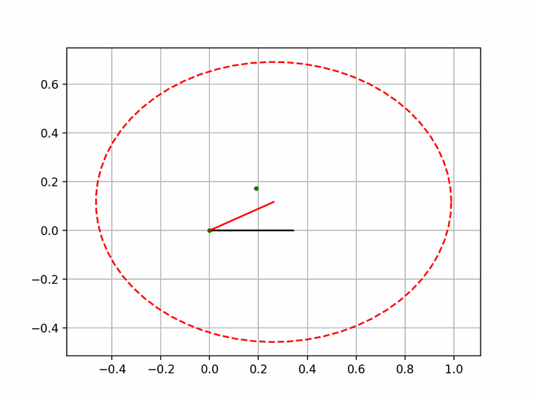
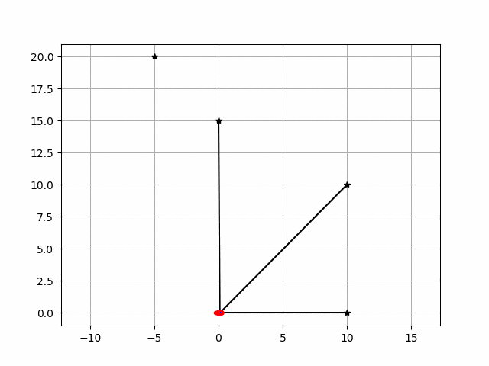
Next time

