Slide 1
AA203
Optimal and Learning-based Control
Intro to Imitation Learning (IL) and Reinforcement Learning (RL)

Slide 2
Course overview
Imitation Learning
Model-free RL
Control
Adaptive
optimal control
Model-based RL
Feedback control
Adaptive control
Optimal and learning control
Open-loop
MPC
Closed-loop
Indirect methods
Direct
methods
DP
HJB / HJI

Slide 3
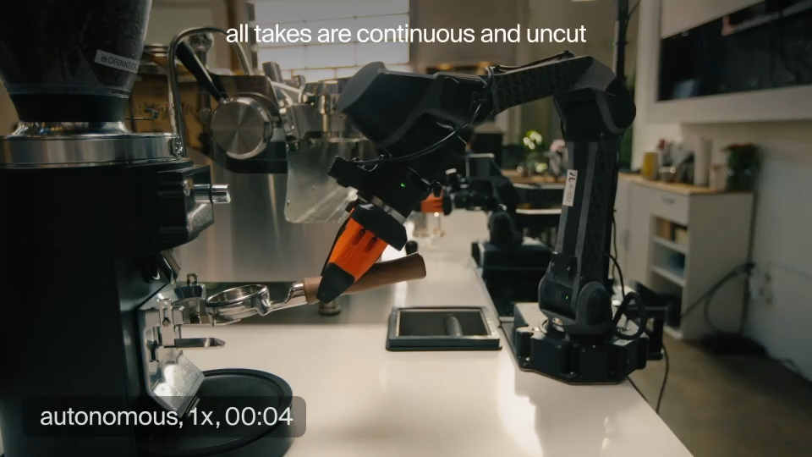
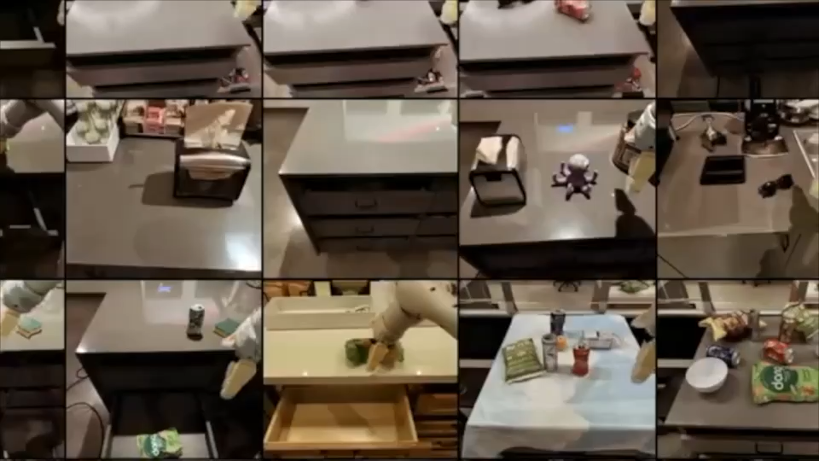
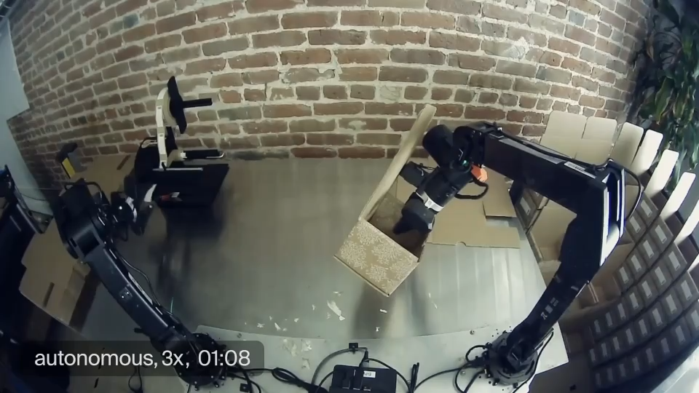
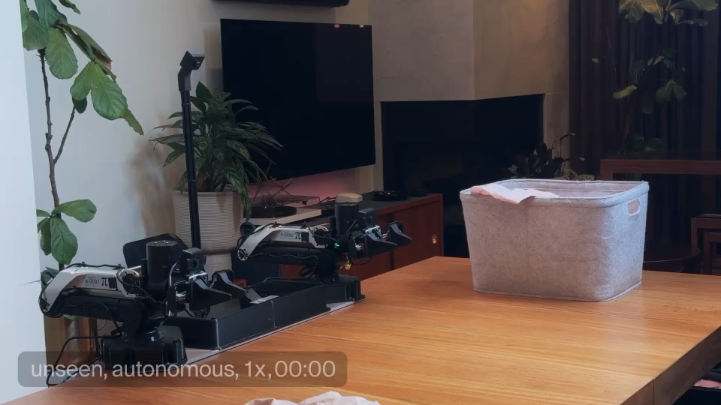



Credits: $π_{0.6}^{∗}$
Credits:
Gemini Robotics
Credits: $π_{0.6}^{∗}$
Credits: $π_{0.6}^{∗}$

Slide 4
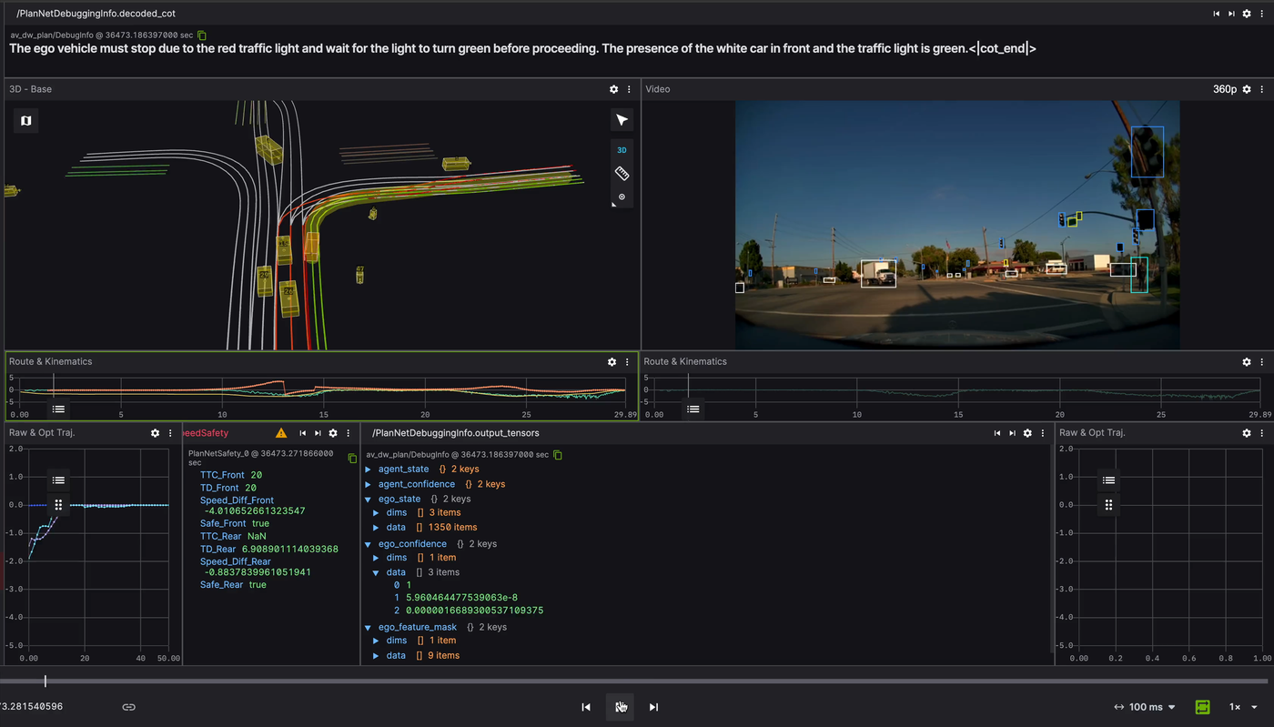




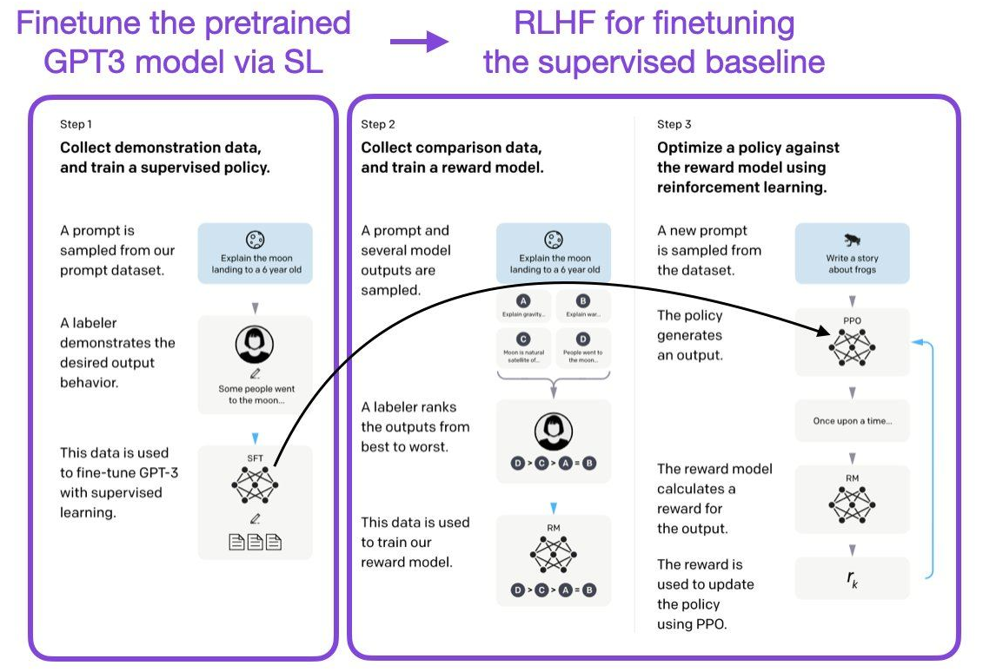
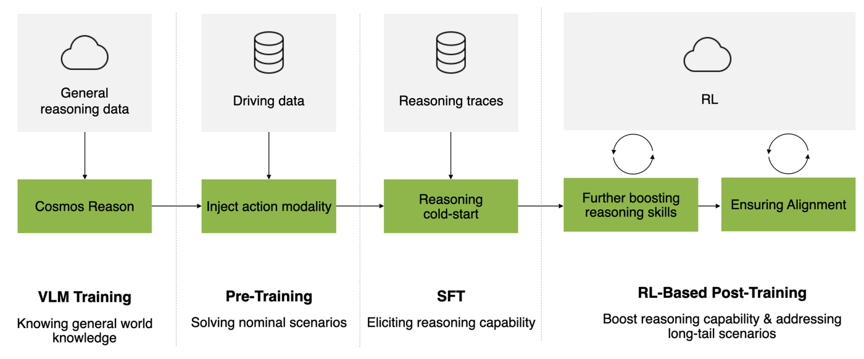
[NVIDIA. Alpamayo-R1]

Slide 5
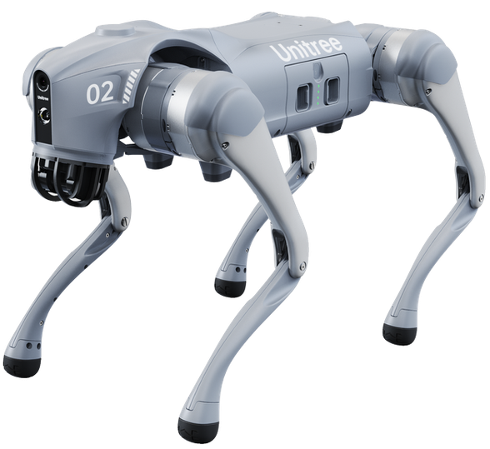
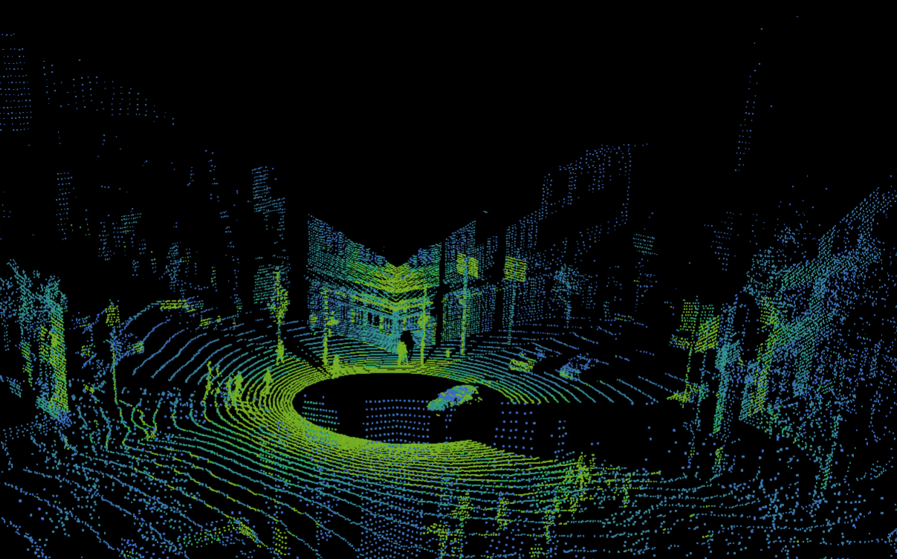
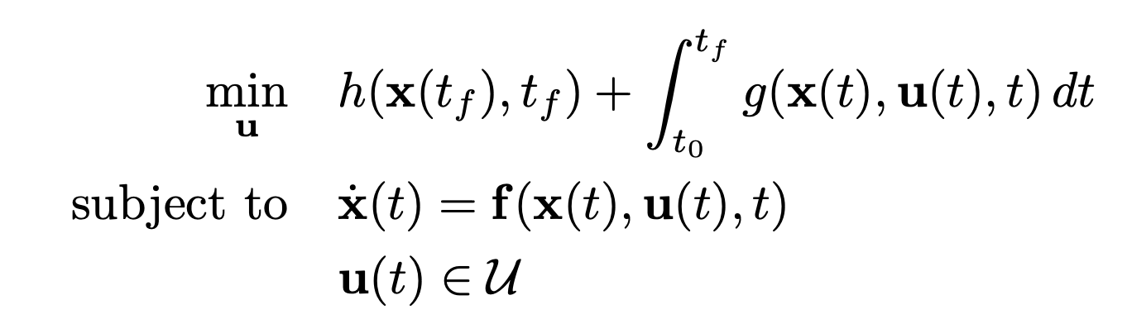
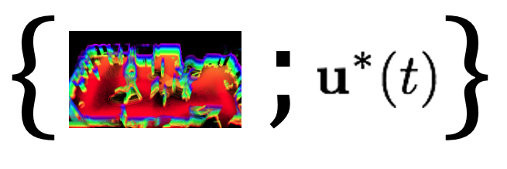
Learning for control, in practice
How can we develop a reliable control algorithm?
12 DoF quadruped
Lidar
RGB front camera
?
Potentially hazardous terrain
…
Upcoming weeks: Set it up as a learning problem
Option 1
Option 2:
Imitation Learning
Option 3:
Reinforcement Learning
Deeply understand the problem
Design a solution
“Learn from demonstrations”
“Learn by trial and error”
Success,
Failure

Slide 6
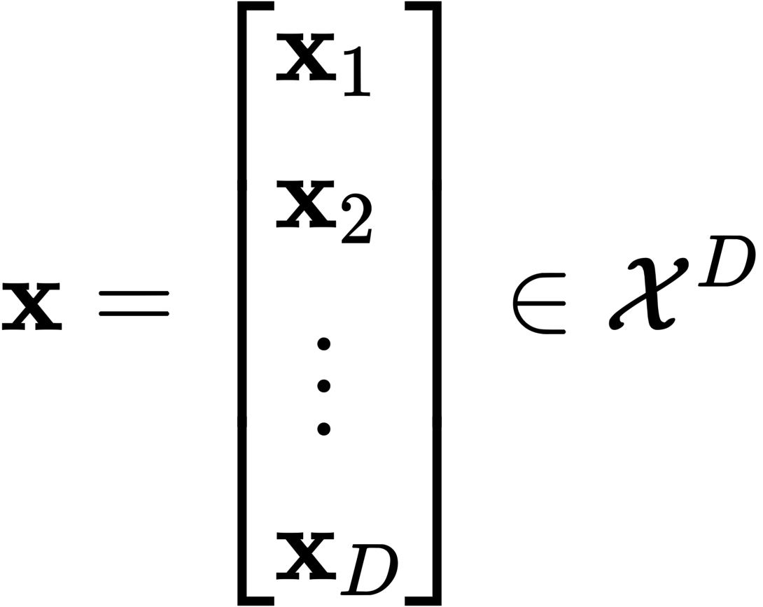
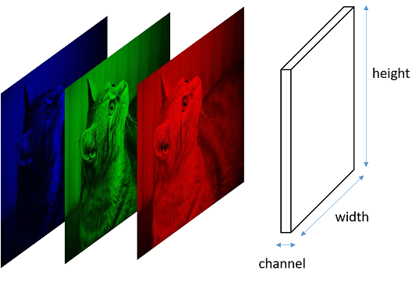
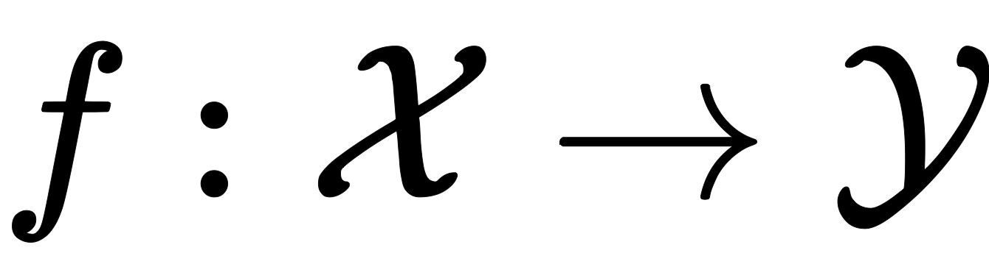
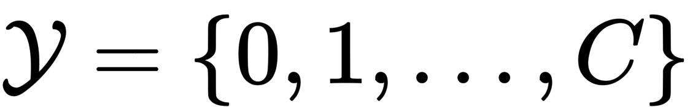
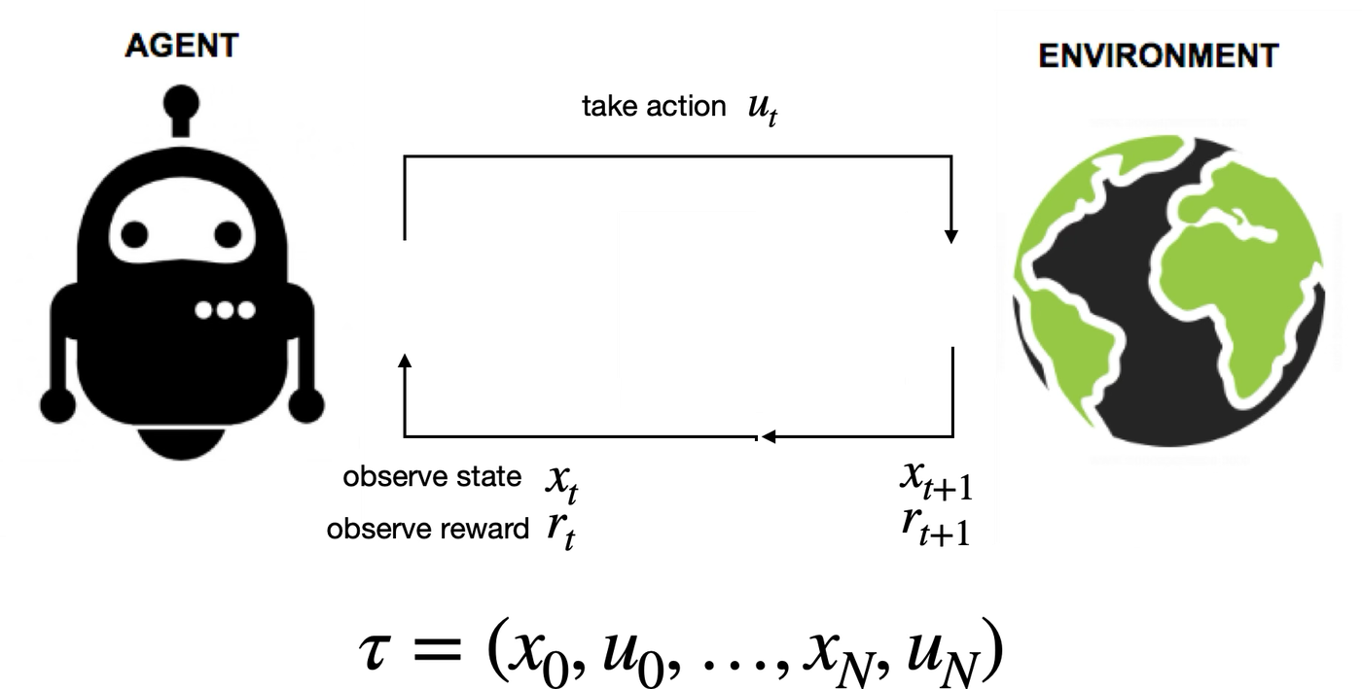
Outline
Primer on Supervised Learning
e.g., [dog, cat, …, mouse]
Imitation Learning
Reinforcement Learning
Key learning goals:
An overview of the fundamentals of IL and RL
Identify the distinctions and similarities between these paradigms

Slide 7
Imitation Learning and Reinforcement Learning
Resources:
PoRA book Chapters 17-19, and references therein, and also:
  Sutton and Barto: “Reinforcement Learning: An Introduction”
Classes:
  Stanford CS 224R Deep Reinforcement Learning
  Berkeley CS 185/285 Deep Reinforcement Learning

Slide 8
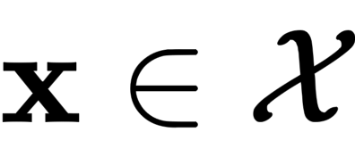
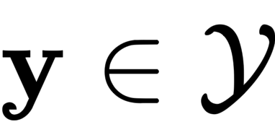
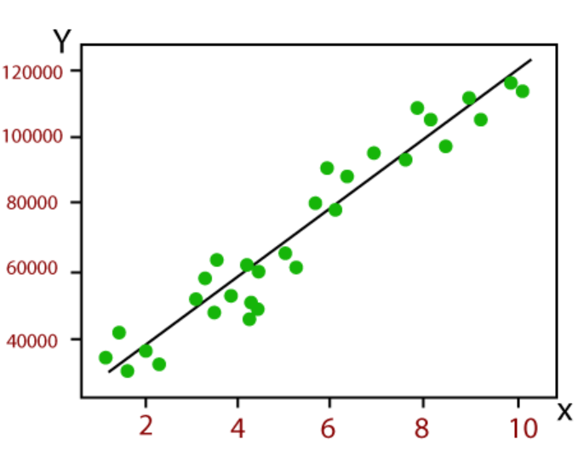
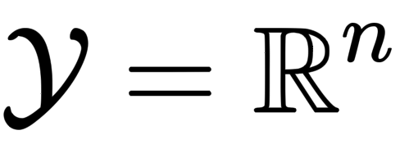
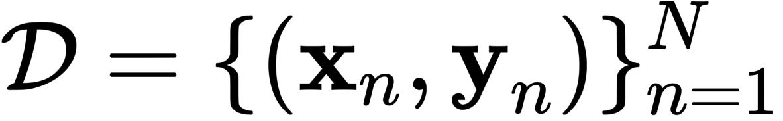
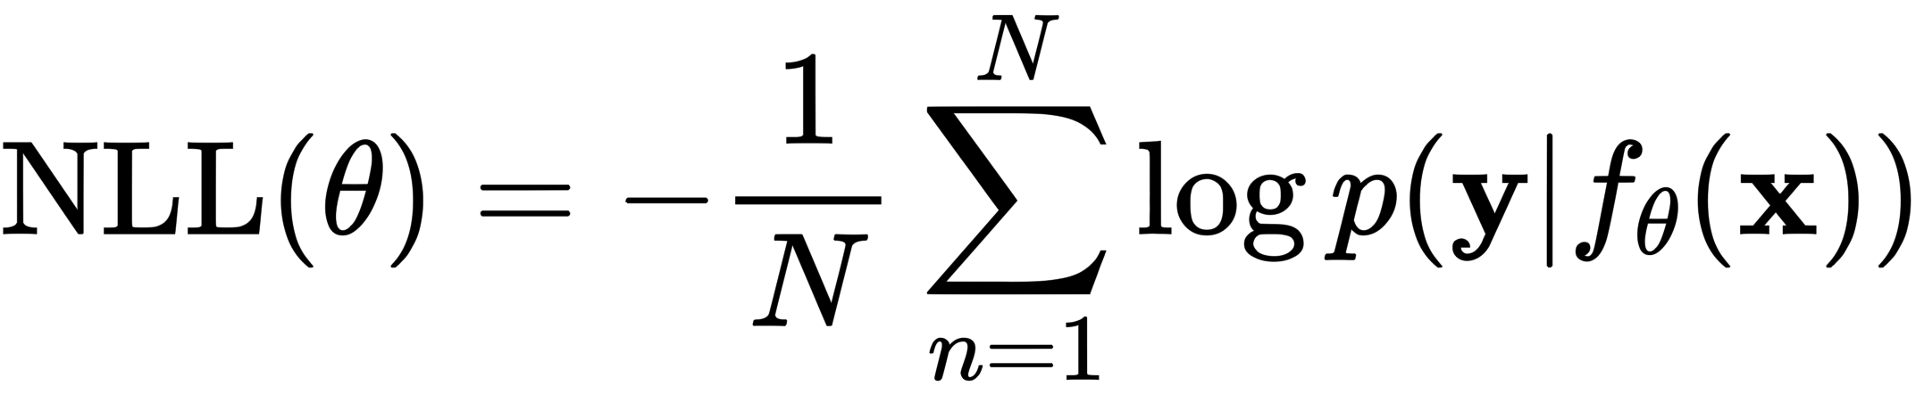

A primer on supervised learning (SL)
In SL, the task is to learn a mapping
from inputs
to outputs
e.g., [dog, cat, …, mouse]
Learning involves data in the form of input-output pairs , e.g., Maximum Likelihood Estimation

Slide 9
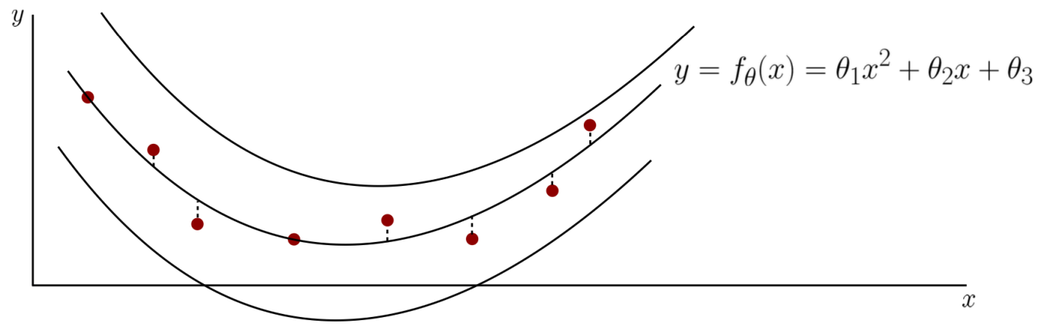
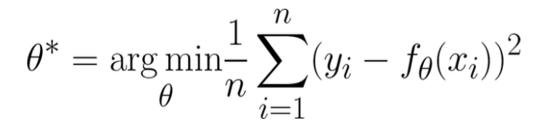
Learning from a probabilistic standpoint
Let’s consider regression as an example
Learning through minimization of squared error

Slide 10
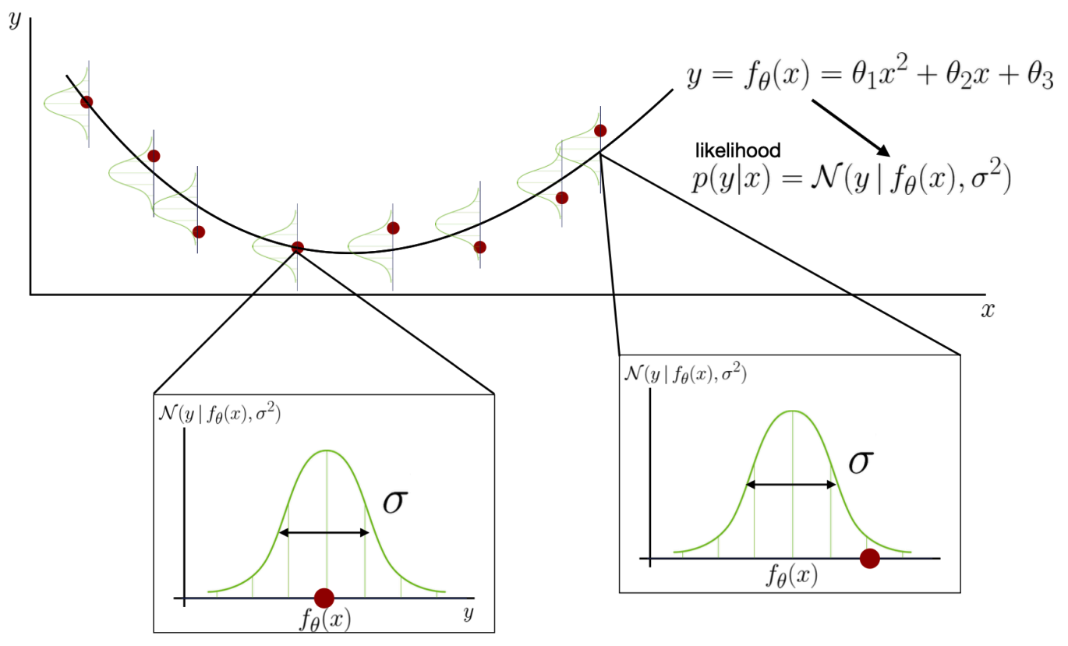
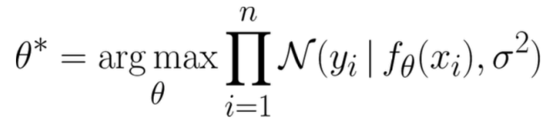
Learning from a probabilistic standpoint
Let’s consider regression as an example
Learning through likelihood maximization:

Slide 11
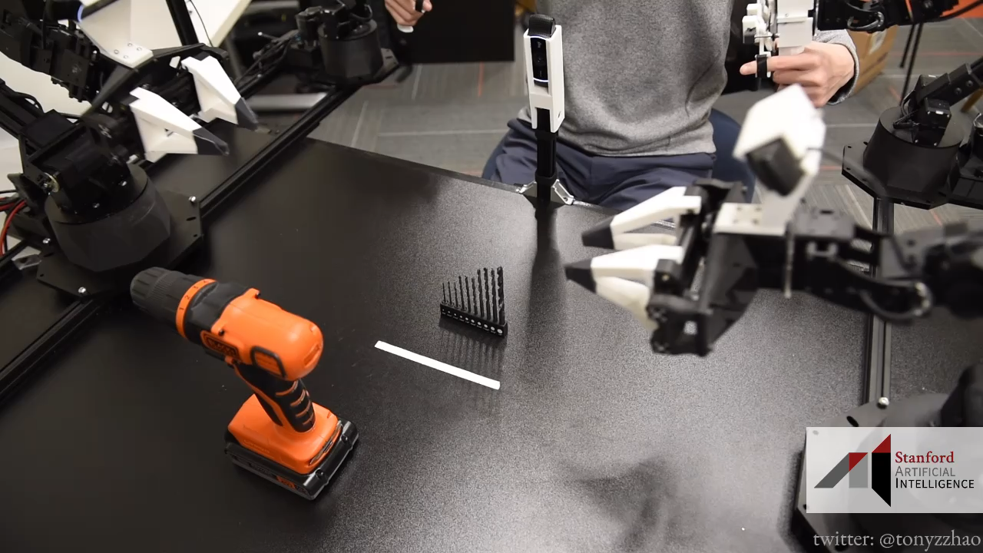
The basics of Imitation Learning
Imitation learning refers to a class of methods that enable skills to be transferred from an expert to a learner
In the context of robotics, the expert is typically a human operator or a pre-existing control policy and the learner is the robot that aims to mimic the expert’s behavior
Example:

Slide 12
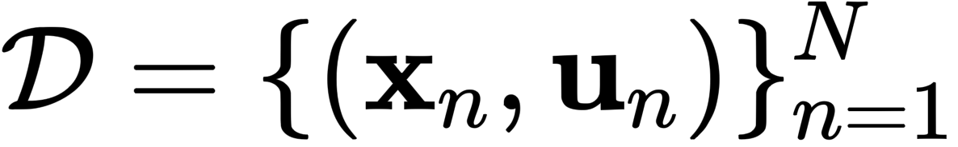
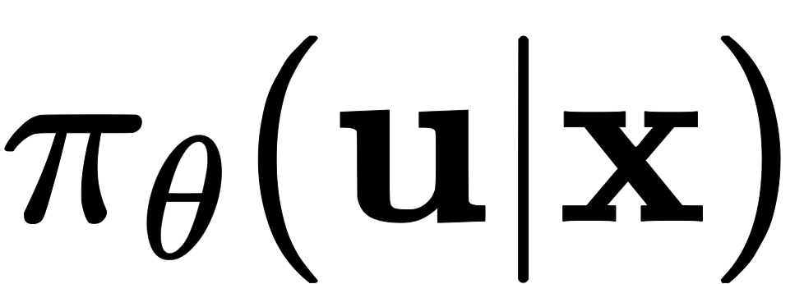
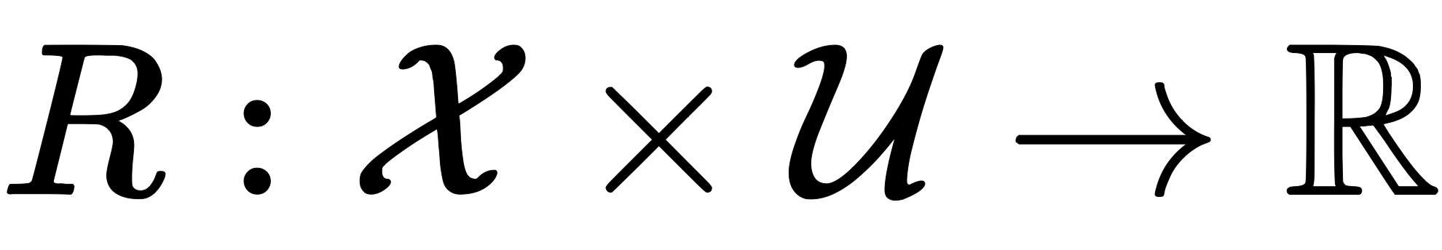
The basics of Imitation Learning
Assume access to a dataset of state-control pairs collected by an expert
At a high-level, approaches to IL belong to two main categories:
  Behavior Cloning “learn the policy used by expert”
  Inverse Reinforcement Learning “learn the objective optimized by the expert”
  (a.k.a. Inverse Optimal Control)
Behavior Cloning Inverse Reinforcement Learning

Slide 13

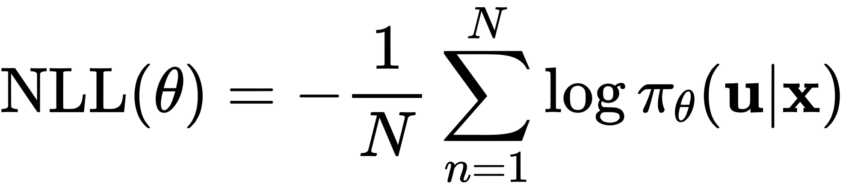
Behavior Cloning (BC)
Main idea: Train policy via supervised learning
Skeleton of an IL algorithm:
Collect a dataset of “expert” demonstrations
Train policy to mimic expert:
e.g., MLE, cross-entropy, L2 / MSE, etc.

Slide 14
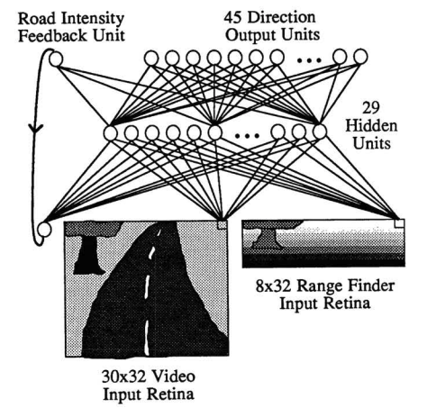
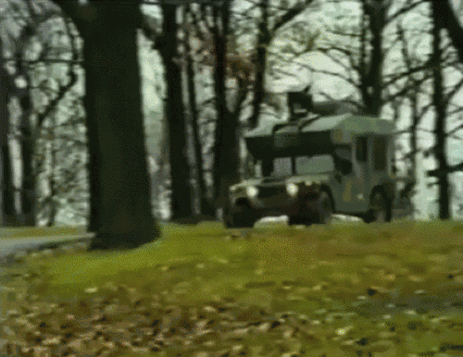
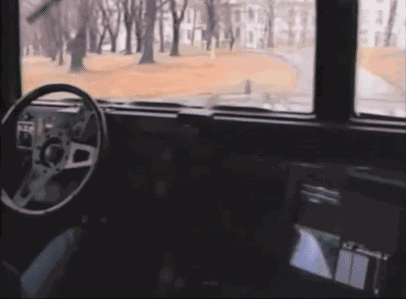
A first (deep) imitation learning system
ALVINN: An Autonomous Land Vehicle In a Neural Network (1989)

Slide 15
Is this guaranteed to work?
Spoiler: NO - Imitation learning is different from “plain” supervised learning
Supervised learning: learn a mapping from input data to output labels based on a dataset of input-output pairs
IL builds heavily on SL, however with some key differences:
  Even small prediction errors will compound over time
  The solution may have inherent structural properties, such as physical constraints or temporal dependencies, that are not present in standard supervised learning tasks
  In IL, the source domain may differ from the one at deployment (e.g., humanoid control by learning from videos of humans)
  Covariate shift, where the distribution of the expert’s data may differ from the distribution of the learner’s data
  Obtaining expert demonstrations may be expensive or time consuming
e.g., [dog, cat, …, mouse]

Slide 16
Inverse Reinforcement Learning (IRL)
IRL takes an orthogonal approach to IL, by attempting to recover a reward function from a policy, or from demonstrations of a policy
Example: (BC vs IRL)
A warehouse robot must navigate from a starting point to a goal while avoiding obstacles.
Behavior Cloning:
Collect demonstration data, train a policy that imitates the demonstrations
Effective in familiar scenarios, however, it may struggle if the layout changes substantially
Inverse RL:
Collect the same demonstration data, infer the reward function (e.g., positive for moving closer to the goal, negative for moving close to obstacles)
The reward function encapsulates the underlying principles of the task

Slide 17
Outline
Primer on Supervised Learning
e.g., [dog, cat, …, mouse]
Imitation Learning
Reinforcement Learning
Key learning goals:
An overview of the fundamentals of IL and RL
Identify the distinctions and similarities between these paradigms

Slide 18





What is reinforcement learning?
Fundamentally:
A mathematical formalism for learning-based decision making
An approach for learning decision making and control from experience
Most RL algorithms follow the same basic learning loop:
take action
$$u_{t}$$
$$x_{t}$$
$$x_{t+1}$$
observe state
$$r_{t}$$
$$τ=(x_{0},u_{0},…,x_{N},u_{N})$$

Slide 19
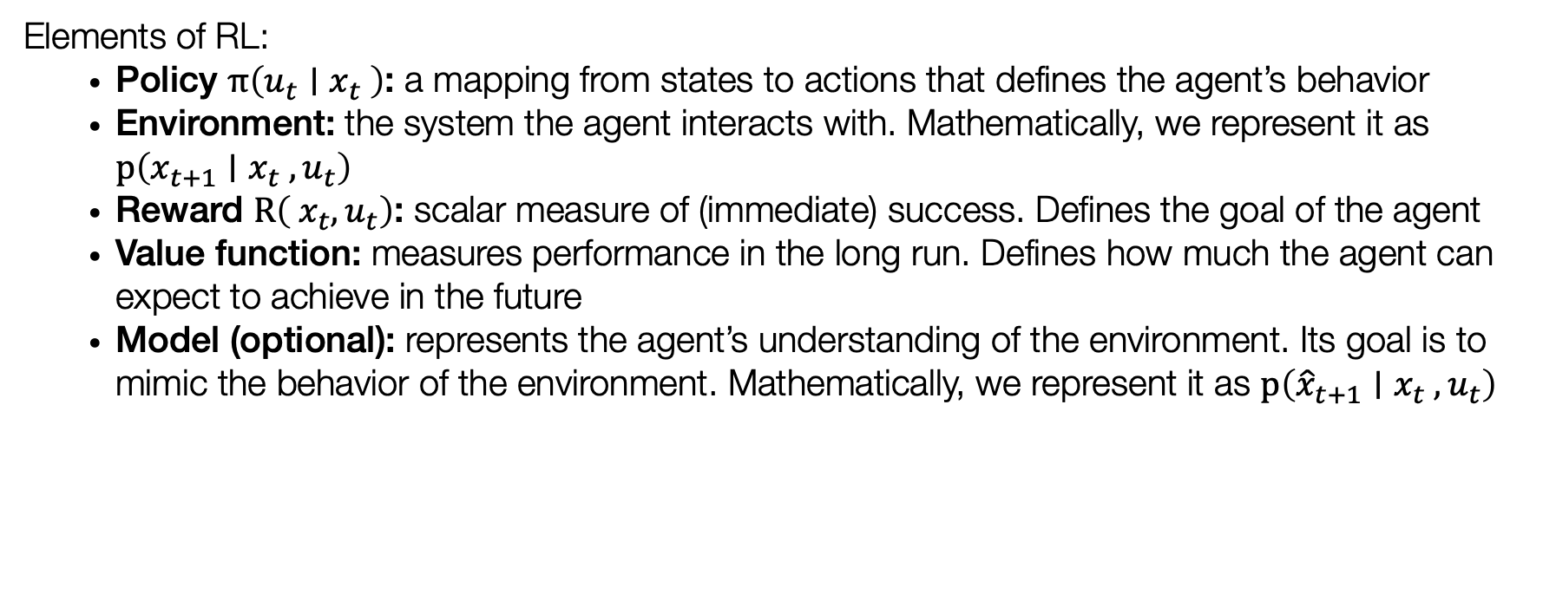
What is reinforcement learning?
take action
$$u_{t}$$
$$x_{t}$$
$$x_{t+1}$$
observe state
$$r_{t}$$
Elements of RL:
  Policy $π\left(u_{t}∣x_{t} \right)$: a mapping from states to actions that defines the agent’s behavior
  Environment: the system the agent interacts with. Mathematically, we represent it as $p\left(x_{t+1}∣x_{t} ,u_{t}\right)$
  Reward $R\left({ x}_{t},u_{t}\right)$: scalar measure of (immediate) success. Defines the goal of the agent
  Value function: measures performance in the long run. Defines how much the agent can expect to achieve in the future
  Model (optional): represents the agent’s understanding of the environment. Its goal is to mimic the behavior of the environment. Mathematically, we represent it as $p\left({\hat{x}}_{t+1}∣x_{t} ,u_{t}\right)$

Slide 20
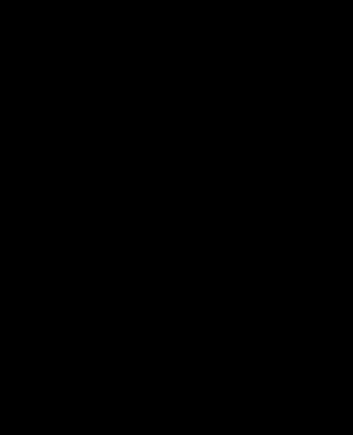
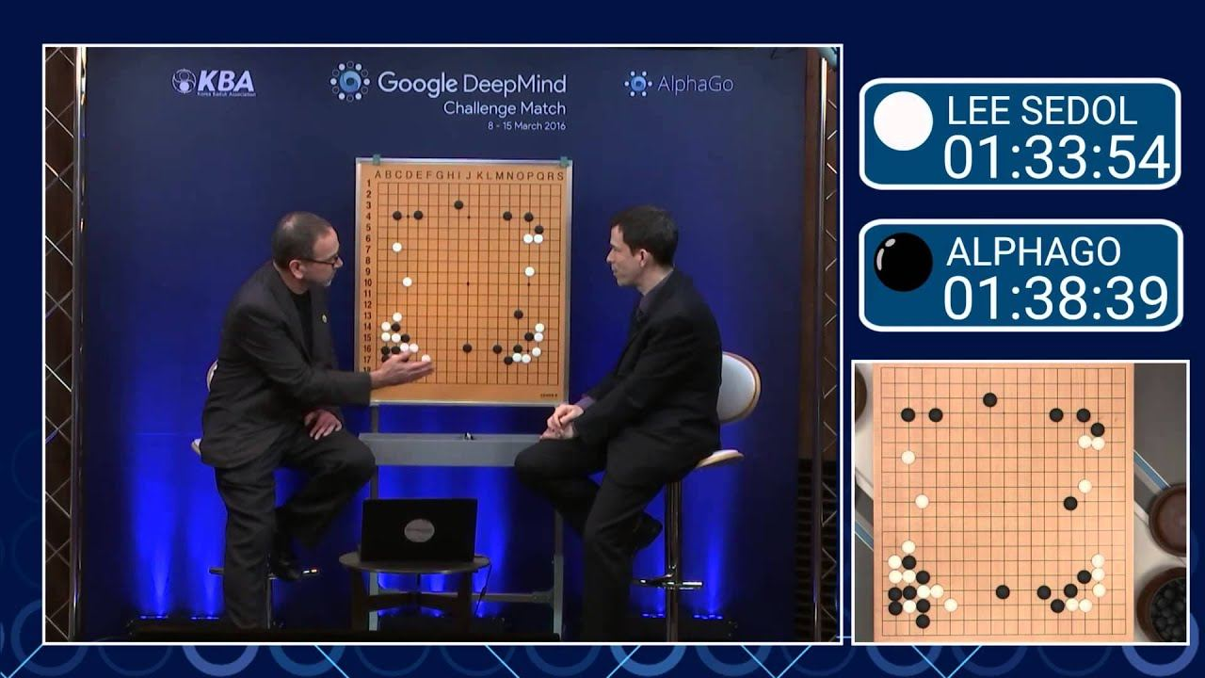
Why reinforcement learning?
RL can discover new, unexpected solutions
“Move 37” in Lee Sedol AlphaGo match

Slide 21
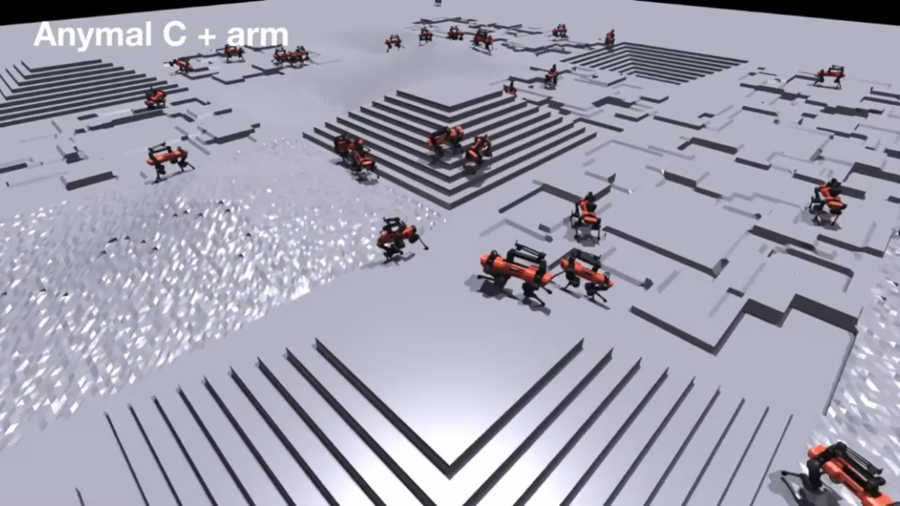
Why reinforcement learning?
RL algorithms are very effective at optimizing complex objectives, with virtually no assumptions on the reward structure
  This makes RL appealing for complex physical tasks

Slide 22
Characteristics of reinforcement learning?
How does RL differ from other machine learning paradigms?
No supervision, only a reward signal
Feedback can be delayed, not instantaneous (i.e., credit assignment)
Data is not i.i.d., earlier decisions affect later interactions (tension between exploration and exploitation)

Slide 23
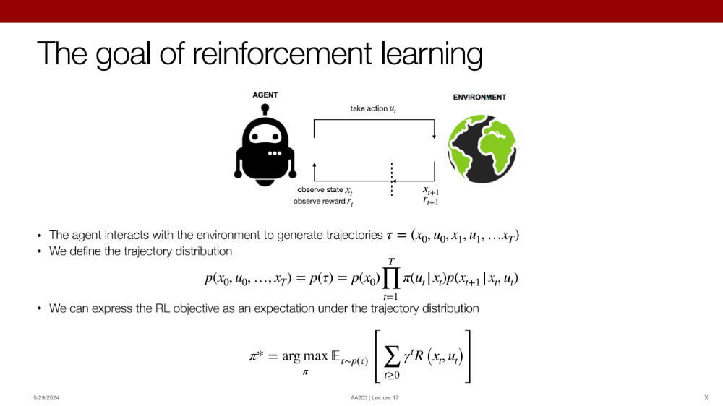





Markov Decision Process
State:
$$x∈𝒳$$
Action:
$$u∈𝒰$$
Typically represented as a tuple
Transition function / Dynamics: $T\left(x_{t}∣x_{t−1},u_{t−1}\right)=p\left(x_{t}∣x_{t−1},u_{t−1}\right)$
$$ℳ=(𝒳,𝒰,T,R,γ)$$
Reward function:
$$r_{t}=R(x_{t},u_{t}):𝒳×𝒰→ℝ$$
Discount factor:
$$γ∈(0,1)$$

Slide 24








Some examples
Chess
State:
$$x∈𝒳$$
position of pieces
Action:
$$u∈𝒰$$
next move
Dynamics
$$p\left(x_{t}∣x_{t−1},u_{t−1}\right)$$
given a move, defines the next configuration of the board (deterministic)
Reward function:
$$r_{t}=R(x_{t},u_{t})$$
-1/+1 for lost/won game
Quadruped
State:
$$x∈𝒳$$
robot’s pose (e.g., foot positions, joint angles) and its position on the terrain
Action:
$$u∈𝒰$$
joint torque commands for each leg
Dynamics
$$p\left(x_{t}∣x_{t−1},u_{t−1}\right)$$
the robot applies the chosen torque commands to its joints, deterministically resulting in the next pose and position based on the physics of the terrain
Reward function:
$$r_{t}=R(x_{t},u_{t})$$
+10 forward step / -5 falling / 0 standing still

Slide 25
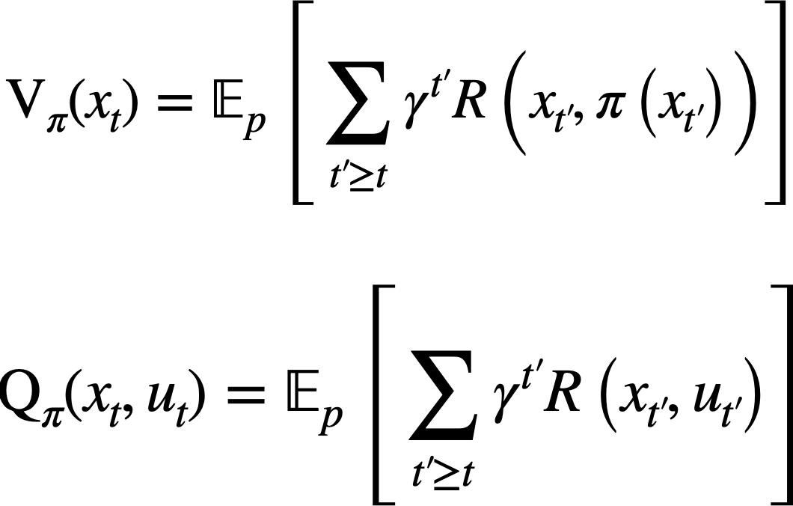
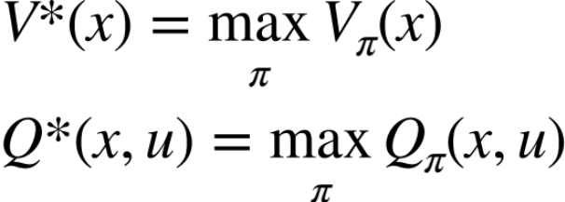
Value functions
State-value function: “the expected total reward if we start in that state and act accordingly to a particular policy”
Action-state value function: “the expected total reward if we start in that state, take an action, and act accordingly to a particular policy”
Optimal state-value function:
Optimal action-state value function:
The majority of RL algorithms are defined via manipulations of these concepts

Slide 26

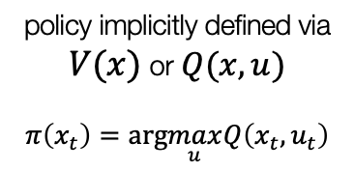


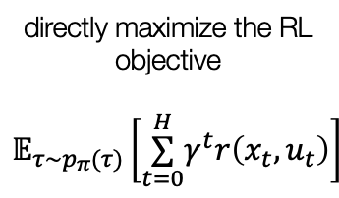

A taxonomy of RL
RL Algorithms
do not use dynamics $T(x_{t+1}|x_{t},u_{t})$
Model-free
Model-based
use dynamics $T(x_{t+1}|x_{t},u_{t})$
Policy optimization
Value-based
Learn the model
Given the model
directly maximize the RL objective
$$𝔼_{τ∼p_{π}(τ)}\left[\overset{H}{\underset{t=0}{∑}}γ^{t}r\left(x_{t},u_{t}\right)\right]$$
policy implicitly defined via
$V(x)$ or $Q(x,u)$
$$π\left(x_{t}\right)=arg\max_{u}Q\left(x_{t},u_{t}\right)$$
Estimate $f_{θ}≈T(x_{t+1}|x_{t},u_{t})$
$T(x_{t+1}|x_{t},u_{t})$ is known

Slide 27
Why so many RL algorithms?
Adapted from CS 185/285
Different tradeoffs:
  Sample efficiency
  Stability & easy of use
Different assumptions:
  Stochastic or deterministic
  Continuous or discrete
  Episodic or infinite horizon
Different things are easy or hard in different settings:
  Easier to represent the policy?
  Easier to represent the model?

Slide 28
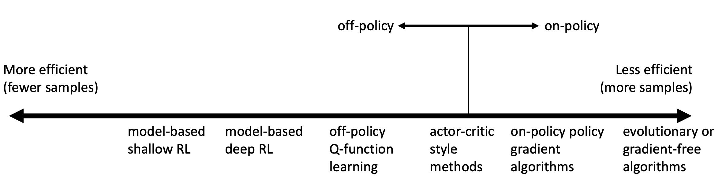
Comparison: sample efficiency
Adapted from CS 185/285
Sample efficiency = how many samples do we need to get a good policy?
Crucial question: is the algorithm off policy?
  Off policy: able to improve the policy without generating new samples from the current policy
  On policy: each time the policy is changed, even a little bit, we need to generate new samples
Why even bother using less efficient algorithms? Wall-clock time is not the same as efficiency!

Slide 29
Comparison: stability and ease of use
Adapted from CS 185/285
Does it converge?
And if it does, to what?
Does it always converge?
Supervised learning: almost always gradient descent
Reinforcement learning: often not gradient descent
  Q-learning: fixed point iteration
  Model-based RL: model estimator is not optimized for expected reward

Slide 30
Some remarks
So far, it may be tempting to view IL and RL as “alternatives”
Today, IL and RL are widely used in scaffolded training pipelines, where both are essential for achieving the desired behavior, robustness, and overall performance.
Imitation Learning:
Pros: Simplicity, Efficiency, No need for explicit reward signal
Cons: Dependence on demonstration quality, generalization, no exploration
Reinforcement Learning:
Pros: Autonomous discovery, long-term optimization in complex tasks, no labels
Cons: Training instability, sample inefficiency, reward function design
[NVIDIA. Alpamayo-R1]

Slide 31
Next class
Imitation Learning (IL)

