Slide 1
AA203
Optimal and Learning-based Control
Imitation Learning

Slide 2
Course overview
Imitation Learning
Model-free RL
Control
Adaptive
optimal control
Model-based RL
Feedback control
Adaptive control
Optimal and learning control
Open-loop
MPC
Closed-loop
Indirect methods
Direct
methods
DP
HJB / HJI

Slide 3
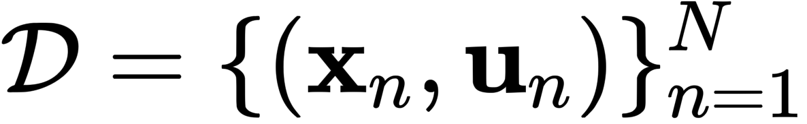
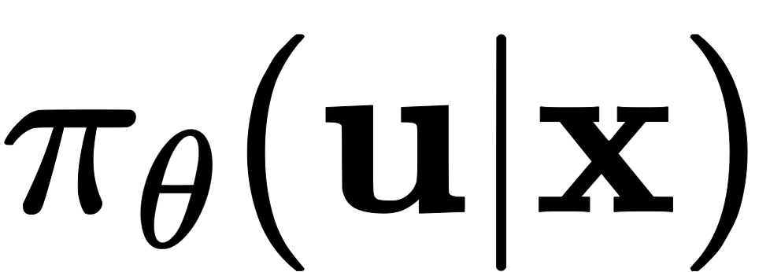
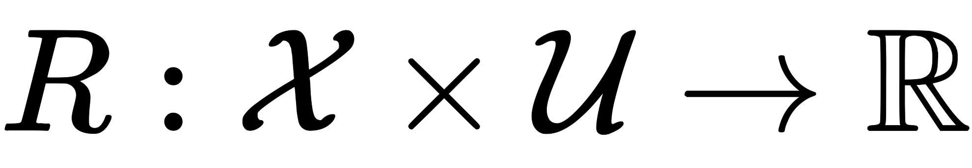
The basics of Imitation Learning
Assume access to a dataset of state-control pairs collected by an expert
At a high-level, approaches to IL belong to two main categories:
  Behavior Cloning “learn the policy used by expert”
  Inverse Reinforcement Learning “learn the objective optimized by the expert”
  (a.k.a. Inverse Optimal Control)
Behavior Cloning Inverse Reinforcement Learning

Slide 4
Outline
Imitation Learning:
  Behavior Cloning (BC)
    Common pitfalls
    Design strategies for effective IL
    Other paradigms (RvS)
  Inverse Reinforcement Learning (IRL)

Slide 5
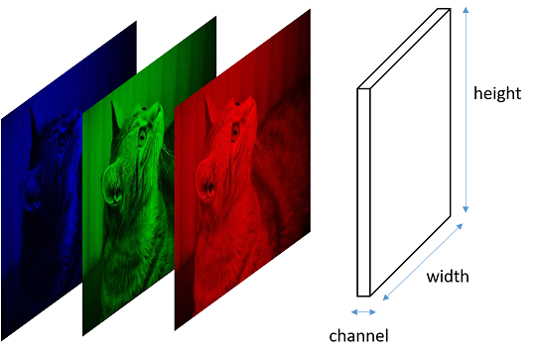
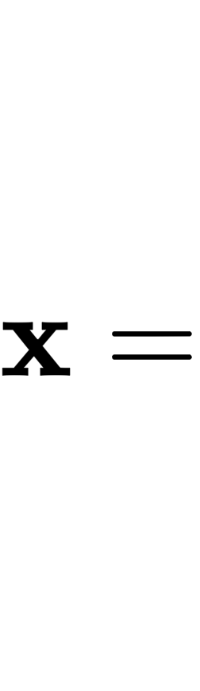
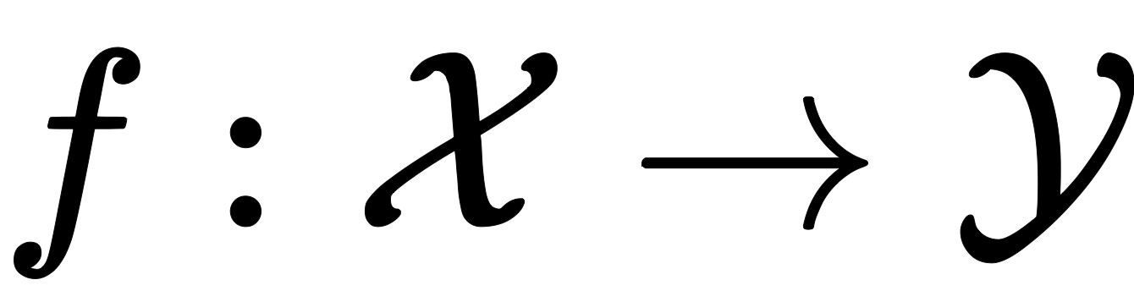
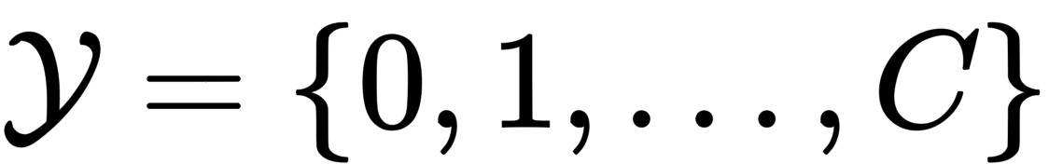
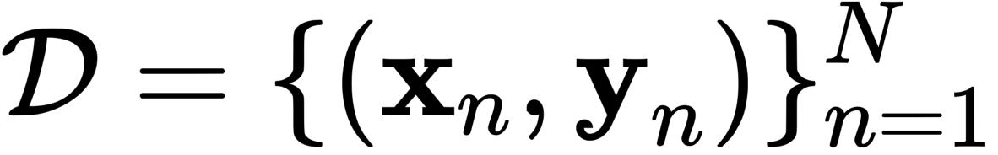
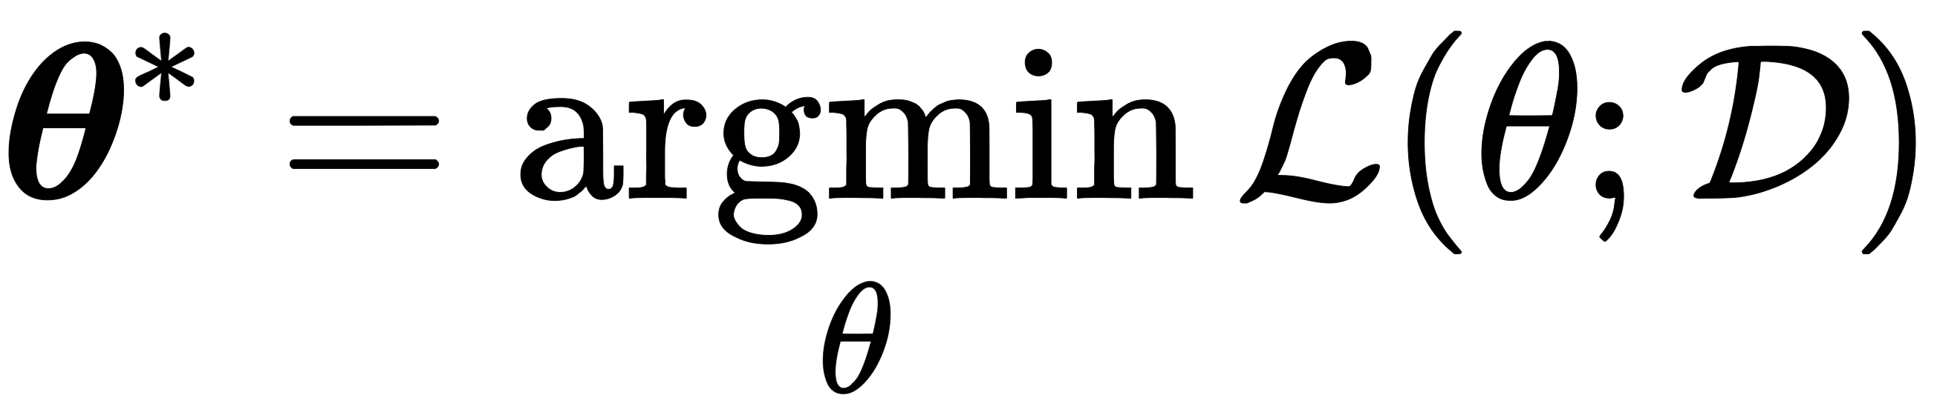
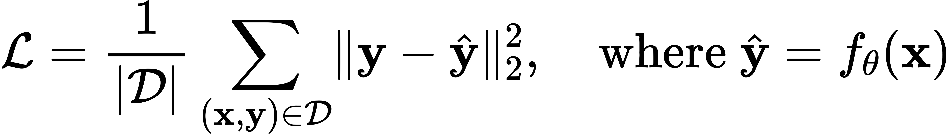

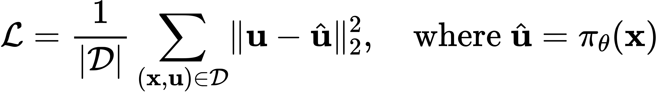
Recap: BC as “supervised learning of behavior”
SL: learn a (parametric) mapping from inputs x to outputs y by minimizing a measure of prediction error
e.g., mean squared error (MSE)
Is this it?
Today:
What could go wrong?
Strategies to address these challenges
Skeleton of a BC algorithm:
  Collect a dataset of “expert” demonstrations
  Train policy to mimic expert:
  Deploy

Slide 6
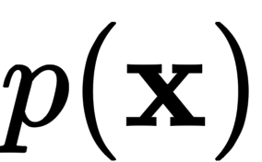
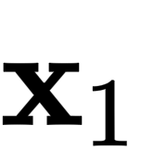
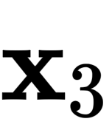
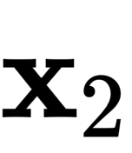
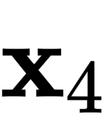
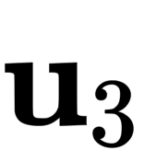
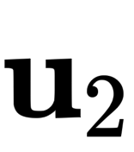
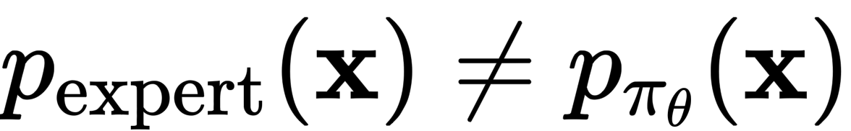
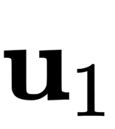
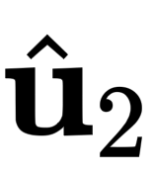
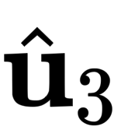
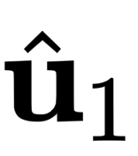
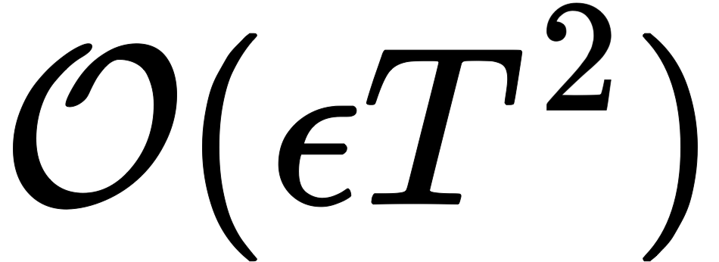
Common Pitfalls: 1) Compounding Errors
In statistical learning theory, data is assumed to be independent and identically distributed (i.i.d)
When learning behavior policies however:
Predicted controls influence future states
Even small errors can lead to drift away from the data distribution
Errors compound
This leads to the state distributions under the expert and the learner to diverge
Probability of making mistakes grows quadratically with the length of the trajectory
“covariate shift”
[Ross & Bagnell ’10]

Slide 7


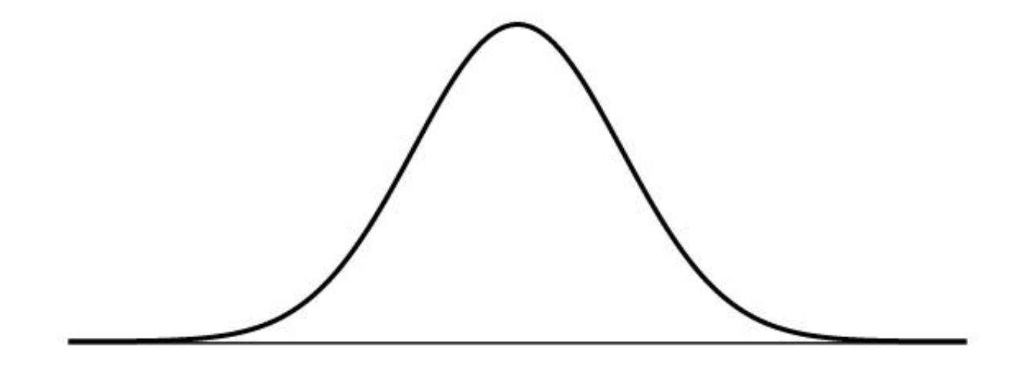
Common Pitfalls: 2) Multimodal behavior
In many tasks, there exist multiple (equivalent) solutions
In IL, this becomes relevant the moment the dataset is characterized by multimodal demonstrations
e.g., fitting multimodal behavior using MSE
This is extremely common in practice, e.g., data collected by multiple experts
Data distribution
Mean of the data

Slide 8

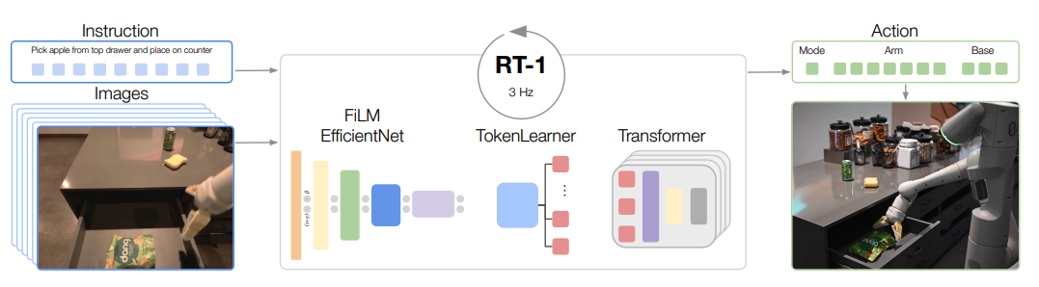

A useful mental model
We can address these challenges in a few different ways:
Targeted algorithms
Smart data collection (and augmentation)
Use expressive models (e.g., that are able to capture the multi-modality of behavior data)

Slide 9
A useful mental model
We can address these challenges in a few different ways:
Targeted algorithms
Smart data collection (and augmentation)
Use expressive models (e.g., that are able to capture the multi-modality of behavior data)
Notes:
\begin{alignat*}{3}
\min_{\uc} & & \quad &h(\x(t_f), t_f) + \int_{t_0}^{t_f}g(\x(t), \uc(t), t)\, dt \\
\text{subject to}& & \quad & \dot\x(t) = \ad(\x(t), \uc(t), t)\\
& &\quad & \x(t) \in \mathcal X, \quad \uc(t) \in \mathcal U
\end{alignat*}
\documentclass[10pt]{article}
\usepackage[usenames]{color} %used for font color
\usepackage{amssymb} %maths
\usepackage{amsmath} %maths
\usepackage[utf8]{inputenc} %useful to type directly diacritic characters
\newcommand{\uc}{\mathbf{u}}
\newcommand{\x}{\mathbf{x}}
\newcommand{\ad}{\mathbf{a}}

Slide 10
The value of corrective data
A lot of the methods that make naïve BC work try to leverage the fact that, during deployment, we can recover from mistakes
  Modify the learning problem to allow BC to learn how to correct from mistakes
Paradox:
  Learning from a broader set of trajectories that make some mistakes (and recoveries) is likely to work better than learning from a narrow set of perfect demonstration data

Slide 11
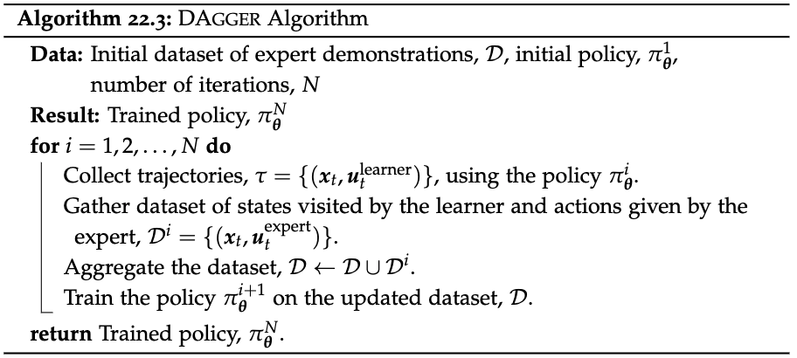
Learning from interventions: DAgger
DAgger is a well-known method for addressing the covariate shift problem through data aggregation techniques
DAgger seeks to reduce the covariate shift by explicitly gathering expert demonstrations under the state distribution induced by the learner.
“covariate shift”
At its core, DAgger defines an iterative procedure:

Slide 12
Learning from interventions: DAgger
Essentially, DAgger operates as a form of
iterative supervised learning:
Reduces the amount of expert data required (i.e., the alternative would be collecting an extremely broad dataset of demonstrations)
+ data-efficient way of querying the expert
- querying the expert can be expensive
Many algorithms have been developed that follow a similar scheme:
Confidence-based methods: “query the expert when the agent is uncertain about its decisions”
Human-gated DAgger: “query the expert when the policy makes a mistake”

Slide 13
A useful mental model
We can address these challenges in a few different ways:
Targeted algorithms
Smart data collection (and augmentation)
Use expressive models (e.g., that are able to capture the multi-modality of behavior data)

Slide 14
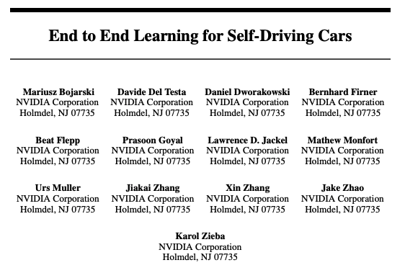
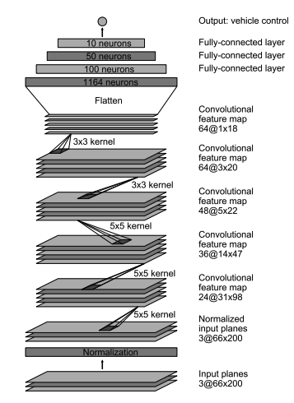
Case Study 1

Slide 15
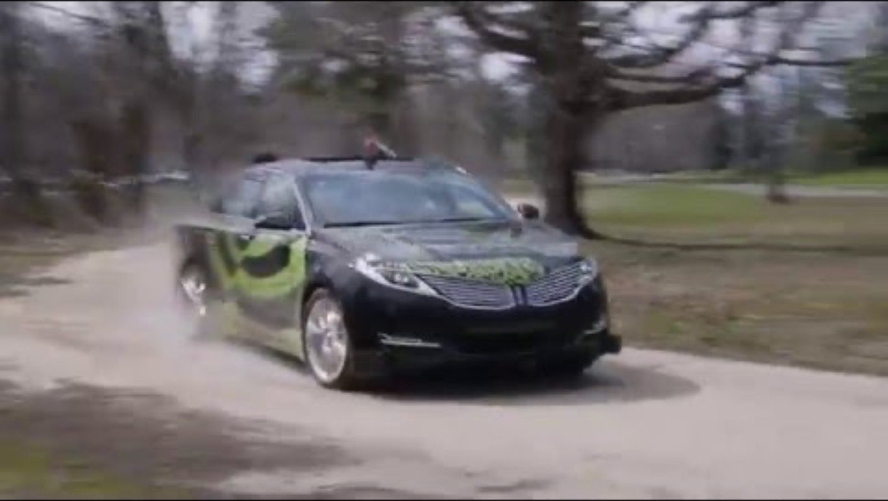
Case Study 1
Bojarski et al. ‘16, NVIDIA

Slide 16
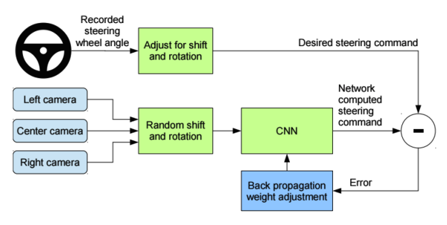
An important detail

Slide 17
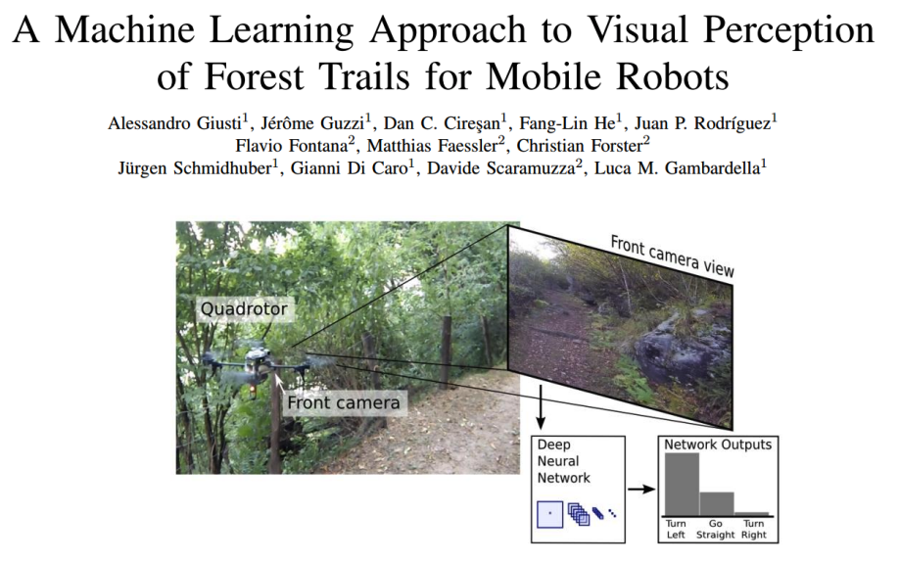
Case Study 2

Slide 18
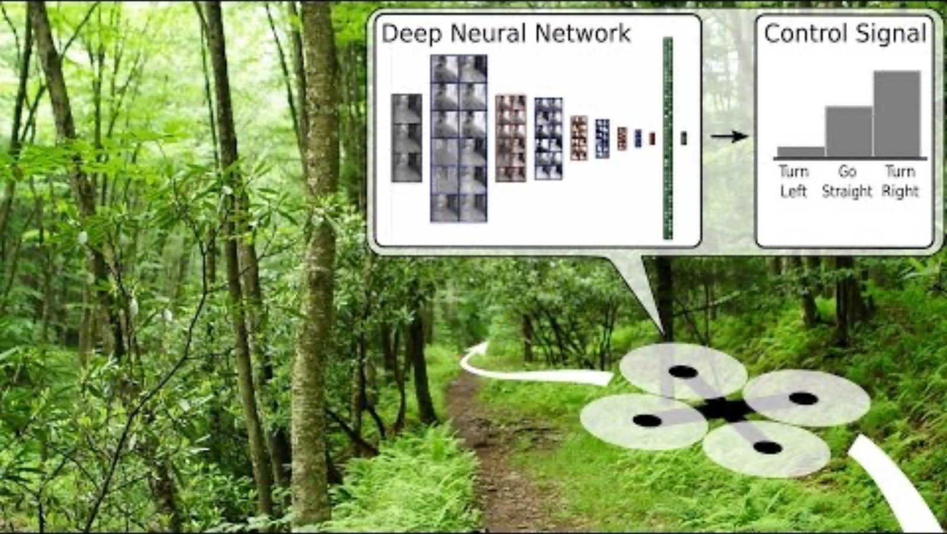
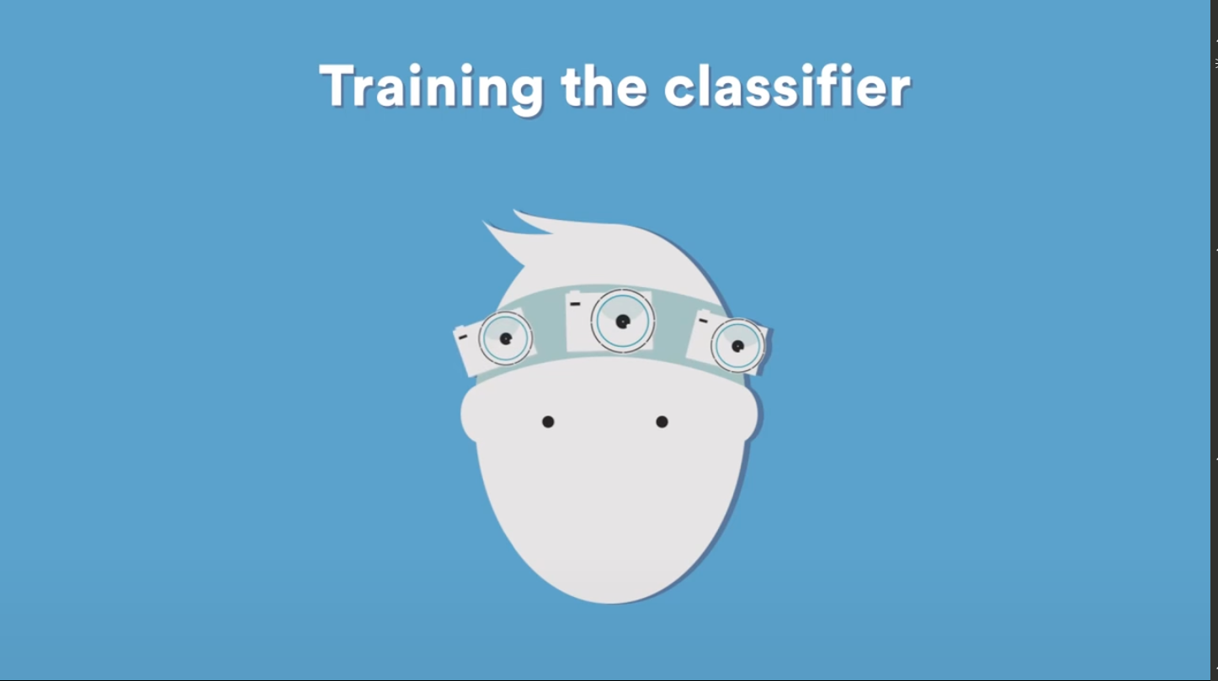
Case Study 2

Slide 19

Key idea: Being intentional with data collection
Intentionally add mistakes and corrections to your data:
Augment your collection pipeline with “fake” demonstrations of corrections (e.g., side cameras)
Use algorithms that automate the collection of correction data where it matters more (e.g., DAgger)

Slide 20
A useful mental model
We can address these challenges in a few different ways:
Targeted algorithms
Smart data collection (and augmentation)
Use expressive models (e.g., that are able to capture the multi-modality of behavior data)

Slide 21
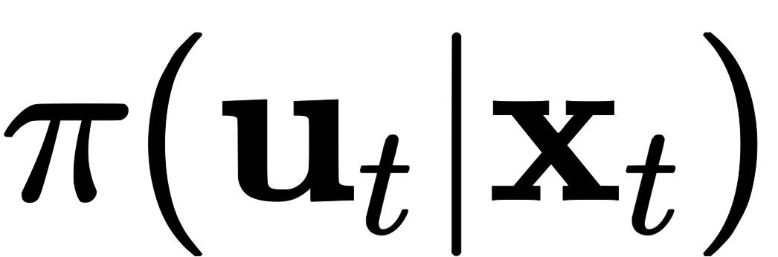
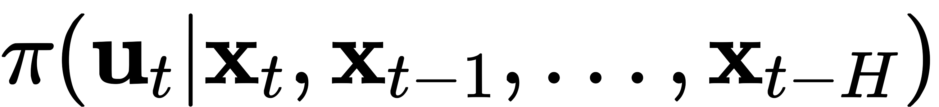
Improving the expert’s predictions
At a high level, two main classes of methods:
Include history of observations
Expressive function class
E.g., mixture of Gaussians, conditional VAEs, diffusion models, etc.

Slide 22
Non-Markovian behavior
Often, the behavior observed in demonstration data does not depend only on the current observation
Idea: represent the policy via any sequence model (e.g., Transformers, LSTM/GRU cells, etc.)
Sequence model

Slide 23
Capturing the data distribution
Data distribution
Mean of the data
Minimizing average prediction error is inherently limited in presence of more complex data distributions
Goal: represent the entire distribution (as opposed to e.g., only the mean)

Slide 24
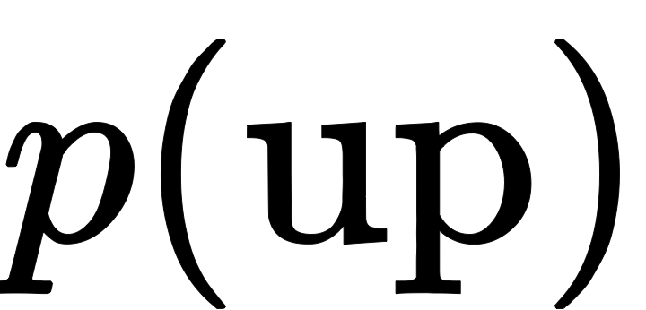
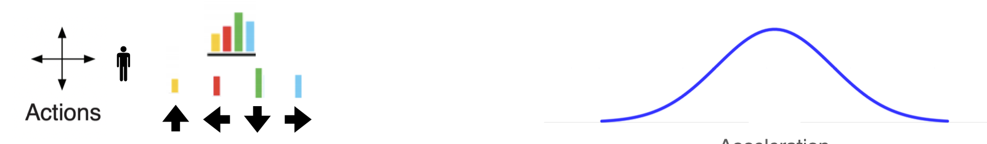
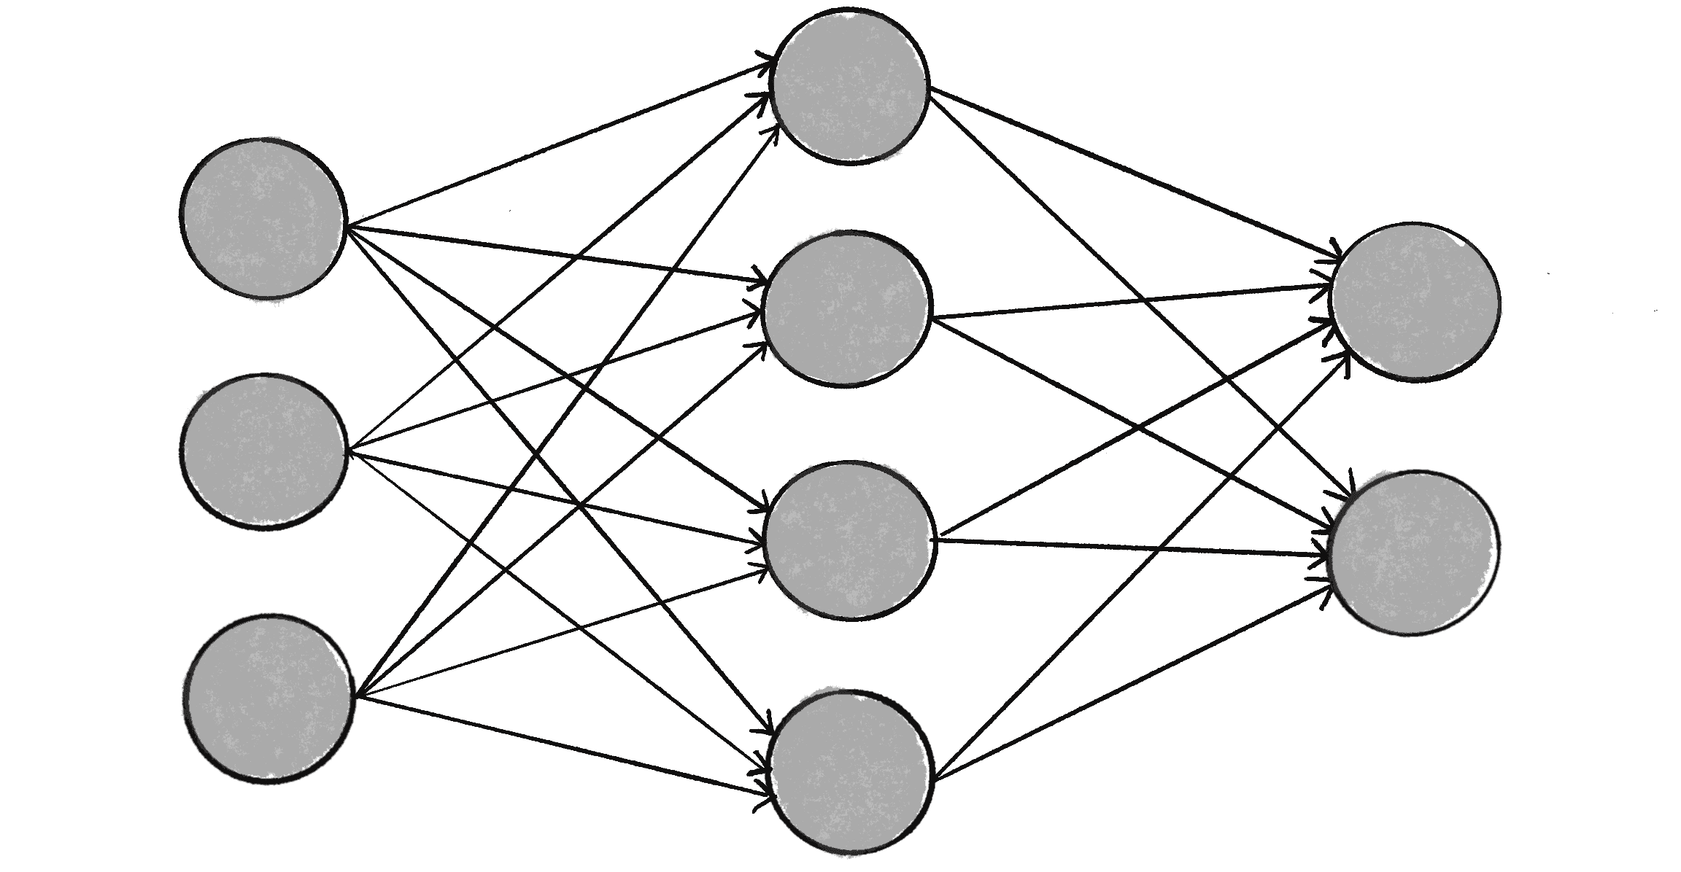

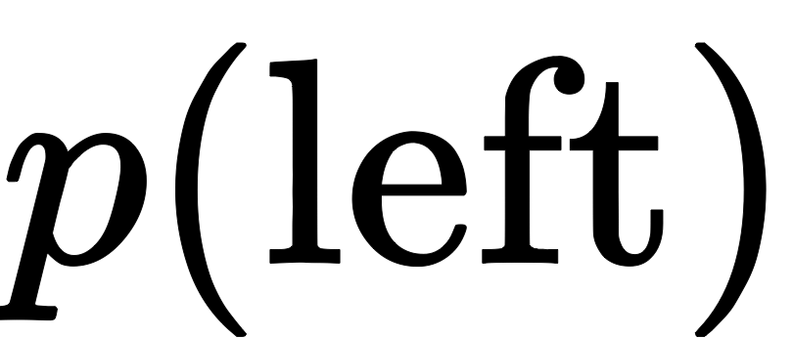
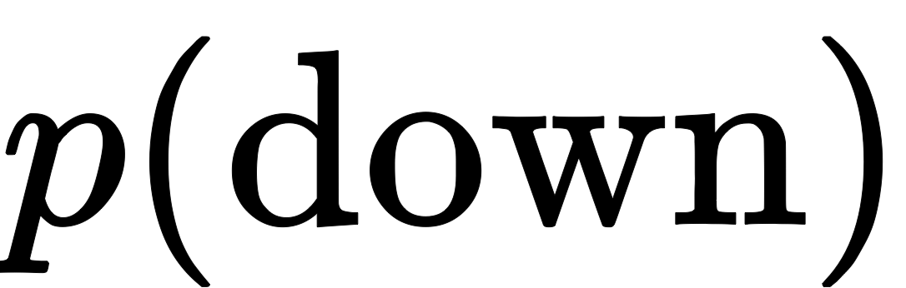

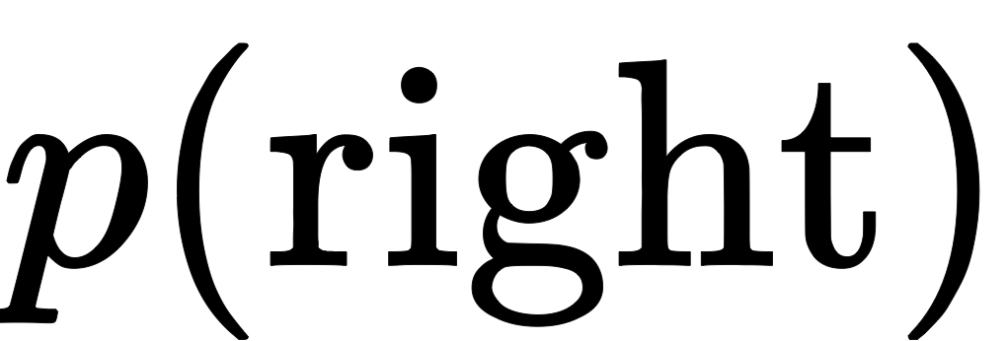
Parametrizing distributions
Use a parametric function (e.g., a neural network) to output the parameters of a distribution
1D discrete distribution
Continuous distribution
steering angle
+ handles multimodality
- scaling to high-dim action spaces
+ captures the continuous nature of actions
- not very expressive (e.g., unimodal)

Slide 25
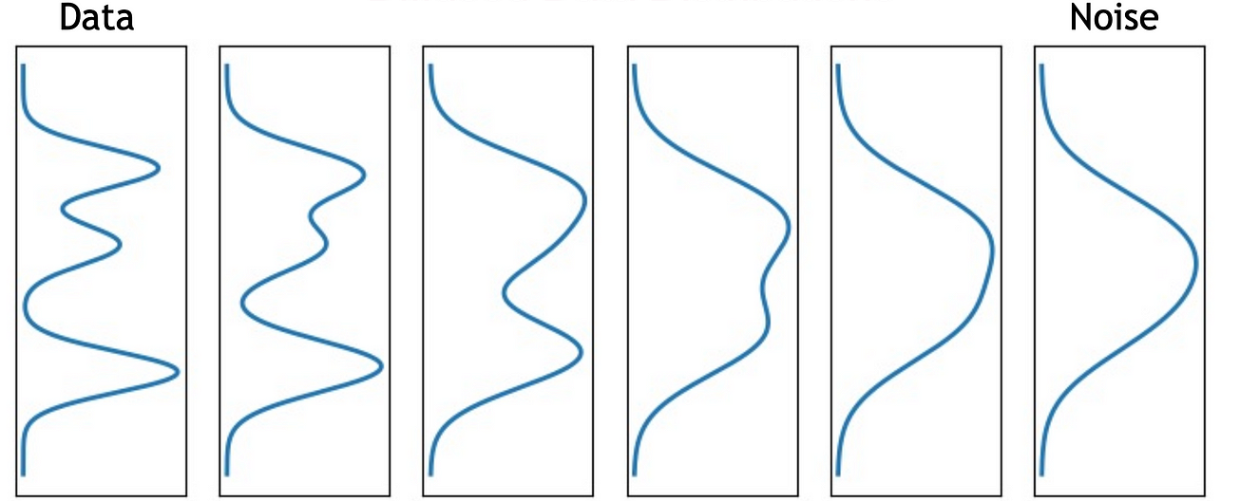
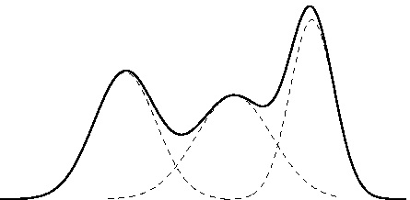
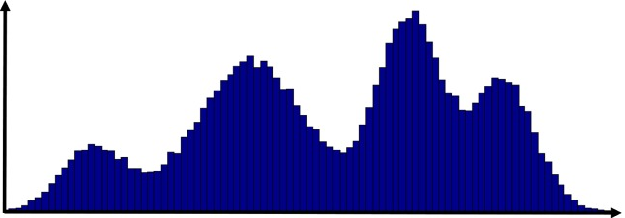
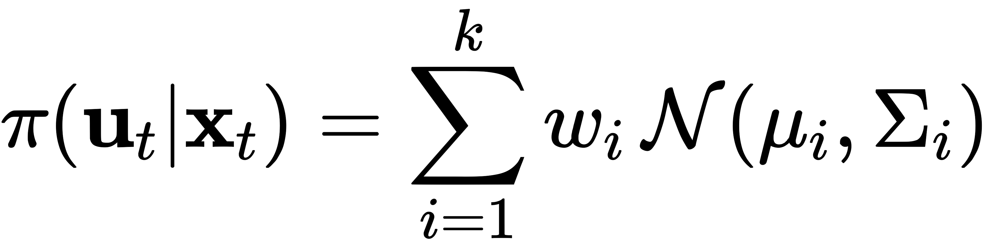
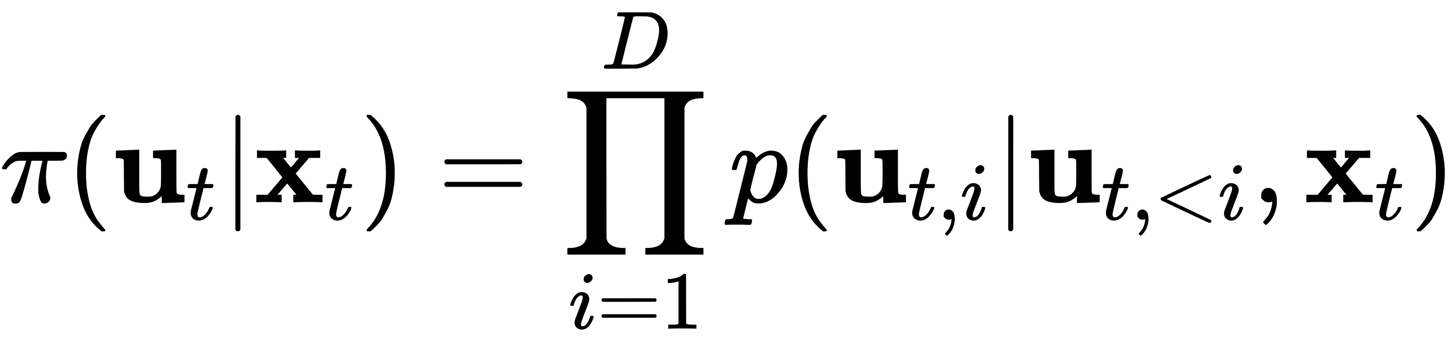
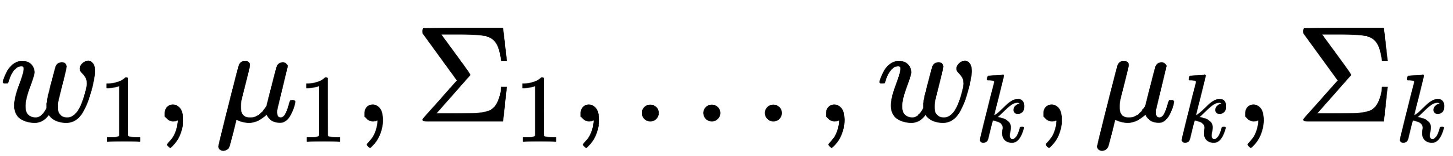
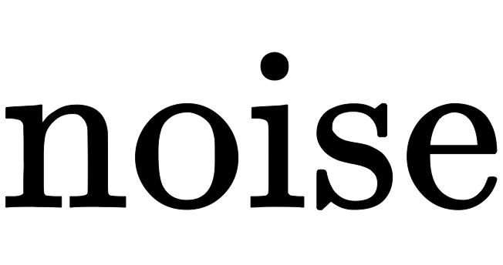
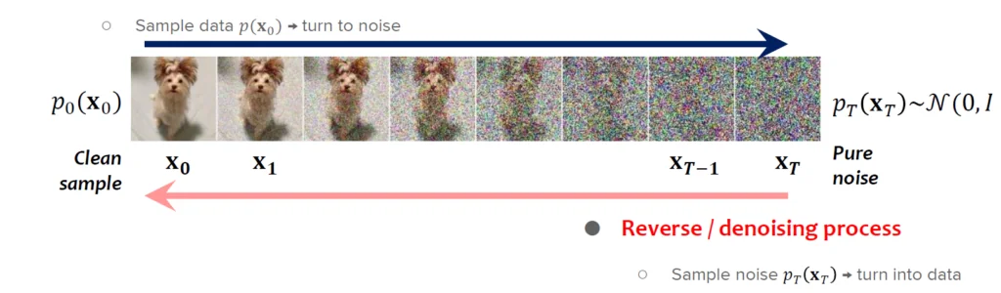

Expressive policy architectures
Gaussian Mixture Model
Discretize + Autoregressive
Flow Matching & Diffusion

Slide 26










Flow Matching
Main idea: learn a vector field for iterative denoising
Sampling (inference):
Sample
Integrate the vector field to get:
(e.g., Euler integration)
Training:
Sample
Sample
Sample , e.g.,
Linearly interpolate
Update to minimize
Source: https://jmtomczak.github.io/blog/18/18_fm.html

Slide 27






Action chunking
A simple trick that works quite well in practice
Controls executed in the environment
(Standard) Feedback policy discussed so far:
Observe state
Sample action
Execute in the environment
Observe and repeat
Decisions
With action chunking:
Observe state
Sample
Execute in the environment
Observe and repeat
In practice:
Allows more time for inference
Generally, “smoother” control trajectories

Slide 28






Diffusion Policy

Slide 29


Robotics Transformer

Slide 30
A useful mental model
We can address these challenges in a few different ways:
Targeted algorithms
Smart data collection (and augmentation)
Use expressive models (e.g., that are able to capture the multi-modality of behavior data)

Slide 31
Pros and Cons
Until now, we discussed IL (namely, Behavior Cloning) as the problem of learning to “mimic” the behavior of an expert from demonstrations
Pros:
Simplicity: essentially, SL; easy to implement and monitor
Efficiency: no need for trial-and-error learning (as in RL)
No need for an explicit reward signal: bypasses the task of designing a reward function; only demonstrations are needed
Cons:
Dependence on demonstration quality: poor demos lead to suboptimal policies
Generalization and compounding errors: struggles with covariate shift
No exploration: does not explore the space of solutions for better policies

Slide 32
Outline
Imitation Learning:
  Behavior Cloning (BC)
    Common pitfalls
    Design strategies for effective IL
    Other paradigms (RvS)
  Inverse Reinforcement Learning (IRL)

Slide 33
Reinforcement Learning via Supervised Learning (RvS)
Recent work has explored the idea of converting the reinforcement learning problem (more in the next lecture) into a conditional, filtered, or weighted imitation learning problem.
Key idea: rather than relying solely on “optimal” demonstrations, leverage a broader set of demonstrations from, e.g., suboptimal policies, related tasks, etc.
Two main classes of methods:
Filtering or Weighting Demonstrations
Goal or Reward Conditioning

Slide 34




Filtering or Weighting Demonstrations
One common approach to RvS is to filter or weight the expert demonstrations based on their quality
Filtering: A simple approach could entail ranking the expert demonstrations based on their return:
Then, we filter the dataset to include only the top-k% of trajectories:
Weighting: A different approach might involve weighting each individual transition of a trajectory based on its reward, rather than filtering entire trajectories.

Slide 35




Goal or Reward Conditioning
Conditioning on outcomes is particularly useful in settings where the expert demonstrations are suboptimal or collected from a different task.
Each trajectory might be described using different outcomes, such as the final state of the trajectory, the total reward obtained, or a specific state that was visited during the trajectory.
Goal-conditioning:
Reward-conditioning:
Pros:
Easily derivable from demonstration data
Allows to extract useful behavior from suboptimal data
Improved generalization; decouples the process of achieving desired outcomes from the reward structure

Slide 36
Outline
Imitation Learning:
  Behavior Cloning (BC)
    Common pitfalls
    Design strategies for effective IL
    Other paradigms (RvS)
  Inverse Reinforcement Learning (IRL)

Slide 37
Inverse Reinforcement Learning (IRL)
IRL takes an orthogonal approach to IL, by attempting to recover a reward function from a policy, or from demonstrations of a policy
Example: (BC vs IRL)
A warehouse robot must navigate from a starting point to a goal while avoiding obstacles.
Behavior Cloning:
Collect demonstration data, train a policy that imitates the demonstrations
Effective in familiar scenarios, however, it may struggle if the layout changes substantially
Inverse RL:
Collect the same demonstration data, infer the reward function (e.g., positive for moving closer to the goal, negative for moving close to obstacles)
The reward function encapsulates the underlying principles of the task

Slide 38


Inverse Reinforcement Learning (IRL)
Formally, the goal of IRL is to recover a reward function from a dataset of demonstrations
In practice, the reward is parametrized by some parameters . Therefore, the goal is to find the value of that better explains the expert demonstrations
Most IRL algorithms follow an iterative learning process:
Key challenge: reward ambiguity (i.e., many reward functions explain the same data)
Popular algorithms:
Apprenticeship learning
Maximum Margin Planning
Maximum entropy IRL

Slide 39
Recap
Skeleton of a BC algorithm:
Collect a dataset of “expert” demonstrations
Train policy to mimic expert:
Main Challenges:
Compounding errors
Multimodal behavior
Potential Solutions:
Smart data collection
Targeted algorithms
Use expressive models
Data distribution
Mean of the data
RvS:
Leverage broader set of demonstrations under the same “BC” paradigm
IRL:
Learn the reward function from demonstrations

Slide 40
Next class
Reinforcement Learning
Additional References:
Stanford CS 224R
Berkeley CS285

